Slide 1
Synergy in Academia: Unveiling the Roles and Responsibilities of Faculty and Academic Leadership in University Success
Prof. B. F. Sule, FAEng.
Department of Civil and Environmental Engineering
Kwara State University, Malete, Nigeria
A paper delivered at a one-day interactive capacity training workshop on
Effective Academic Leadership for Deans of Faculties and Heads of Departments in Kwara State University
Organized by Centre for Research and Development

Slide 2
CONTENTS
INTRODUCTION
KEY PLAYERS
THE FACULTY (ACADEMIC STAFF)
RESPONSIBILITIES OF ACADEMIC STAFF
DUTIES OF A HEAD OF DEPARTMENT AS AN ACADEMIC LEADER
DUTIES OF A DEAN AS AN ACADEMIC LEADER
IMPACT OF ACADEMIC LEADERSHIP ON STUDENT LEARNING AND EXPERIENCES
CONCLUSION

Slide 3
INTRODUCTION
The success of a university is not merely measured by its physical infrastructure or enrollment figures but is intrinsically linked to the caliber of its faculty and the effectiveness of its academic leadership.
Today, we are exploring how the faculty and academic leaders, contribute to the success and vibrancy of a university.
This presentation will discuss the diverse roles faculty members play in shaping the academic landscape of a department.
It will further examine the responsibilities shouldered by academic leaders (heads of departments and deans) in governance, policy-making, and strategic planning in the university.
At the end we will understand better the symbiotic relationship between faculty and academic leadership, recognizing the impact they wield on institutional reputation, student experiences, and the broader communities they serve.

Slide 4
INTRODUCTION
Synergy in academia requires researchers, scholars, administrators and educators to work together across disciplines, faculties, colleges, institutions, and even geographical boundaries to advance knowledge, solve complex problems, and contribute to the broader academic community. This can be achieved through engagement in the following activities
Interdisciplinary Research
International Research Collaborations:
Joint Publications and Conferences
Collaborative Teaching and Curriculum Development:
Community Engagement and Outreach
Research Centers and Institutes
Collaborative Grant Applications:
Industry Collaboration
Consequently, the combined efforts of individuals with different perspectives and expertise result in more comprehensive and impactful outcomes than individual efforts alone.

Slide 5
KEY PLAYERS
Achieving success in a university involves the collaborative efforts of various key players who contribute to different aspects of the institution's mission. These key players include:
University Management:
Vice-Chancellor
Deputy Vice-Chancellors
Registrar
Bursar
Librarian
Academic Leadership:
Deans: Lead individual colleges or schools within the university, providing academic direction and oversight.
Department Heads: Manage academic departments, overseeing faculty, programs, and research initiatives.
Faculty:
Professors/Lecturers: Teach courses, conduct research, and contribute to the academic and intellectual life of the university.
Researchers: Engage in research activities, often collaborating with colleagues, students, and external partners.

Slide 6
KEY PLAYERS
4. Administrative Staff: Support various administrative functions, including finance, human resources, and facilities management.
5. Students: Undergraduate and Graduate Students contribute to the academic community, engage in research, and participate in extracurricular activities.
6. Center/Institute Directors: Lead research centers or institutes, promoting collaboration and overseeing specialized research initiatives.
7. Community Engagement and Outreach: Foster relationships between the university and the local community, NGOs, and industry partners.
8. Public Relations and Communications: Manage the university's external communications and public image.
9. International Relations: Facilitate international collaborations, student exchanges, and partnerships with institutions abroad.
10. Technology Transfer and Industry Engagement: Facilitate the transfer of research findings into practical applications, often through collaborations with industry partners.

Slide 7
KEY PLAYERS
11. Development and Fundraising (Advancement Office): Seek external funding, donations, and philanthropic support to enhance the university's financial resources.
12. Student Affairs and Support Services: Provide support services such as counseling, career guidance, and extracurricular activities to enhance the student experience.
13. Quality Assurance and Accreditation (Academic Planning Office): Ensure the university meets accreditation standards and compliance requirements.
14. Legal and Compliance: Provide legal guidance and ensure the university's compliance with laws and regulations.
15. Alumni Relations: Engage with alumni, build networks, and encourage alumni support for the university.
Success in a university is often the result of effective collaboration and communication among these key players. Their collective efforts contribute to academic excellence, research advancements, positive student experiences, and the overall impact of the institution on society.

Slide 8
THE FACULTY (ACADEMIC STAFF)
A faculty in a university typically consists of a diverse group of individuals who are engaged in teaching, research, and various academic and community related activities. The composition of a faculty can vary depending on the structure and organization of the university. A faculty typically comprise of the following:
1. Full Professors: Senior faculty members who have achieved the highest academic rank. They are often recognized experts in their field and contribute significantly to research and teaching.
2. Associate Professors/Readers: Faculty members who have demonstrated excellence in research and teaching, usually on the path to achieving the rank of full professor.
3. Lecturers (senior and others): Faculty members who are in the middle and early stages of their academic careers. They engage in research and teaching as they work towards promotion
4. Instructors (research fellows): Typically involved in teaching but may not have the same level of research. They may be specialists in certain topics.
5. Researchers: Faculty members with a primary focus on research. They often lead research projects, secure grants, and publish extensively – research professors
6. Department Chairs: Unit lead whose primary duty is to pursue research excellence in a particular field mostly sponsored projects.

Slide 9
THE FACULTY
7. Department Heads: Faculty members who take on administrative roles, overseeing the operations of academic departments. They provide leadership and ensure the effective functioning of the department.
8. Adjunct and Visiting Lecturers: Individuals who teach part-time and often bring real-world experience to the classroom. They may not be full-time faculty members.
9. Adjunct Professors: Individuals who teach part-time and often bring real-world experience to the classroom. They may not be full-time faculty members.
10. Visiting Professors: Faculty members from other institutions who temporarily join a university for a specific period, often to contribute their expertise or engage in collaborative research.
11. Postdoctoral Researchers: Individuals who have completed their doctoral studies and are engaged in advanced research under the mentorship of senior faculty.
12. Teaching Assistants: Graduate students who assist in teaching undergraduate courses, grading assignments, and providing additional support.
13. Graduate Assistants: Graduate students involved in various academic or research tasks, including assisting faculty with their research projects.

Slide 10
RESPONSIBILITIES OF ACADEMIC STAFF (FACULTY)
Primary duties of faculty include
effective classroom teaching,
academic advising and counseling of students,
participation in departmental committee work,
continuous development of the curriculum
research and scholarly activity,
service such as assisting in community development
initiatives designed to help students succeed academically,
taking on other assigned duties.
Participating in University governance by participating in committee work, meetings,
Faculty serving on University committees, either through election or appointment with consent, should not interfere with duties related to regularly-scheduled classes and other work assignments related to primary work responsibilities.

Slide 11
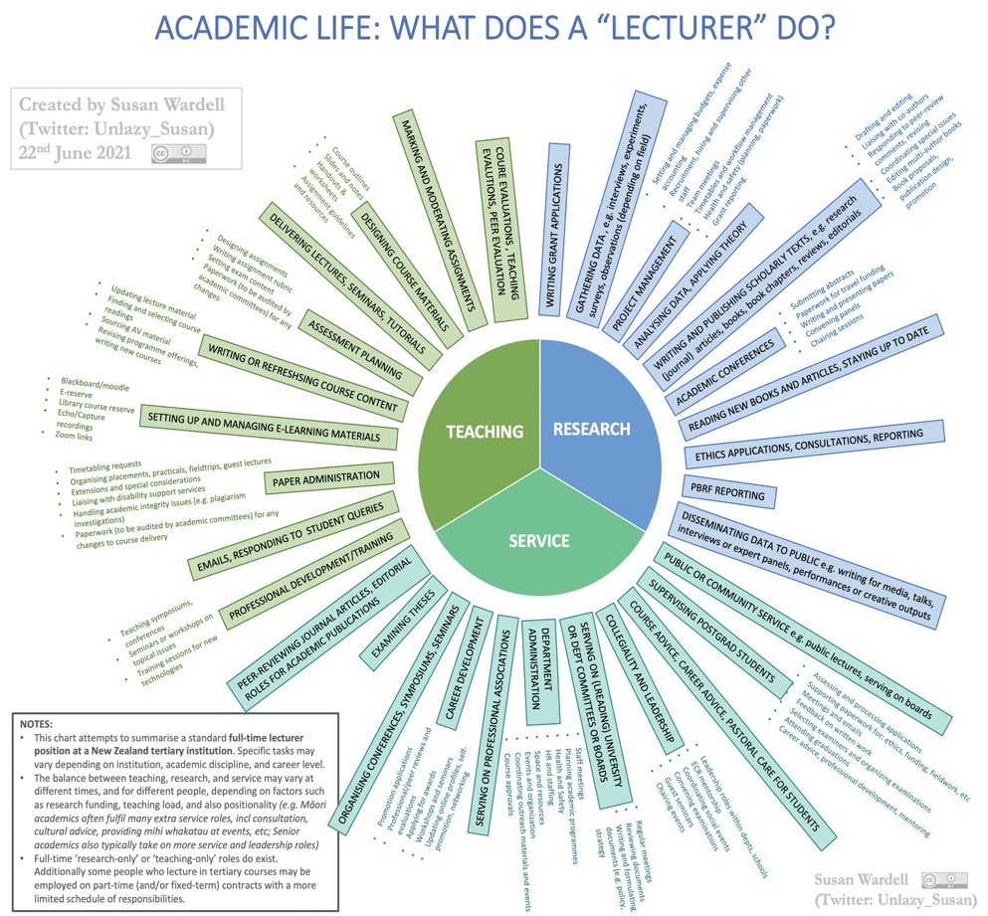

Slide 12
RESPONSIBILITIES OF FACULTY (ACADEMIC STAFF)
These duties and responsibilities are summarized in the Figure above titled “what does a lecturer do”.
The figure breaks it into three duties:
teaching,
research and
service.
Teaching has nine (9) components; research has ten (10) components while service has eleven (11) components.

Slide 13
DUTIES OF A HEAD OF DEPARTMENT AS AN ACADEMIC LEADER
Who is a head of department?
A Head of Department (HOD), is a faculty member who assumes a leadership role within an academic department at a university and responsible for overseeing and managing the activities of the department, working closely with faculty members, staff, and administrators.

Slide 14
Responsibilities of the head of department (University of Ilorin)
The head of department shall be responsible through the Dean and Provost (where applicable) to the Vice-Chancellor for the smooth running of his department.
He shall make arrangements for the teaching and assessment of all courses as well as for research programmes in the department
He shall make budgetary and other proposals to the Dean, and operate the budget approved for the Department
He shall process papers from the Department, through the Dean and Provost (where applicable) for the A&PC
He shall represent the department at interviews for the appointment of staff of his Department and also accompany the Dean to meetings as may be required
He shall submit annual report on the activities of the department to the academic planning not later than 31st July of every year.

Slide 15
Other Responsibilities of the head of department
7. Student Advising and Support:
Overseeing student advising and support services within the department.
Addressing student concerns and contributing to a positive learning environment.
8. Collaboration with Other Departments:
Collaborating with other department chairs and academic leaders to foster interdisciplinary initiatives.
Participating in university-wide committees and projects.
9. Conflict Resolution:
Addressing conflicts or issues within the department, including those involving faculty, staff, or students.
Mediating disputes and promoting a collegial atmosphere.
10. Curriculum Development:
Collaborating with faculty to develop and revise academic programs and curriculum.
11.. Accreditation and Quality Assurance:
Ensuring that the department meets accreditation standards and complies with academic regulations.
Participating in accreditation processes and reviews.

Slide 16
DUTIES OF A DEAN AS AN ACADEMIC LEADER
Who is a Dean of Faculty?
He/she is the academic leader of a faculty or school within a university. He serves as a liaison between faculty, students, and the university administration, contributing to the overall excellence and reputation of the institution.

Slide 17
Responsibilities of the dean (University of Ilorin)
The dean shall be chairman at all meetings of the Facuity Board when he is present and shall be a member of all Committees and other Boards appointed by the Faculty
In the absence of the Dean, the immediate past Dean, if present, shall normally preside. Otherwise, the Board shall elect the Chairman from among the most senior members of (academic) staff present.
The Dean of a Faculty, where appropriate, shall exercise general superintendence over the academic and administrative affairs of the faculty.
It shall be the function of the Dean to present to convocation for the conferment of degrees, persons who have qualified for degrees of the university at examinations held in the branches of learning for which responsibility is allocated to the faculty.
He shall submit annual report of the faculty to the academic planning not later than 31st July of every year.

Slide 18
Other Responsibilities of the Dean
6. Academic Program Oversight:
Oversee the design, development, and evaluation of academic programs within the faculty.
Ensure that programs meet accreditation standards and remain current in response to industry needs and advancements in the field.
7. Faculty Recruitment and Development:
Participate in the recruitment of faculty members.
Support faculty development, mentorship, and advancement in research, teaching, and service.
7. Budget Management:
Manage the budget, allocating resources for operational needs.
Ensure responsible financial stewardship and alignment of resources with strategic priorities.
8. Research Support:
Foster a culture of research excellence within the faculty.
Support faculty in securing research funding, publishing research, and engaging in collaborative research initiatives.
9. Student Admission and Retention:
Collaborate with admissions office and the management to attract and admit students.
Develop and implement strategies to enhance student success and overall satisfaction.

Slide 19
OTHER DUTIES OF THE DEAN
10. Curriculum Development and Assessment:
Work with faculty to develop, assess, and enhance academic curricula.
Ensure that assessment processes are in place to evaluate program effectiveness and student learning outcomes.
11. Community Engagement and Partnerships:
Foster collaborations with local communities, industry partners, and external organizations.
Promote contributions to the community and through impactful projects and programmes addressing various challenges in the community
12. Governance and Policy Development:
Participate in university-wide governance structures and decision-making processes.
Develop and implement college-specific policies in alignment with university policies.
13. Student Affairs and Support Services:
Oversee student academic advising, counseling, and extracurricular activities.
Address student concerns and contribute to a positive and inclusive learning environment

Slide 20
OTHER DUTIES OF THE DEAN
14. Facilities and Infrastructure Management:
Manage the physical facilities and infrastructure within the college.
Oversee maintenance, renovations, and improvements to support academic activities.
15. Alumni Relations and Fundraising:
Engage with alumni to build relationships and support for the faculty and its various departments.
Initiate and participate in fundraising activities to secure donations, endowments, and other financial support for the faculty
17. External Relations and Advocacy:
Represent the faculty internally and externally, protecting and advocating its interests
Build relationships with external stakeholders, government entities, and industry partners.
18. Accreditation Compliance:
Ensure that the college meets accreditation standards and compliance requirements.
Participate in accreditation processes and reviews.

Slide 21
IMPACT OF ACADEMIC LEADERSHIP ON STUDENT LEARNING AND EXPERIENCES
Faculty and Academic leaders are expected to assist students in navigating their academic journey, making informed decisions, and addressing various challenges they may encounter.
The key aspects of student advising and support that are to be provided by academic leaders include
Academic Advising:
Individualized Guidance: Academic advisors work one-on-one with students to provide personalized guidance on course selection, degree requirements, and academic planning.
Personal Counseling:
Mental Health Support: Address students' emotional and mental well-being by offering counseling services or referring them to appropriate resources.
Stress Management: Provide strategies for managing stress, coping with challenges, and maintaining a healthy work-life balance.
Tutoring Services:
Peer Tutoring: Arrange peer tutoring services or learning centers where students can seek help from their peers.
Professional Tutoring: Provide access to professional tutors or learning support services for more challenging subjects.

Slide 22
IMPACT OF ACADEMIC LEADERSHIP ON STUDENT LEARNING AND EXPERIENCES
4. Student Advocacy and Services:
Navigating University Systems: Help students navigate administrative processes, such as registration, withdrawals, and appeals.
Advocacy for Student Needs: Advocate for students' needs and concerns, ensuring they are heard and addressed by appropriate university offices.
Ensure that learning materials and resources are accessible to all students.
Facilitate access to health services on or off-campus.
5. Feedback Mechanisms:
Surveys and Feedback Sessions: Implement mechanisms for students to provide feedback on course teaching, advising and support services
Responsive to Feedback: Use student feedback to refine and enhance teaching and learning and other services based on their needs.

Slide 23
CONCLUSION
The journey through the academic realm is a collaborative venture. it becomes clear from this presentation that the collective efforts of Faculty and Academic Leaders are the bedrock upon which the success of a university stands. The faculty, with their passion for knowledge and commitment to research, serve as the catalysts for intellectual curiosity, molding the minds of students that are called future leaders. Their impact extends beyond the confines of lecture halls, leaving an indelible mark on the lives of students who will go on to become leaders, innovators, and contributors to the global community.
Simultaneously, the academic leadership, through their vision, governance, and strategic acumen, provide the institutional framework within which faculty can thrive. Deans and HODs and administrators navigate the complex terrain of policy-making, resource allocation, and community engagement, ensuring that the university remains dynamic, relevant, and responsive to the local, national, regional and global issues.
I therefore urge you to be inspired by the shared responsibility we hold in shaping the future of our students through education. Our commitment to fostering a vibrant academic community and nurturing the potential within each student will serve as a testament to the enduring success of Kwara State University.

Slide 24
THANK YOU

