Slide 1

KWARA STATE UNIVERSITY, MALETE, NIGERIA
(the Green University for Community Development
and Entrepreneurship)
CENTRE FOR RESEARCH AND DEVELOPMENT
Retreat for Deans and Heads of Department

Slide 2

Strategies for Effective Academic Leadership in the Development and Management of a World- Class University
Effective academic leadership for deans and heads of departments in kwasu

Slide 3
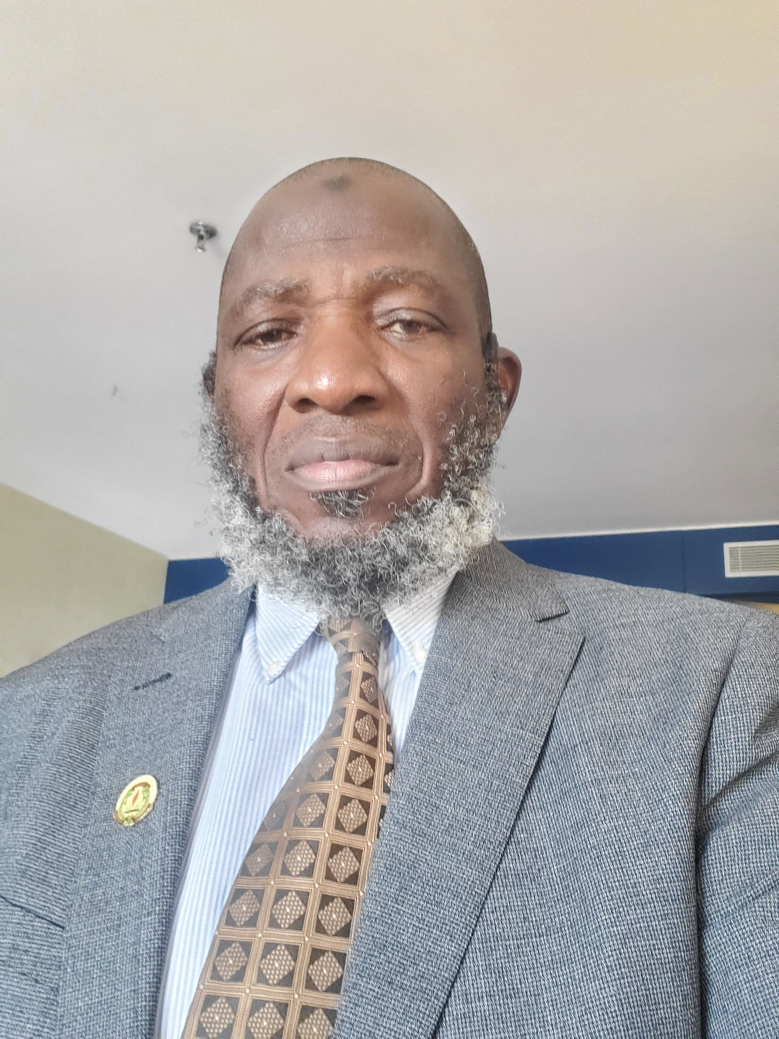
About Me
Professor Musbau Adewumi AKANJI, FAS
Director, Strategic Planning Unit

Slide 4
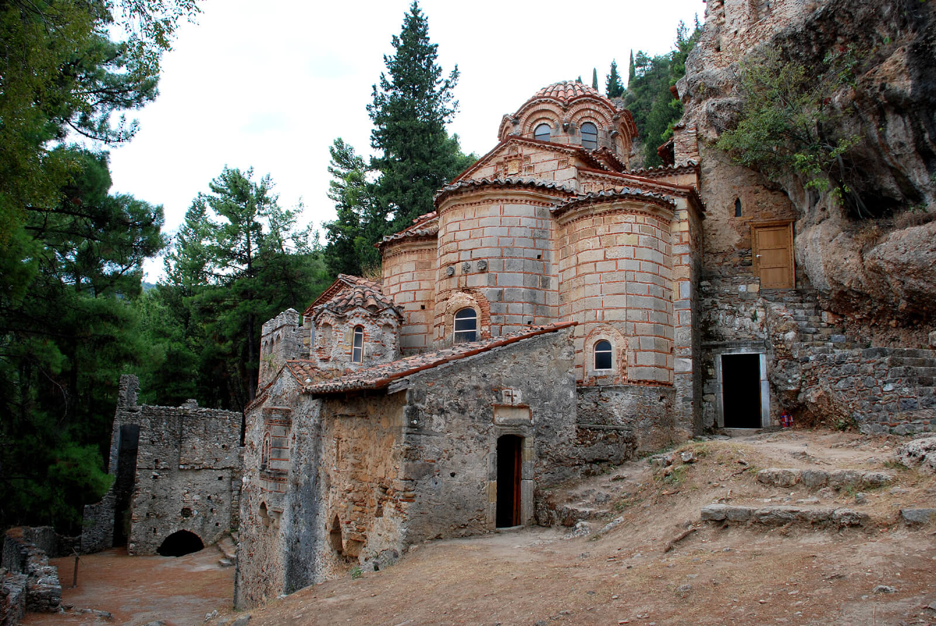
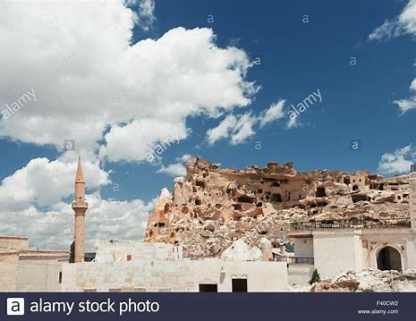
Early educational institutions started from Madrassahs & Monasteries

Slide 5
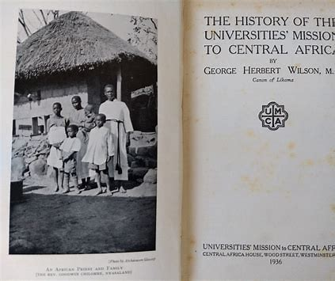
Some Early Universities
Universities are more than 2, 000 years old
Al- Azar University, Cairo, Egypt (972)
University of Bologna, Bologna, Italy (1088)
University of Paris, Paris, France (1150)
University of Oxford, Oxford, England (1167)
University of Modena (1175)
University of Palencia (1208)
University of Cambridge, Cambridge, England (1209)
University of Salamanca, Spain (1218), etc

Slide 6

Development of Universities in Nigeria
University College, Ibadan (1948)
University of Nigeria, Nsukka (1960),
University of Lagos, Lagos (1962),
University of Ife (now Obafemi Awolowo University), Ile- Ife (1962),
Ahmadu Bello University, Zaria (1962)
University of Benin, Benin- City (1970)
Kwara State University, Malete (2009)

Slide 7

Federally owned 52
State owned 63
Private 147
TOTAL 262

Slide 8
Universities are established to:
generate NEW Knowledge by research
spread such knowledge by teaching students
apply results of research to IMPROVE the Community
Purpose for establishment of Universities

Slide 9

Initially, workers are mostly Teachers (Lecturers)
However, due to increase in number of students
who are from far and near and to allow
concentration on lecture delivery, research and
its applications, there was the need for
different classes of people to look after other
aspects of life in the Institutions, like:
Accommodation
Feeding
Environment
Municipal services, etc

Slide 10
Those needed to work in the universities now include but not limited to:
Lecturers
Professional Administrators
Accountants
Engineers
Librarians
Technologists
Technicians
Medical Personnel
Secretaries
Drivers
Cleaners
Gardeners etc

Slide 11
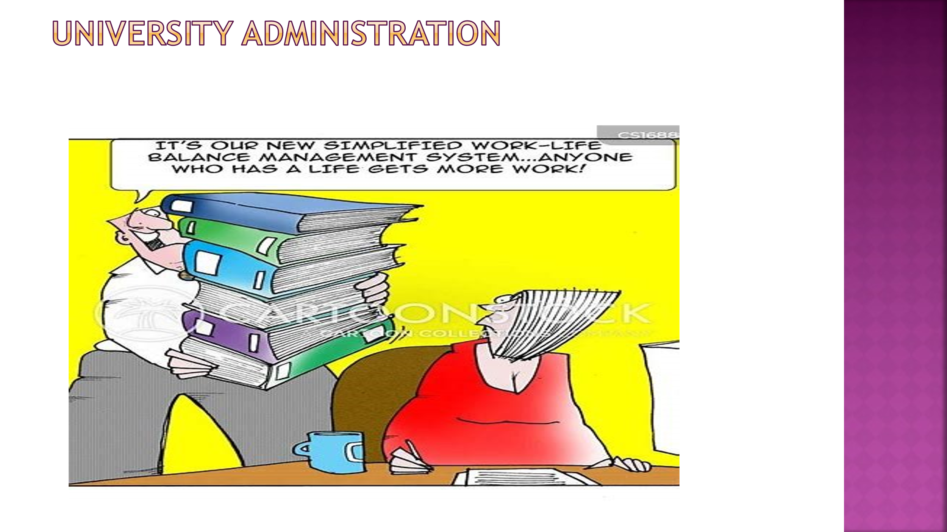

Slide 12
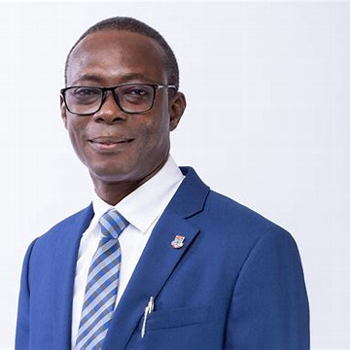
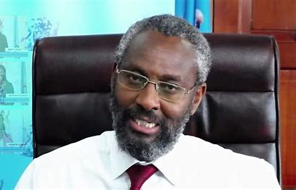
Fresh Vice- Chancellor
Mid- Term Vice- Chancellor

Slide 13
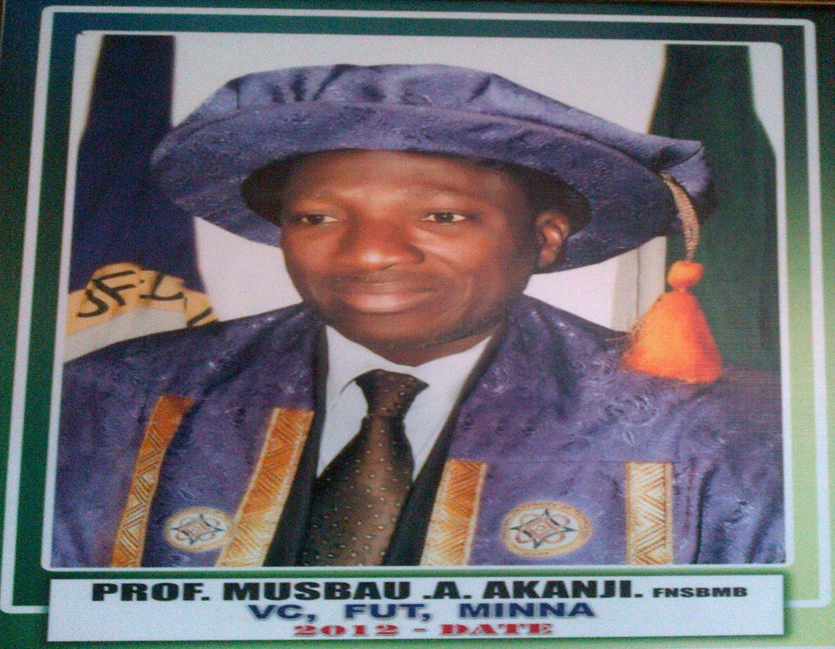
Akanji, 2012
Akanji, 2018

Slide 14
Various officers are appointed to assist VC in carrying out the varied functions outline above
Principal Officers
Deans of Faculties
Directors of Centres
Heads of Departments/Units
Heads of non- academic units

Slide 15
Management in university
University is a multi- directional workplace where variety of specialist are supposed to work together towards achieving specific objectives
Vice- Chancellor is Chief Executive and supported by Principal Officers
Each PO is the Chief in his/her domain to be assisted by varieties of officers
There is therefore cascade of authority down to the most junior personnel

Slide 16
Each Dean is the Manager in his Faculty
Head of Department is the Manager in his /her department
Each Level adviser is the Manager over the students in his/her Level
Registrar is the Manager over staff in Registry
Each Unit Head is the Manager overstaff of his/her Unit
etc

Slide 17
Sallee (2018) summed up what Management is supposed to achieve:
“harnessing man and material resources for the achievement of an organization”
It is thus the responsibility of Vice- Chancellor to ensure harmony between and within the work force

Slide 18

Enhancing corporate governance in university administration

Slide 19
Characteristics of world class universities
Very sound FINANCIAL Base
Availability of resources for quality Teaching, Learning and Research
Centres where radical thoughts could be expressed without hindrance
Where research could be conducted unfettered
Presence of Students and Faculty from DIVERSE places
World Class research output
Good number of World Class Publications (Citation of work done in the University)
Prize winners among Faculties (e.g Nobel Prize, NNOM, FAS, SAN, FNAL, FNAE etc)
Recognition by outside world ( Ranking)
Attraction and Retention of Best Staff
Produce ALUMNI who occupy positions of influence locally, nationally and globally
Signing MoU with International Universities and Organizations

Slide 20
Characteristics of World- Class Universities
Quality of Academic Staff
Quality of Research as shown by publications
Quality of students
International presence of staff and students
Quality of Governance

Slide 21
How universities are governed
For more than two thousand years, universities had established a way of life, a pattern by which affairs within the community are conducted.
Because they are recognized as unique institutions with self-regulating mechanisms, its governance is structured in such a way as to insulate it from the ‘outside bureaucracy’. Governing Councils are thus established to serve as regulators of activities of the universities.

Slide 22
Committee system
Committee system in universities refers to a structure comprising various committees that are responsible for decision – making, policy formulation, and oversight related to academic and administrative matters.
Such Committees exist to:
streamline processes,
ensure transparency,
involve different stakeholders in university governance

Slide 23
Examples of Committees
Council Committees
Senate Committees
University – wide Committees
Administrative Committee of Vice- Chancellor
Faculty Committees
Standing Committees
Ad- Hoc Committees
Departmental Committees

Slide 24

What then is expectation of the university from you???

Slide 25
KWASU CORE Values
Integrity
Excellence
Resilience
Creativity
Commitment
Compassion
Collaboration

Slide 26

Please Advise
In a number of cases, style and content of communication have a bearing on success or lack of it, of administrators

Slide 27
Timeliness
Among institutions that respect time is the university. When a programme is scheduled for 9am, it means 9.00am, not 9.01am. Over time, this tradition is being gradually lost in our universities. As Deans and HoDs, you are expected to lead in this regard
Courtesy
There is respect for order. In a university setting, the order of precedence is expertly set out. Everybody know that the Vice- Chancellor is number one, followed by his Deputies, Registrar, Bursar, Deans, Directors, Heads of Departments and so on.

Slide 28
At any official function, 10am means 10.00 not 10.01Hrs
At any official university function, the Vice Chancellor should not arrive the venue before any Dean.
At Faculty level, no Head of Department should arrive after the Dean.

Slide 29

Mentorship
You are expected to provide support and help in your offices. The more experienced individual is supposed to teach and give help and advice to a less experienced person.

Slide 30

You should see yourselves as mentors and therefore must be selfless and guide your mentees till such mentees grow to meet you or even surpass you
I wish you All, Deans and Heads of Department, successful and impactful tenure

Slide 31

You are supposed to help others by encouraging them to be more effective at work

Slide 32
Vice- Chancellor Sample 1A
KWASU
Thro’
Dean of Faculty forwarded
Thro’
Head of Department recommended
Application for Leave of Absence
Leave of absence to contest election for position of Local Government Chairman

Slide 33
Vice- Chancellor Sample1B
KWASU
Thro’
Dean of Faculty The position of HoD is endorsed. The alternative is for the university to employ a replacement for him. The application is therefore not recommended.
Thro’
Head of Department Dr XYZ is the only Senior Lecturer in the Dept apart from myself who is currently HoD. His services will be required in the coming session when our programme will be due for NUC Accreditation. The position he is going to seek has no bearing to his expertise. Application is therefore not recommended.
Application for Leave of Absence
Leave of absence to contest for post of Local Government Chairman during the coming election year

Slide 34
Vice- Chancellor Sample 2A
KWASU
Thro’
Dean of Faculty forwarded
Thro’
Head of Department Application lacks merit . Not recommended
Appeal for reconsideration of my promotion
I wish to appeal the decision of Faculty Review Board not to recommend my application for promotion to SL.
I have spent required 3 years as LI and has 100 publications instead of 20 required for SL…..

Slide 35
Vice- Chancellor Sample 2B
KWASU
Thro’
Dean of Faculty The recommendation of the Head of Dept is endorsed. Dr ABC had been warned severally both verbally and in writing without remorse. He is therefore not recommended.
Thro’
Head of Department Applicant is a Lecturer I. He has spent 3 yrs. in post and has more publications than required for the post he aspired to. However, he does not help in administration of the dept. He does not attend deptal. meetings nor carry out any assignment given to him. He comes to the dept only when he has lectures. Publications alone is not enough to earn promotion. He is therefore not recommended
Appeal for reconsideration of my promotion
I wish to appeal the decision of Faculty Review Board not to recommend my application for promotion to SL.
I have spent required 3 years as LI and has 100 publications instead of 20 required for SL…..

Slide 36
Dean Sample 3A
Faculty of xxx
Thro’
Head of Department recommended
Thro’
Level Adviser recommended
Application for Extra Credit
I wish to apply for 4 extra credit to enable me graduate this session which is my final year.

Slide 37
Dean Sample 3B
Faculty of xxx
Thro’
Head of Department The student can adequately cope with the demands of the extra credits applied for. Recommended for your approval.
Thro’
Level Adviser This students is above average. He offered 44 Credits last session and passed all with minimum of C grade. The extra credits applied for is as a result of his illness during his 100 Level when he missed some examinations. He will cope adequately with the extra credit load. Recommended.
Application for Extra Credit
I wish to apply for 4 extra credit to enable me graduate at the end of this session.

Slide 38
Sample 4A
Dean Not approved
Faculty of ABC
Thro’
Head of Department forwarded
Application for permission to be away for 5 days.
I wish to apply for permission to be away from the university from Monday 5th till Friday 9th February 2024.
During the period, I wish to accompany my friend whose brother is relocating to Canada.

Slide 39
Sample 4B
Dean HoD, please look at the University Regulations, page 62, section 6 d. Request in excess of 3days can only be approved by the Vice Chancellor. The purpose for the journey is also not covered by the Regulations.
Thro’
Head of Department Dr DEF has covered his lectures for two weeks in advance, his application is recommended.
Application for permission to be away for next week
I wish to apply for permission to be away from the university from Monday 5th till Friday 9th February 2024.
During the period, I wish to accompany my friend to Lagos, whose brother is relocating to Canada.

Slide 40
Sample 4C
Vice Chancellor
KWASU
Thro
Dean University Regulations on page 62, section 6 d refers. The reason adduced by Dr DEF is not tenable. Therefore request is not recommended Sir.
Thro’
Head of Department Dr DEF has covered his lectures for two weeks in advance, his application is recommended.
Application for permission to be away for 5 days
I wish to apply for permission to be away from the university from Monday 5th till Friday 9th February 2024.
During the period, I wish to accompany my friend to Lagos, whose brother is relocating to Canada.

Slide 41
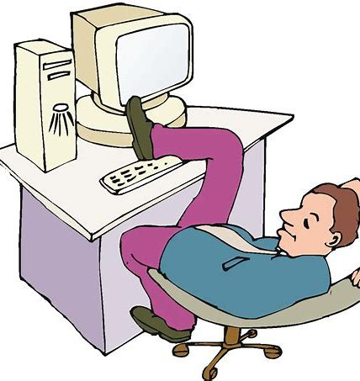
Under no circumstance should a Dean or HoD or anybody be found in this way in the office.

Slide 43
Bibliography
Akinkugbe, OO () Nigeria’s higher education 50 years after Ashby: on course or on curse. Maiden Convocation lecture, Osun State University, Osogbo,
Faborode, MO and Edigheji, O (2012) The future and relevance of Nigerian Universities and other Tertiary Institutions. Higher Education Policy Brief.. Committee of Vice- Chancellors of Nigerian Universities. TrustAfrica, Dakar- Fann, sSenegal.
Kirkpatric, B (1987) Roget’s Thesaurus of English words and phrases. Penguin Books, London
Ladipo, M (2017) University culture and ceremonies: mindfulness as a key factor. Public Lecture delivered on 21st November, 2017 at the Federal University of Technology, Minna.
Maigida, AY (2016) Growth and development of university education in Nigeria from colonial era. In: Discourse on the state of education in Nigeria. Omolewa M (Ed), Laurel Educational Publishers Ltd, Ibadan. Chapter 19, pp 265 – 291
Mihyo, PB (2008) Staff retention in African universities and links with the diaspora. Association of African Universities, Accra, Ghana
Okojie, JA (2016) Universities as ivory towers: the Nigerian adaptation. Paper presented at the Annual Association of Vice- Chancellors of Nigera Universities conference, University of Jos, 30th May, 2016.
Oloyede, IO (2020) Synchronizing cacophony: interrogating some issues of concepts and perception in the Nigerian higher education topology. In; Pivotal Issues in higher education development in Nigeria ; Essays in honour of Distinguished Professor P. Okebukola, OFR (Eds; Akinrinade, S, Oyeweso, S, Odewumi, SG, & Kola- Olusanya, A); University Press, Ibadan, pp 33 – 73.
Popoola, AO (2021) Higher education Nigeriana: a journey across time and space. 2021 Convocation lecture of Kwara State University, Malete; 9th December
Rauhvargers, A (2013) Global University Ranking and their impact – Report II. European University Association, Report on Ranking. www.eau.be
Salee, KW (2018) Managing twenty- first century university: issues and prospects. University of Ilorin Registry Seminar Papers Vol 1, 1 - 8
.

Slide 44

At the End!

Slide 45


