Slide 1
From Provost’s Diary: Advice to the New Academic Leaders
By
Olawale Mashood Aliyu
Director
Centre for Research & Development
Kwara State University Malete
olawale.aliyu@kwasu.edu.ng
One-Day Retreat for KWASU Deans & HODs – 7th February 2024

Slide 2

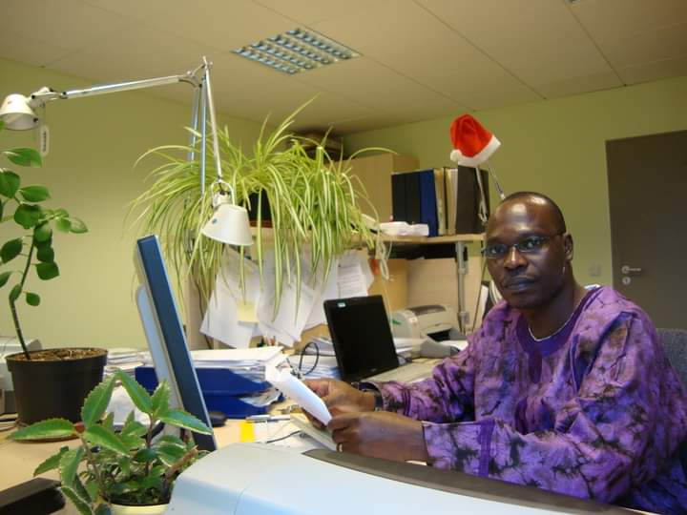


Administrative Peep

Slide 3

Academic Leader
Manages all aspect of the employees
Responsible for performance management.
Builds a high performance teams that work collaboratively
Have the ability to develop and execute functional strategy as well as
Act as a change leader.

Slide 4
Tip 1: Know The Rules & Regulations!!!
Kwara State University Law, 2008
Kwara State University Administrative Manual
Kwara State University Approved Guidelines for Promotion of Academic Staff, 2022
Kwara State University Students Handbook
Kwara State University Code of Conducts/Condition of Service
Relevant Memorandum of Understanding (MoU)

Slide 5
Tip 2: Understand Your Relationship/Obligations
Students
Faculty staff
ACADEMIC LEADER
Management
Public
First and foremost, you serve as the spokesperson for the interest and welfare of the entire faculty/department
Loyalty (Management, Council & Government)
Confidentiality

Slide 6


Tip 3: Have Goals and Plan (Agenda)
Plan – You need a set of goals and a vision, though a subset of the Institution’s vision.
Have an honest assessment of the strength and weakness of your jurisdiction.
Ensure available lean resources are efficiently utilized through careful planning.
A successful leader must have goals – The goals must be articulated, open and shared with faculty and pursued until accomplished

Slide 7


Tip 4: Know Your Faculty
Find time to see faculty members in their offices.
Have a sense of their moods, attitudes and goals.
Just stop by to ask about their classes, research, publications and welfare.
You must know the their interest professionally and personally.
Your knowledge of the personality of your faculty members will help you provide good leadership.

Slide 8

Tip 5: Be a Good Example & Appreciate Scholarship
Understand and appreciate teaching, research and community development
Find time to keep your in hands in each of these areas.
It afford you opportunity to know the students, and the challenges of the staff and students.
You earn respect of faculty when you are active in areas in which they are evaluated.
To be effective leadership, you must lead by example.
You must have good working ethics.
It will be difficult to reprimand faculty members for some misconducts if you are not above board

Slide 9


Tip 6: Know When to Consult
Consultation – When you are faced with difficult decisions, consult others especially senior university officials
2nd October Date of Resumption and Promotion Eligibility (3 Years)

Slide 10

Tip 7: Learn to Say No
Say no can sometimes be painful, but knowing when and how to say no pays rich dividends (Jalabia).
While you must learn to say no, you must also be caring.
You should feel a need to help others and to do what you can to make people more productive and happy.
When you notice/have a distressed faculty – please give/show love “Love is a very powerful medicine”

Slide 11

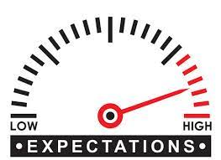
Tip 8: Hide Your Frustration
As a leader you will create morale problems if you are regularly glum, moody and/or look frustrated.
Don’t let faculty start asking Secretary/Faculty Officer, “Is oga in a good mood today”.
Give hope and never give up.
Tip 9: Know What is Expected of You
You should know precisely what is expected of you.
Never say “Oh no, I didn’t know I was supposed to do that”.

Slide 12


Tip 10: Hire with Caution!!& Be Honest in Evaluation
Be careful when hiring and be honest when evaluating
Watch out for Cadre compression/jump syndrome!.
Be honest and thorough when evaluating faculty members for promotion.
Have courage to tell the weak faculty member the truth.
Never support falsification
Provide needed support to weak faculty member

Slide 13



Tip 11: Be Creative & Innovative
You need to do more than treating mails and see that classes are taught and covered.
You must be dynamic and open to new ideas in line with current reality.
Especially in shaping/building the students for the new directions and tendencies
Encourage change and innovation

Slide 14


Tip 12: Be a Leader & Not a Boss
Be Sensitive to the need of Faculty, Staff, and Students
Is it possible to have high standards and at the same time be understanding of others?
Of course, we cannot meet all expectations, but we can make our Faculty/Department a challenging, enjoyable place to work.

Slide 15


Tip 13: Be Decisive
There many decisions that you can make jointly with your faculty/board members
However, there will be other tough and difficult decisions you must take to be successful as an administrator.

Slide 16


Tip 14: Avoid favouritsm
Give fair treatment irrespective of relationship or congeniality.
Many will be resentful and unsupportive if they noticed lapses/favouritism.
Best ways to ensure fairness to your staff is to have a written policies and procedure governing privileges and opportunities.

Slide 17
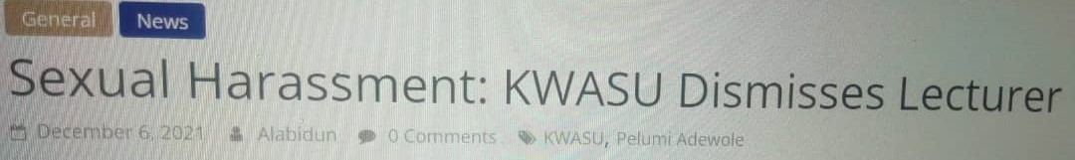
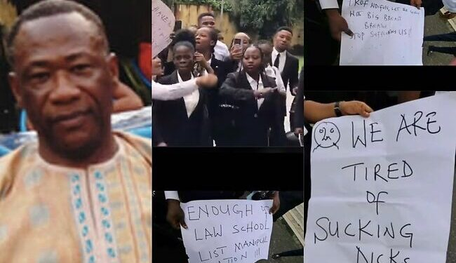
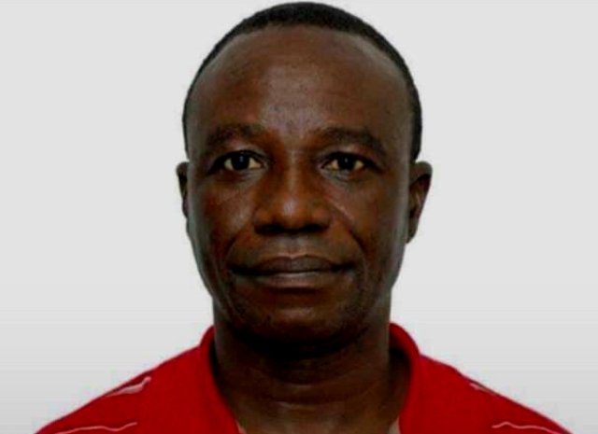
Tip 15: Be Decent & Discipline
Transparency, probit and accountability are key to successful leadership.
Be honest, forthright and decent
Say No to:
sexual harassment
Sex for Marks
Sex for Admission Plagiarism

Slide 18
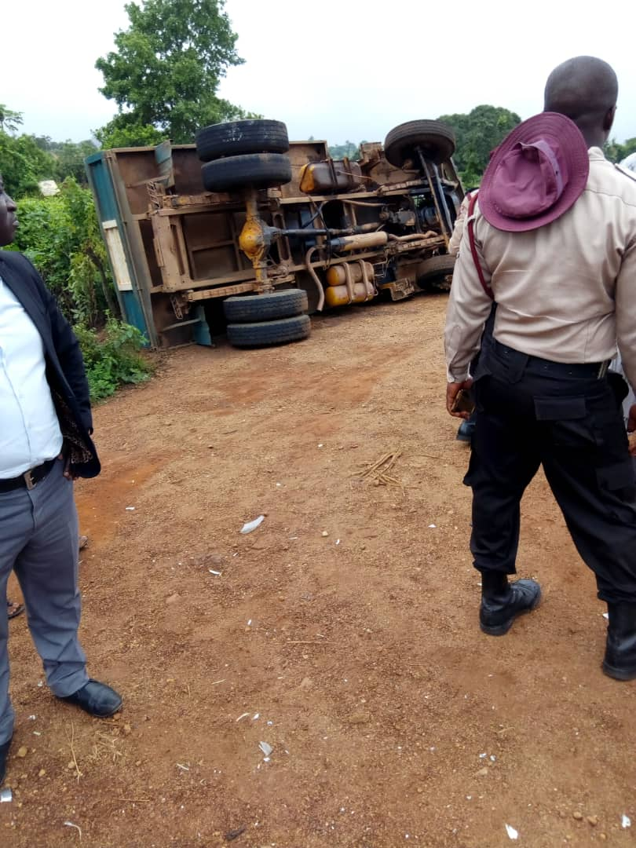
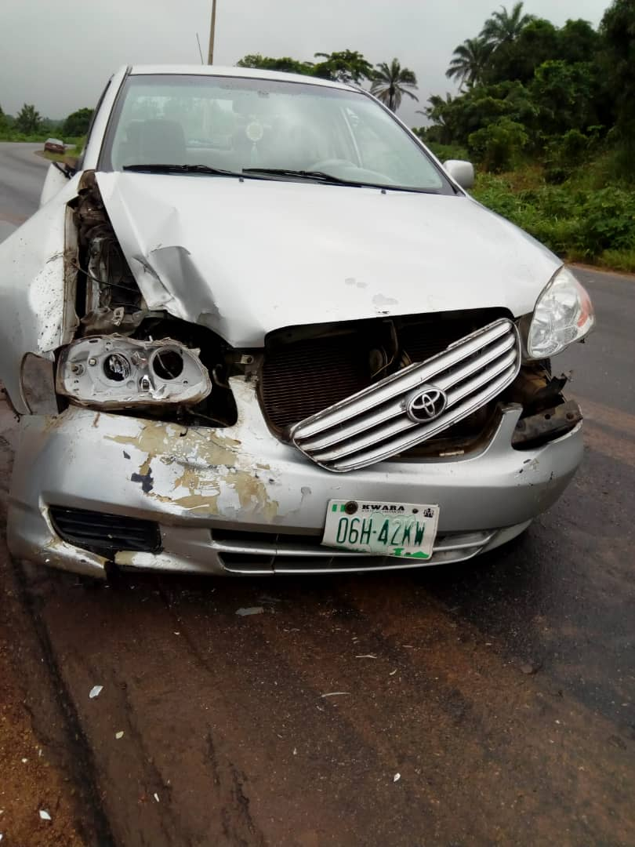
Beyond the Campus!!!!

Slide 19
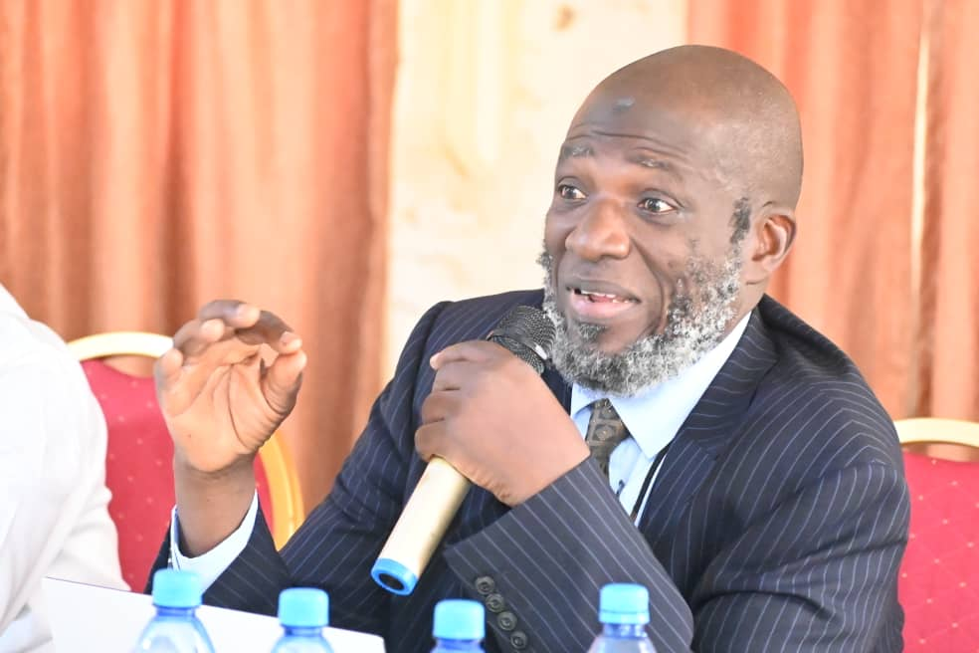
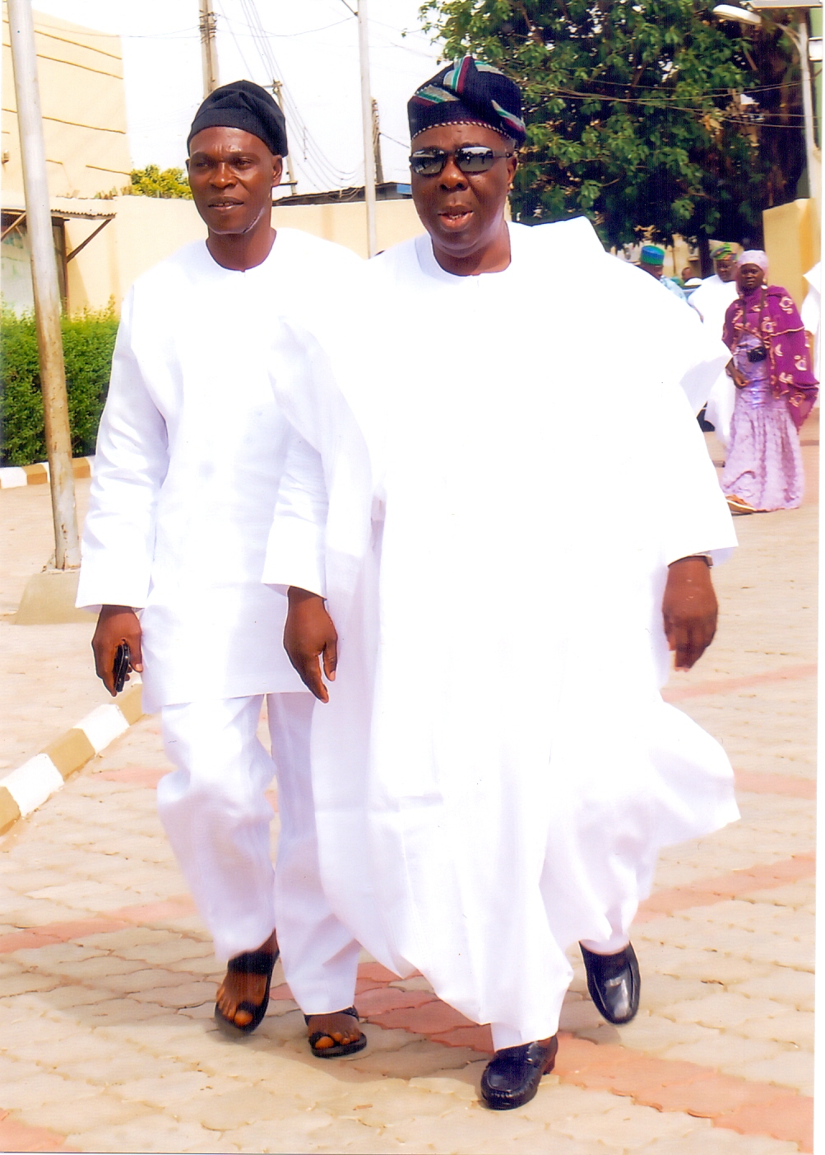
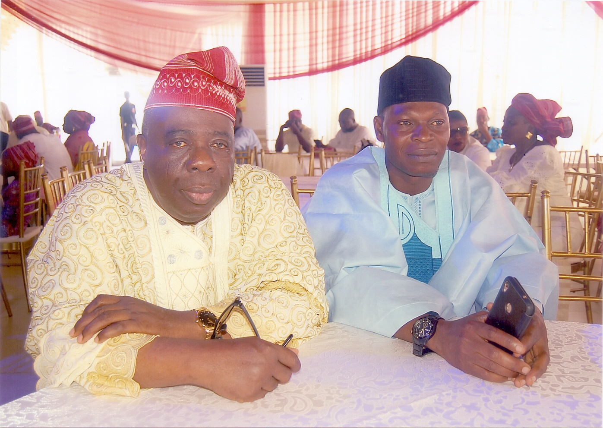
Do you have a mentor?

Slide 20
Final Words
Always ask for help from others when you’re not sure.
The best way to master your administrative responsibilities is to understand their requirements and implications.
Always keep in mind that your primary job remains that of a scholar/educator
Becoming a good administrator is a worthwhile goal; using the skills of efficient administration to enhance teaching is a far greater accomplishment.

Slide 21

Further Suggestions
Faculty Representative
Career Development – Advice to New Recruits
Inter-Faculty Relationship
Pre-Evaluation
Provide Oversight on Quality of PG programme
Research Proposal Development
Thank You for Listening

