Slide 1
Artificial Intelligence, Digitisation, Publishing and Reference Services Imperatives of Libraries in the Twenty First Century
By
Professor ‘Niran Adetoro
Professor of Library and Information Science
Director,Academic Planning & Quality Assurance,
Tai Solarin University of Education,Ijagun,Ogun-State
Keynote presented at 2nd Virtual Conference of KWASU Library Malete Kwara State

Slide 2

Libraries and Innovation
Innovation is designing a new way to offer to help a beneficiary make the progress they are seeking better than they currently can. Understanding that progress is both functional and non-functional (safer, quicker, self-actualisation, wellness etc).

Slide 3

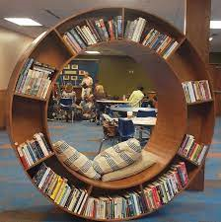
The communities and users that libraries serve are always changing.
So innovation helps libraries adapt to meet their needs and aspirations both now and in the future.

Slide 4
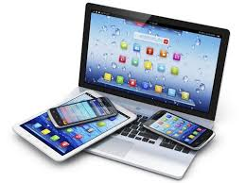
Nigeria and the Reality of Digital Access
digital opportunity index score 0.41 is LOW
ownership and access to personal computers 4.5%
Internet penetration, access via mobile devices 48% Aug,2021
over 108 million internet users in Nigeria in July 2021
In 2026, almost all the internet users are expected to use a mobile device

Slide 5

21st century Libraries
The focus has moved from the library as a confined space to one with fluid boundaries that is layered by diverse needs and influenced by an interactive community
Community hubs; providing for general needs as well as endless learning possibilities

Slide 6
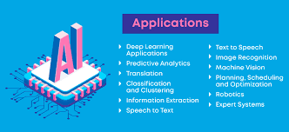
Artificial Intelligence (AI)
AI , Machine learning technologies are no longer science fiction!
The vast majority of digital data is BIG and unstructured: a complex mesh of images, texts, videos and other data formats.
Estimates suggest 80-90 percent of the world’s data is unstructured and growing at an increasingly rapid rate each day. We in a world of BIG DATA!

Slide 7
Libraries and AI
To make sense of this much data, advanced technologies are required. AI offers the means by which Library data can be processed
Artificial Intelligence is the name given to programmed algorithms that automatically analyse and apply knowledge
Using computer algorithms that think, work and react like a human being

Slide 8
AI in Libraries
Libraries worldwide have been experimenting with this technology for the last two decades ..
predict customer behaviour
Improve Library products and services
keep track of all inventories
analyze Data & perform routine tasks
support remote access to library services

Slide 9

AI uses in Libraries
to improve device performance, manage facial recognition, do an image search and provide virtual assistant services.
Turnitin application is a common type of AI for similarity index
Chat-bot feature, Chat GPT and GPS has become the need of the hours, are robust applications of AI

Slide 10
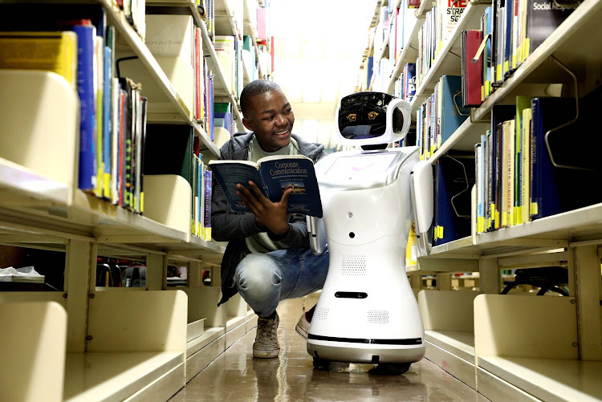
AI and libraries have a great nexus to empower library operations with quality services.
If people trust artificial intelligence (AI) to drive a car, people will most likely trust AI help improve library services

Slide 11
Digitization and libraries
Despite the high cost of digital conversion, many institutions are taking on ambitious projects to find out for themselves what the technology can do for them. They are making their collections more accessible and,
believing that they are also accomplishing preservation goals at the same time.
impact of digitizing projects on an institution is far reaching
The proliferation of electronic information;
the dwindling budget;
desire to access materials in remote locations;
quest for collaboration,
partnerships and resource sharing;
increasing cost of preserving analogue materials, and so on
Are factor propelling digitisation…
,

Slide 12
Digitisation imperative
enhanced intellectual control through creation of new finding aids,
increased and enriched use through the ability to search widely,
creation of a “virtual collection” through the flexible integration and synthesis of a variety of formats, of materials scattered among many locations

Slide 13

Library Publishing
The practice of academic Libraries Providing Publishing services
The set of activities led by academic and research libraries and library consortia to support the creation, dissemination and curation of scholarly works

Slide 14
Why library Publishing?
The disconnection between the producers of scholarly literature and the intermediaries who purchase it for consumption by others which created a dysfunctional economic relationship
dominated by a small number of large commercial publishers
High costs of journal subscriptions
Shrinking budgets and subsidies
Content protection and restrictive licences

Slide 15
Worthy of note….
Library Publishers should understand and have experience with all operational aspects of the publishing process, including the setup, configuration, and maintenance of publishing platforms; the description and discoverability of content (including working with identifiers such as DOIs, ORCIDs, ISSNs, ISBNs, etc.); the establishment of publishing production processes (including accessibility); the implementation of tracking metrics and impact factors; and the methods for ensuring long-term digital preservation. Library Publishers should be accomplished project managers in order to define roles and distribute responsibilities within a library publishing program (Lib. Publ. Coalition,2020)

Slide 16

Digital reference service imperatives..
“In this information-rich world, information can be sought anytime, anywhere. Users have alternatives that are more convenient than coming to a physical library to consult with a reference librarian. Reference librarians have to find ways to respond to contemporary users’ values and expectations of immediacy, interactivity, personalisation, and mobility.
If reference services are to be used, attention must be given to minimising the time, the effort, and the difficulty of use”

Slide 17

People feel comfortable in utilising and depending on digital services in their day-to-day ways of life
Users expect their libraries to provide:
more services online,
access to electronic information resources and online catalogues,
facility to place requests online
provision of some sort of DRS,
find answer to every query online.
Libraries are challenged to provide the greatest information access and an improved level of reference and information services by keeping pace with the latest trends and technological developments.

Slide 18

How should Libraries evolve as Institutions for learning in 21st Century
All libraries and the people they serve—stand to benefit from becoming more intentional and purposeful about accommodating the lifelong learning needs of people in the 21st century, and doing this, work collaboratively in alignment with community needs.
In the light of 21st century demands, libraries should build on current strengths and embrace new approaches􀀁􀁂􀁔􀀁􀁕􀁉􀁆􀀁􀁐􀁏􀁆􀁔􀀁􀁅􀁆􀁔􀁄􀁓􀁊􀁃􀁆􀁅􀀁􀁊􀁏􀀁􀁕􀁉􀁆􀀁􀁄􀁉􀁂􀁓􀁕􀀁􀁃􀁆􀁍􀁐􀁘􀀛􀀁􀁊􀁃􀁓􀁂􀁓􀁊􀁆􀁔􀀁􀁂􀁏􀁅􀀁􀁎􀁖􀁔􀁆􀁖􀁎􀁔􀀁􀁆􀁗􀁐􀁍􀁗􀁆􀀁􀁂􀁔􀀁􀁊􀁏􀁔􀁕􀁊􀁕􀁖􀁕􀁊􀁐􀁏􀁔􀀁􀁐􀁇􀀁􀁍􀁆􀁂􀁓􀁏􀁊􀁏􀁈􀀁􀁊􀁏􀀁􀁕􀁉􀁆􀀁􀀓􀀒􀁔􀁕􀀁􀁄􀁆􀁏􀁕􀁖􀁓􀁚􀀠

Slide 19



Slide 20


