Slide 1



Quality-controlled knowledge sharing through open access
Reggie Raju (PhD)
Director: Research and Learning Services
UCT Libraries
28th May 2024

Slide 2
Introduction
Budapest, Bethesda and Berlin Declarations advanced the bidirectional flow of knowledge between the global north and global south
Initiators of the Declarations and funders acquiesced to interventions that resulted in the continued marginalization of research from the global south
Global south countries need to develop an open access model which is driven by social justice principles
Need for a model which promotes the sharing of quality knowledge
Global south countries and institutions have sought an appropriate intervention via diamond open access
In Latin American countries more than 90% of their journal research output is disseminated via diamond open access
Quality-controlled knowledge sharing through open access
2

Slide 3
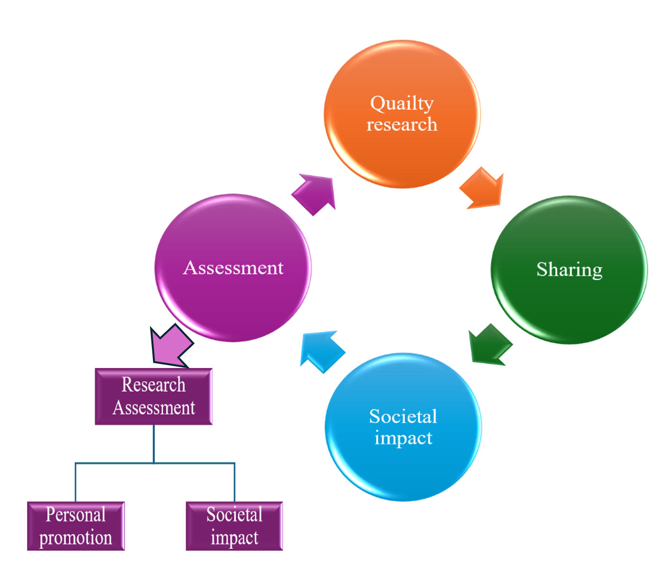
Examination of key pillars
Quality
Setting of standards and attributes that ensure the integrity, reliability, and usefulness of scholarly works
Academic rigour is misconstrued as prepublication peer review
Assumption is that the reviewers are familiar with the context and will contribute to the strengthening of the manuscript
Quality-controlled knowledge sharing through open access
3

Slide 4
Examination of key pillars
Quality
Subjectivity and bias is embedded in the peer review process
African researchers are often subjected to or are victims of geographic bias
Misnomer that peer review, be it due to conscious or unconscious, is the gold standard for quality
Relevance
      impact on the research to advance of knowledge; does the research address the SDGs; does the research address the relevant challenges of the region, country or continent?
Quality is about the most appropriate methodology
Quality-controlled knowledge sharing through open access
4

Slide 5
Examination of key pillars
Knowledge sharing
Dissemination of knowledge
Knowledge sharing aims to make research and information available to a wide audience, facilitating learning, collaboration, and innovation
Knowledge sharing - democratizing access to information, fostering collaboration and innovation
Betterment of society
Quality-controlled knowledge sharing through open access
5

Slide 6
Examination of key pillars
Social impact
Open access promotes social inclusion and equity
Fourth pillar is research assessment
Open access has a profound impact on research assessment
Increase in the visibility of the research and the researcher, enhances citation rates and promotional opportunities
Makes for a more inclusive and innovative scientific ecosystem
Quality-controlled knowledge sharing through open access
6

Slide 7
Social justice underpinning open access
Global open access movement left Africa behind
Social justice - act of being fair and equitable and breaking down barriers to unfair practices and inequalities
Rawls (2014) posit and advance that while the principle of inclusivity is central to social justice – need to dismantle structures that perpetuate inequality
Society cannot be just until there is equity and that will include equitable access to scholarly literature
Global north architectured models such as transformative agreements and APCs do not uphold the principles of equity and inclusivity
Need to deconstruct the inequalities that are so embedded in the current publishing ecosystem and to reconstruct a forum that nurtures and grows the open dissemination of African scholarship
Quality-controlled knowledge sharing through open access
7

Slide 8
Tenant model
Model - multiple tenants or institutions are served by a single instance of software, along with its underlying database and hardware
Incorporate social justice principles, making it more inclusive and aligned to the goal of hosting African scholarship
Serves as a central hub for hosting African scholarship, fostering communities of practice
Provides the necessary software manipulation capabilities for delivering of services
Aims to overcome infra-structural challenges that have hindered the widespread access to African scholarship
Quality-controlled knowledge sharing through open access
8

Slide 9
Tenant model
Affordability and sustainability are also considered in the development of the platform, aiming to provide a viable solution to these issues
Foundational pillars
Each participating institution has the opportunity to retain their identity
                Look and feel of its journals and books will be reflective of the institution
                Participating institutions to take ownership of their segment within the platform while showcasing its research productivity
                Prestige of the participating institution needs to be upheld
Quality-controlled knowledge sharing through open access
9

Slide 10
African Platform for Open Scholarship a platform for inclusivity and equity
Creation of the platform offers vastly improved opportunities to openly share their scholarship and address the myriad challenges that beset the continent
Core principles of APOS
Academic rigour is not compromised
Commitment to adoption of diamond open access model
Advancement of diversity, equity and inclusion
Commitment to adhering to social justice principles
Commitment to nurturing the next generation of African researchers
Commitment to growing African research output
Promotion of unhindered participation in the dissemination of African scholarship
Improvement in the visibility and discoverability of African scholarship
Enhancing institutional reputation through showcasing of their research output
Enhancing institutional prestige through showcasing of their research output
Quality-controlled knowledge sharing through open access
10

Slide 11
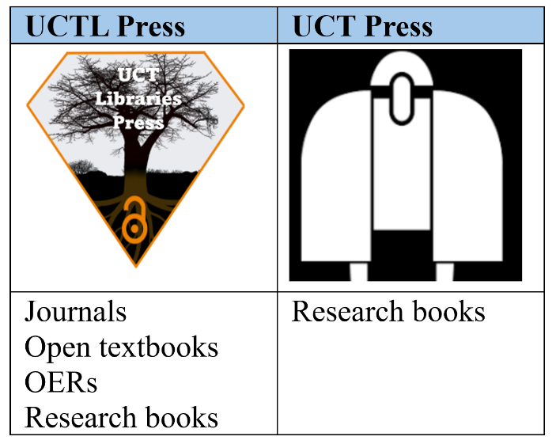
African Platform for Open Scholarship addressing fundamentals
UCT has two presses
UCT Libraries Press - ‘library as a publisher service’
Second is UCT Press
Quality-controlled knowledge sharing through open access
11

Slide 12
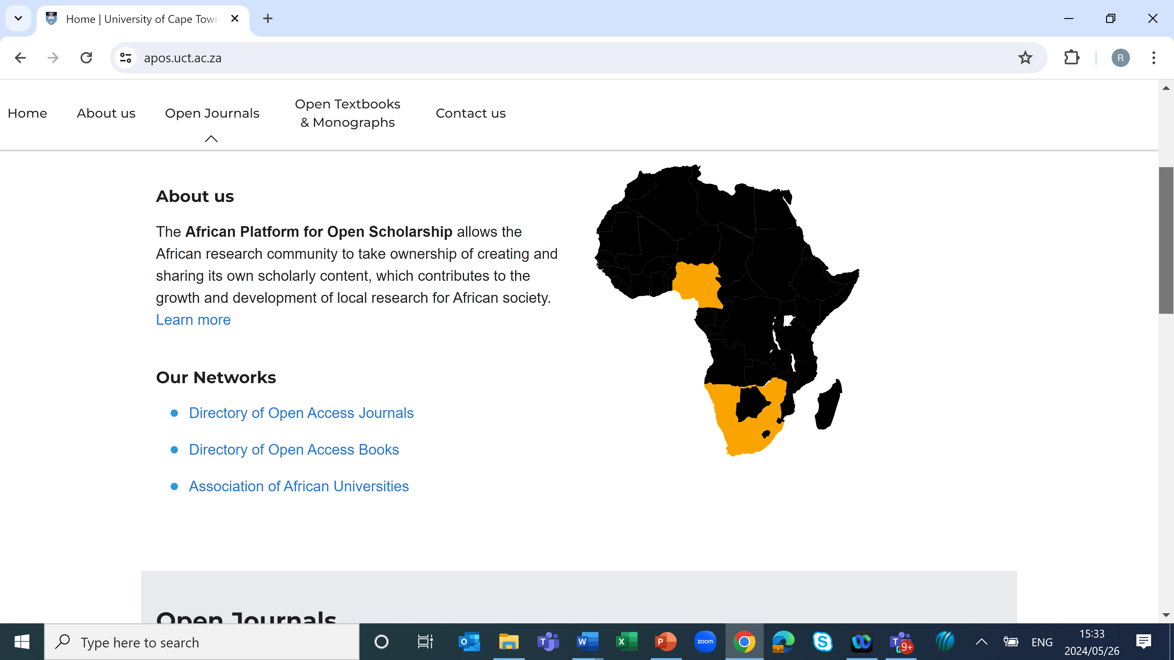
African Platform for Open Scholarship
UCT Libraries Press
Need to bridge the prevailing skills shortage and poor information technology infrastructure
Research shows lack of capacity
UCTL Press - published 26 monographs and publishes six journals
DOAJ - Journal of Construction Business and Management and Journal of African Real Estate Research
‘Library as publisher’ inspired UCT to rethink its commercial model – adopting an open model
Quality-controlled knowledge sharing through open access
12

Slide 13
African Platform for Open Scholarship
Sharing a quality open access publication
UCT Libraries publishing demonstrates how libraries can dismantle structures that perpetuate inequality and exclusionary practises
Constitutional law for students textbook
Structure of the book was done by a senior professor
Written by students for students in support of a complex subject
Reviewed by a senior profession in
constitutional law, a student and two
constitutional law judges
Since March 2020 - solicited
240 196 downloads
2020 | 12 328
2021 | 58 954
2022 | 68 855
2023 | 61 654
2024 | 38 405
Quality-controlled knowledge sharing through open access
13

Slide 14
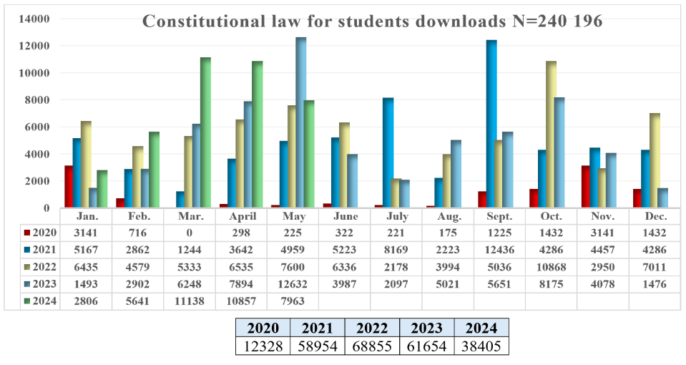
African Platform for Open Scholarship
Constitutional law for students textbook
Quality-controlled knowledge sharing through open access
14

Slide 15
African Platform for Open Scholarship
UCT Press: transitioning a commercial publisher
Myth that commercial publishing is the best way to disseminate scholarship
UCT created UCT Press as university presses –
    enhances the prestige of the institution
    distributes the scholarship generated by the institution
    University presses have the potential of being inspirational in the promotion of research
After 25 years - UCT Press imprint was returned to the University
67 of the back titles have been published on the continental platform (APOS) (https://openuctpress.uct.ac.za/uctpress)
Demonstration of increased visibility and discoverability of open content
Quality-controlled knowledge sharing through open access
15

Slide 16
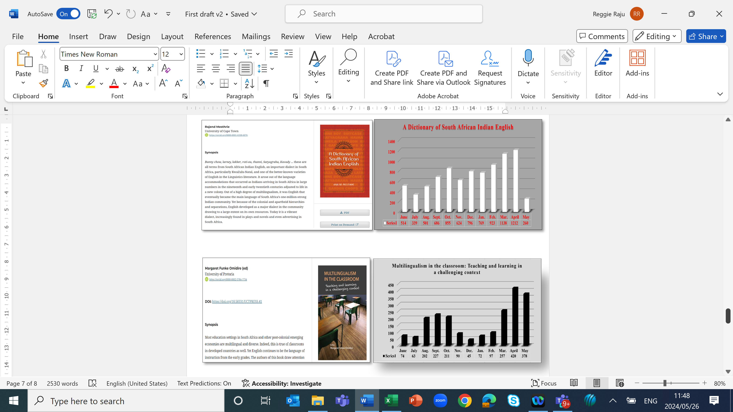
African Platform for Open Scholarship
A Dictionary of South African Indian English
Dictionary of South African Indian English written by UCT authors
Downloaded more than 8 600 times and from countries across the world
Quality-controlled knowledge sharing through open access
16

Slide 17
African Platform for Open Scholarship
Multilingualism in the classroom: Teaching and learning in a challenging context
Edited volume by a researcher from another university
Downloaded 2 136 times, again from across the world
Non-selling titles with increased downloads
Publishing quality knowledge open improves sharing, visibility and accessibility
Quality-controlled knowledge sharing through open access
17

Slide 18
Conclusion
Quality controlled knowledge sharing is about the systematic process of disseminating trusted and relevant information
Africa needs to develop interventions that are commensurate with continental imperatives
Global north gold standard of prepublication peer review is fraught with bias contributing to the high rejection rate of African scholarship
African Platform for Open Scholarship is an intervention that addresses continental challenges without compromising on academic rigour
Quality controlled knowledge sharing via open access is the most viable alternative for Africans to grow their scholarship
Quality-controlled knowledge sharing through open access
18

Slide 19
Conclusion
Thank you
Quality-controlled knowledge sharing through open access
19

