Slide 1

MANAGING LIBRARY RESOURCES IN THE ERA OF AI AND BIG DATA
KWARA STATE UNIVERSITY, MALETE. KWARA STATE
The 3rd International Virtual Conference of the Muhammadu Buhari Main University Library, Kwara State University (KWASU)
Open Access, Artificial intelligence (AI), and Big Data
Presenter:
Ibrahim ABDULLAHI PhD. SMIEEE, MACM, MINNS, MAITP, MCPN, MNCS, MISOC
Director, ICT
Ibrahim Badamasi Babangida University, Lapai. Niger State.
Nigeria

Slide 2

Library
- A building or room containing collections of books, periodicals, and sometimes films and recorded music for use or borrowing by the public or the members of an institution.
"a university library“
A collection of books and periodicals held in a library.
A room in a private house where books are kept.

Slide 3


LIBRARY, AI AND BIG DATA
Notes:
Libraries have always been essential repositories of knowledge, serving as places where people from all walks of life can learn and grow. In today’s fast-paced digital world, libraries must adapt to remain relevant. Artificial Intelligence (AI) is a powerful technology that can help libraries achieve this goal. By leveraging AI, libraries can automate processes, enhance user experiences, and ensure equitable access to information.

Slide 4
Ooutline
Libraries
Collections of ideas, books, periodicals for reference, study, research and safekeeping
Promise of AI in Libraries
A new revolutionized approach to ease things
Ethical Considerations
Code of operations
Impact Areas of AI in Libraries
Fast delivery
AI Potentials in Libraries
Inheritance and additional approaches
Challenges
Hindering factors that threatens the way to go

Slide 5

Library Units
Classification
Bindery
A classification system uses letters and/or numbers (call numbers) to arrange the books so that books on the same topic are together.
The Bindery Unit assists in the preservation of materials of the Library.
Catalogue
E-Resources
A library catalogue is a listing of all the items within a library. In pre-computer times, library books were indexed in card catalogs which were cabinets of drawers of index cards: author cards, title cards, and subject cards.
e-resources are electronic journals (e-journal), electronic books (e-book) DBs, etc
Circulation
Holdings/Collections/References
Library lending comprises the activities around the lending of library books and other material to users of a lending library
The Reference Collection consists of items that must remain in the library so that library users can rely upon their accessibility. These books include encyclopaedias, dictionaries, handbooks, almanacs, statistical sources, and specialized materials such as atlases.
Notes:
Circulation Section.
Acquisition Section.
Classification Section.
Catalogue Section.
Periodicals Section.
Information Technologies Section.
Reference Section

Slide 6
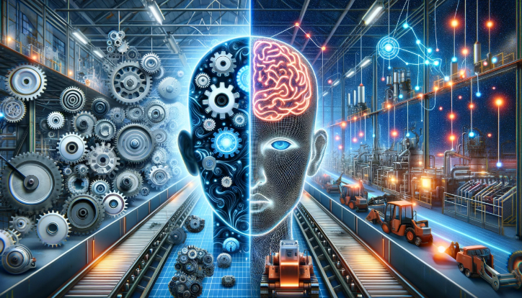
Promise of AI in Libraries
The entire heritance of the services in automation, services and access
1. Automating Processes
AI can streamline routine tasks such as cataloguing, inventory management, and circulation. This automation frees up librarians’ time, allowing them to focus on more strategic activities.
NOTE: Librarians need not to be SCARED to lose their roles

Slide 7

Promise of AI in Libraries
The entire heritance of the services in automation, services and access
2. Personalized Services
AI algorithms can recommend relevant resources based on users’ preferences, reading history, and interests. Personalized recommendations not only save time but also expose users to a broader range of materials they might not have discovered otherwise.
Robots Law?
NOTE: Librarians need not to be SCARED to lose their roles

Slide 8

Promise of AI in Libraries
The entire heritance of the services in automation, services and access
3. Equitable Access
AI can help bridge the digital divide by ensuring that all users have equal access to information. For instance, AI-powered chatbots can assist users with inquiries, regardless of their location or background.
Robots Law?
NOTE: Librarians need not to be SCARED to lose their roles, they must ensure the services rendered by AI is sustained, inherent and improved by maintaining the ethical standings.

Slide 9
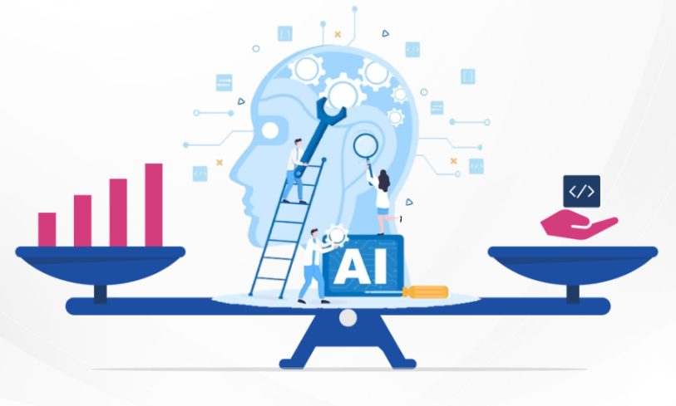
Ethical Considerations
Defining the code of operations in the Library field and respect for data
?
?
?

Slide 10
Ethical Considerations
Defining the code of operations in the Library field and respect for data
Responsibility
Transparency
Equity

Slide 11
Ethical Considerations
Defining the code of operations in the Library field and respect for data
Responsibility
Libraries have an ethical obligation to their users. AI must be deployed responsibly, considering factors like privacy, bias, and transparency. Librarians should actively monitor AI systems to prevent unintended consequences.
Responsibility
Equity
AI should promote equitable access to information. Librarians must ensure that AI recommendations do not reinforce existing biases or exclude marginalized groups.
Transparency
Equity
Transparency
Users should understand how AI systems work. Librarians can provide explanations and guidelines to demystify AI processes.

Slide 12


Impact Areas of AI in Libraries
Great harvest of using AI in our Libraries

Slide 13
Impact Areas of AI in Libraries
Great harvest of using AI in our Libraries
User Services and Fast Delivery
Chatbots and virtual assistants powered by AI can handle routine queries, freeing librarians to focus on complex user needs
Data and AI Literacy
Library Operations
AI can optimize resource allocation, predict demand, and manage physical spaces. For example, AI can help libraries allocate budgets effectively or plan space utilization.
Libraries play a crucial role in educating users about AI. They can offer workshops, tutorials, and resources to enhance data literacy and understanding of AI technologies.
Research and Information Organization
Library Analytics
AI can enhance metadata creation, improve search algorithms, and automate content tagging. This leads to more efficient information retrieval for users.
AI-driven analytics can provide insights into user behaviour, collection usage, and trends. Librarians can use these insights to make informed decisions.

Slide 14
AI Potentials in Libraries
Potential AI revolution and services
Search Functionality
Knowledge Organization and Discovery
Library Operations
AI algorithms can enhance search capabilities within library catalogs and databases.
Chatbots powered by AI can assist users in finding relevant resources and answering queries.
ML, Book scans, QRCodes etc
AI can optimize resource allocation, predict demand, and manage physical spaces (budget, planning and inventory mgt.
User Services
Data and AI Literacy
Chatbots and virtual assistants powered by AI can handle routine queries, freeing librarians to focus on complex user needs. Personalized recommendations based on user behaviour and interests can enhance the user experience.
Artificial Intelligence (AI) has the potential to revolutionize libraries by enhancing services, improving efficiency, and providing personalized experiences.
Libraries play a crucial role in educating users about AI. They can offer workshops, tutorials, and resources to enhance data literacy and understanding of AI technologies.
Notes:
AI can improve optical character recognition (OCR) of texts, making digitized materials more accessible.
Machine learning (ML) can categorize and discover patterns in large collections, aiding librarians in managing resources more effectively.
AI-driven recommendation engines can suggest relevant books, articles, or other materials based on users’ preferences and reading history.

Slide 15
Challenges in Adopting AI in Libraries
Needs and knitting for Better AI Adoption
Implementing Artificial Intelligence (AI) in smaller community libraries can be both exciting and challenging. Let’s explore some of the hurdles that smaller libraries might face:
Lack of Infrastructure and Resources
Lack of exposure
Leadership
Personality and Technology resistance
Shortage of Skilled Personnel
Digital Divide
Good Ideas
Education
Political will
Cost Constraints
Data Privacy Regulations
Vision
Notes:
Lack of Infrastructure and Resources:
Smaller libraries often have limited budgets and resources. Investing in AI infrastructure, such as powerful servers or cloud services, can be challenging.
Without adequate infrastructure, implementing and maintaining AI systems becomes difficult.
Shortage of Skilled Personnel:
AI implementation requires expertise in machine learning, data science, and programming. Smaller libraries may struggle to find or afford staff with these specialized skills.
Training existing staff to handle AI technologies can also be time-consuming.
Data Privacy Regulations:
AI systems rely on data, and libraries must comply with privacy regulations (such as GDPR or HIPAA). Smaller libraries may lack the legal expertise to navigate these complexities.
Ensuring user privacy while leveraging AI is crucial but can be challenging without proper guidance.
Digital Divide:
Smaller community libraries often serve diverse populations, including those with limited digital literacy or access to technology.
Implementing AI should not exacerbate the digital divide. Libraries must find ways to make AI services accessible to all users.
Cost Constraints:
AI solutions can be expensive, especially for smaller libraries. Licensing AI software, maintaining hardware, and training staff all come with costs.
Balancing the benefits of AI with the available budget is a significant challenge.

Slide 16
Conclusion
Despite these challenges, smaller community libraries can still benefit from AI by starting with manageable projects, collaborating with other institutions, and seeking external support
As libraries embrace AI and Big Data, they must do so with care, considering both the benefits and ethical implications

Slide 17
References and Acknowledgments
https://www.sciencedirect.com/topics/computer-science/library-catalog#:~:text=A%20library%20catalog%20is%20a,title%20cards%2C%20and%20subject%20cards.
https://www.librarianshipstudies.com/p/circulation.html
https://www.usg.edu/galileo/skills/unit03/libraries03_04.phtml#:~:text=Libraries%20use%20classification%20systems%20to,the%20same%20topic%20are%20together.
https://library.ucc.edu.gh/section/bindery-unit#:~:text=The%20Bindery%20Unit%20assists%20in,the%20longevity%20of%20library%20materials.
https://www.igi-global.com/dictionary/transcending-doors-in-library-service-provision/49025#:~:text=format%20accessible%20electronically.-,Examples%20of%20e%2Dresources%20are%20electronic%20journals%20(e%2Djournal,pdf)%2C%20web%20pages.&text=Chapter%2015-,Electronic%20resources%20form%20one%20of%20many%20formats%20that%20the,to%20support%20its%20universal%20collections.
https://lib.gccaz.edu/about/collections/reference/#:~:text=The%20Reference%20Collection%20consists%20of,specialized%20materials%20such%20as%20atlases.
https://informaconnect.com/finovateasia/artificial-intelligence-summit/
https://www.linkedin.com/pulse/tech-equity-milwaukee-overcoming-ai-divide-black-community-moody-ka3ec

Slide 18
THANK YOU
Contact: Ibrahim Abdullahi
ibrojay01@ibbu.edu.ng

