Slide 1
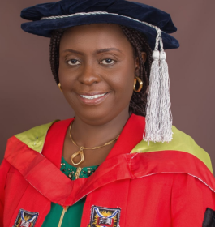
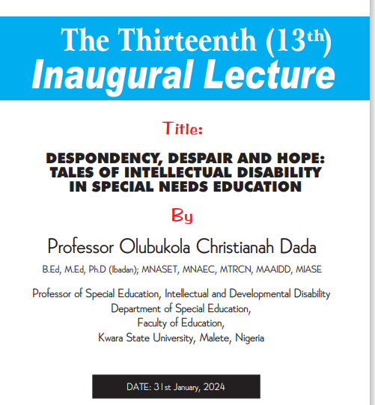

Slide 2
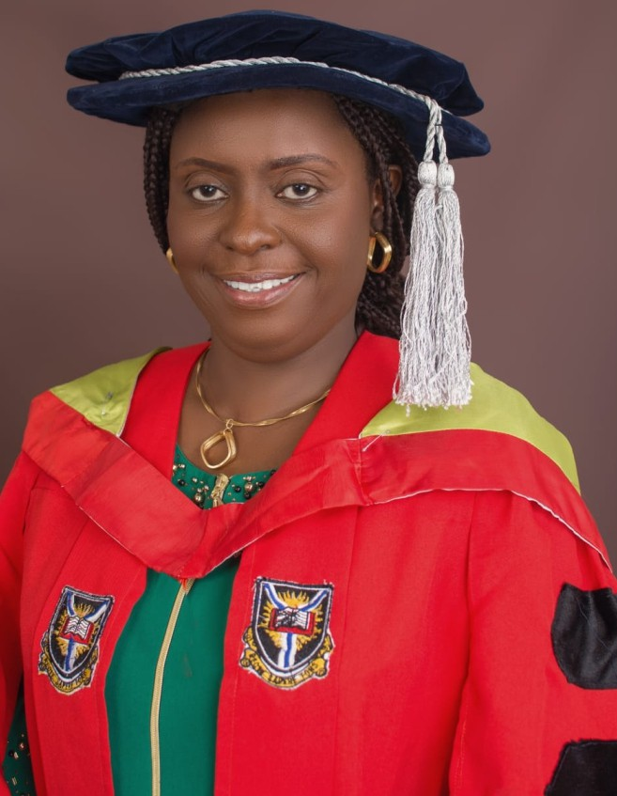
Professor Olubukola Christianah Dada
B.Ed, M.Ed, Ph.D (Ibadan); MNASET, MNAEC, MTRCN, MAAIDD, MIASE
Professor of Special Education, Intellectual and Developmental Disability

Slide 3

Courtesies
Acting Vice Chancellor,
Registrar,
Bursar,
University Librarian,
Dean, Faculty of Education,
Deans of other Faculties, Postgraduate Studies, and Student Affairs,
Distinguished Professors and Members of Senate,
Directors of Academic Units and Centres,
Heads of Departments and Units,
Academic Colleagues and Non-Teaching Staff,
Distinguished staff and students of Department of Special Education,
Gentlemen of the Press
Great KWASU Students,
Ladies and Gentlemen.

Slide 4
PREAMBLE
Today, I am deeply honoured to have the esteemed opportunity to present the 13th Inaugural lecture of Kwara State University, Malete, Nigeria. This marks the second inaugural lecture from the Faculty of Education, following Prof Titus Umoru's lecture of 18th January 2023 from the Department of Business and Entrepreneurship Education. Notably, this lecture stands as the pioneering discourse from the Department of Special Education, with me as the sole Professor within the department at present. As customary, an inaugural lecture aims to provide an insight to the audience through the lecturers' journey within their field, by providing a concise overview. In adherence to this tradition, my lecture will be no exception in offering a brief account of my professional path.

Slide 5
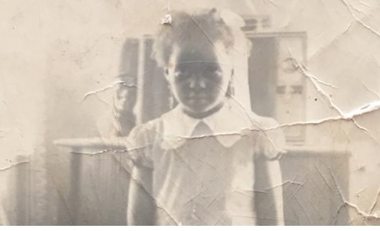
PREAMBLE
Growing up at Alafara-Olubadan, Ibadan, Oyo State, Nigeria in the 70's was difficult with many young children not ready to go to school but preferred hawking to fetch quick money. Being, the 7th child of a retired Assistant Superintendent of Police, not schooling was never an option. Baba enrolled me at the Vining Day Nursery and Primary School Molete, Ibadan in 1977. My aunt Miss Oluninyo Adedokun of sweet memory took me to school daily from Ojagbo to Molete while she attended Ibadan Grammar School Molete, Ibadan. I had accelerated promotion hence I skipped Nursery two and three and moved to Primary One after a year. On getting to Primary One, I became playful until I was reported to my sister by Mr Faturoti and within 24 hours, my sister, Chief Olufunmilayo Adewoyin reset my brain with cane. I am ever grateful to the duo of Auntie Olu and Sister Funmi, my first teachers for setting me on the right path. By the end of primary two, I was promoted to primary four.

Slide 6
PREAMBLE
By age 9+ in 1982, I attended St. Anne's School Molete, Ibadan, Oyo State for my secondary school education, and I graduated from the school in 1987. To the Glory of the Almighty God, I passed my West African School Certificate Examination (WASC) at 1st sitting. By 14+, I had finished my secondary education. I could not proceed to university because of my age and therefore opted for A' Levels at Olivet Baptist High School, Oyo, Oyo State where I served as the Assistant Senior Girl in 1989. I passed my A' Level in flying colours but I opted for the preliminary JAMB admission in Special Education. Initially, I wanted to study Law or Mass Communication but my relationship with my friend, Funke Lanihun, who has hearing- impairment and my cousin with intellectual disability made me to fall in love with Special Education. I was so inquisitive about why Funke could not talk but we always communicated with pen and paper and the reason my cousin was always drooling, not knowing it is all about disabilities. On getting to University of Ibadan where I studied Special Education, the Lectures of Late Dr. Emmanuel Adima, the field trip anchored by Prof. Michael Sunday Eniola attracted me more to Special Needs Education. Ever since my undergraduate days, I have seen Special Education as my Calling, and I am happy being a Special Educator today.

Slide 7

PREAMBLE
With a first degree in Special Education and English, I continued a master's degree, where I emerged as the best student and capped it with a PhD in Special Education in 2004. My teaching career started at the Federal College of Education Special (Oyo) in 1997 as a Lecturer III where I rose through the ranks and became a Chief Lecturer in 2013. I came to the Kwara State University in 2012 for my sabbatical leave during which I helped in the commencement of Special Education programme and by 2014 I joined the service of the University as a full time Senior Lecturer. By dint of hard work and grace of God, I was promoted as a full Professor of Special Education in 2021. I became the first Professor of Special Education and first female Professor in the Faculty of Education of Kwara State University.

Slide 8
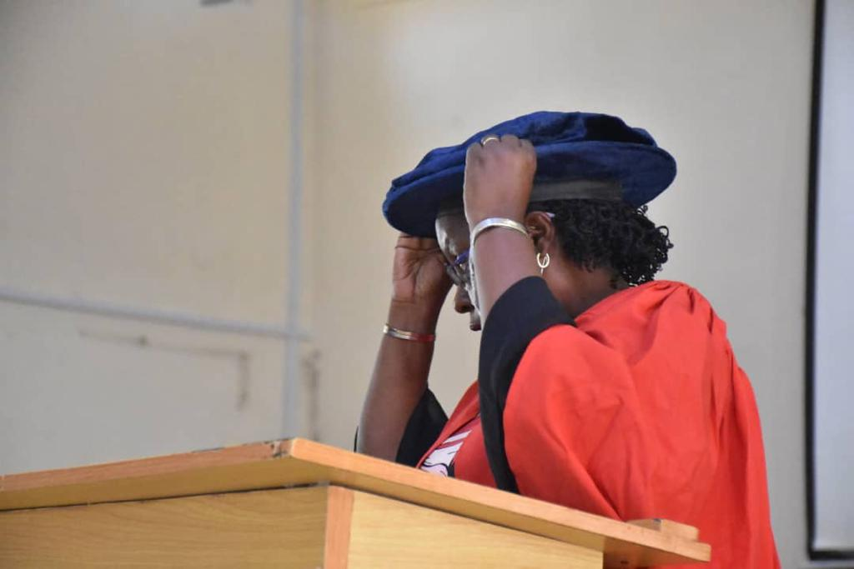
Mr. Acting Vice-Chancellor, this day, I will give a summary of my contributions to this distinguished audience by talking about the challenges facing individuals with disabilities especially those with intellectual disability which I have tagged Despondency, Despair and Hope: Tales of Intellectual Disability in Special Needs Education. But before that, I will give a brief historical account of Special Education.

Slide 9
INTRODUCTION

Slide 10
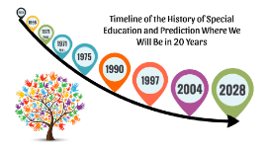
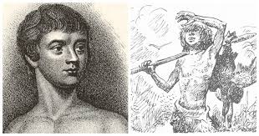
Victor the Wild Boy of Aveyron

Slide 11

Special education has a long and complex history, marked by changing attitudes towards disability and evolving educational practices. Disability and education are not new phenomena, as evidenced in the historical account of special care for individuals with disabilities in ancient times. The history of special education dates to primitive societies and ancient civilizations such as Greece, Rome, and Egypt where individuals with disabilities were often excluded from society because they were thought to be possessed by evil spirits and sometimes even killed. However, there were some instances of special education during these times, such as the education of blind children in ancient Egypt. Some ancient societies, such as the Greeks and Romans, recognized the potential of individuals with disabilities and provided them with specialized education and training.

Slide 12
By the 18th century the modern history of special education began with change in attitudes towards individuals with disabilities when Jean-Marc Gaspard Itard worked with a boy named Victor, who was found living in the wild, in the woods of Aveyron, France and unable to communicate (Smith 2013). He was pronounced an incurable idiot. Itard refused to believe that Victor was uneducable and began intensive training with him, alongside another Frenchman, Edouard Seguin. Itard's work with Victor is considered the first documented case of special education at the beginning of the nineteenth century and the first attempt to educate an individual with mental retardation now intellectual disability.

Slide 13
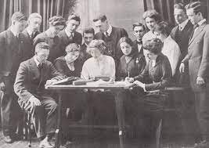
Cont……
In the 1920s and 1930s, the field of special education began to gain recognition as a legitimate field of study with the establishment of the first university-based special education program at the Columbia University in 1924. The 1950s and 1960s witnessed several significant developments in special education especially the1954's landmark Supreme Court case of Brown v. Board of Education which ruled that segregation in schools was unconstitutional. That decision paved the way for the integration of students with disabilities into mainstream classrooms

Slide 14
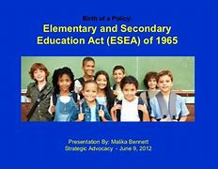

Special Education Acts
Elementary and Secondary Education Act (ESEA) 1965
Rehabilitation Act 1973,
Individuals with Disabilities Education Act (IDEA) 1975,
The Education for All Handicapped Children Act (EAHCA) 1975.
Nigeria Disability Decree 1993
Discrimination against persons with disabilities (Prohibition Act 2018)

Slide 15


SPECIAL EDUCATION – A DISCIPLINE OF HOPE
Ag. Vice Chancellor Sir, special education or special needs education is the practice of educating students with special needs in a way that address their differences and needs. This process involves the individually planned and systematically monitored arrangement of teaching procedures, adapted equipment, and materials in accessible settings. The interventions are designed to help learners with special needs to achieve a higher level of personal self-sufficiency and success in school and their community, than may be available if the student were only given access to a typical classroom education. It is a unique type of educational provision for students who cannot gain maximally in the regular classroom system without adequate provision of specialized equipment and materials, and this makes special education to be different from other types of education.

Slide 16
Special education programmes are designed for those students who are mentally, physically, socially, and/or emotionally delayed. This aspect of delay is broadly categorized as a developmental delay that places them behind their peers. Due to these special requirements, students' needs cannot be met within the traditional classroom environment. People with special needs are, therefore, those who experience/manifest more than the usual difficulties and problems in learning and training as normally offered in regular schools. They are those who need closer personal attention, some modifications and adaptations of the school routines and practice, general curriculum, and approaches to teaching and learning to attain their optimum learning levels and development. However, they are first and foremost, learners like any other learner who can be and should be taught in regular schools and classrooms by teachers who are painstaking enough to recognize and understand their problems and difficulties, and who are innovative enough to find appropriate methods and approaches to meet their special learning needs.
SPECIAL EDUCATION – A DISCIPLINE OF HOPE

Slide 17
SPECIAL EDUCATION IN NIGERIA
Neglect
Discrimination
Abandonment
Label
Infanticide

Slide 18
Elizabeth Torrey, an American missionary, and a devoted educationist was the first to start the education of the intellectually disabled in Nigeria. She established a child placement treatment school at Apapa, Lagos in 1965. The education of the intellectually disabled in Nigeria ever since, had witnessed tremendous growth. Several schools were established to cater for the needs of the intellectually disabled. Also, the intellectually disabled were educated alongside other disabled children. In most cases, units were established in special schools to take care of the educational needs of the intellectually disabled, where they were taught subjects such as English Language, Mathematics, Family Living, Elementary Science, Arts, and other basic, school subjects. Oftentimes, emphases were laid on these core subjects for them rather than practical and vocationally oriented subjects with which they could be gainfully employed (Dada, 2006).

Slide 19
Basic Steps in Special Education
Identification
Child Evaluation
Eligibility
Writing of Individualized Education Programme (IEP).
Provision of Services
Re-evaluation of Child
Progress Report
Review of IEP

Slide 20

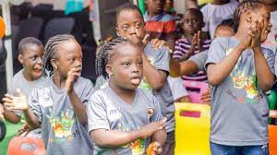
WHAT IS DISABILITY?
Disability is a disadvantage, deficiency—especially a physical or mental impairment—that restricts normal achievements, that is, something that hinders, incapacitates, or disqualifies” an individual from performing or functioning optimally.
Different Categories of Disabilities
Persons with Intellectual Disability

Slide 21
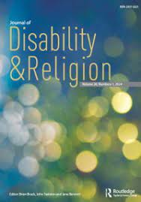
DISABILITY: THE MYTH AND RELIGIOUS PERSPECTIVES
This theme was exclusively reported by Adegbindin (2018) in his paper titled “Disability and Human Diversity: A Reinterpretation of Ẹni-òòṣà1 Philosophy in Yorùbá Belief.‘’
It was reported that Hippocrates, the Greek physician, contests the view of those who argue that disabled parents usually had disabled offspring. But the views of both Plato and Aristotle are not reconcilable with Hippocrates'.

Slide 22

Like what obtained in ancient civilization, the mystical connotations of disability are well reflected also in Judaism, Christianity, and Islam.
In Judaism, disability is often couched as evidence of God's punishment. The Jewish official religious structures tend to marginalize people with disabilities by exempting them from ritual acts since such acts required that priest or supplicants have no physical defects, implying the view that “holiness involved wholeness”
Although Christianity, unlike Judaism, does not trace disabilities to God's wrath, it however suffers the same problem of interpretation as Judaism. While the most popular Christian opinion is that people with disabilities represent “the media through which God communicates messages of mercy and power”.
Martin Luther, the sixteenth century religious reformer, once remarked that children with disabilities be drowned on the grounds that they were incarnation of the devil.
However, Christianity, through Jesus' encounters with people with disabilities, suggests that a man's disability does not devalue his worth, thereby dissolving the claim that disability has a divine origin.

Slide 23

One aspect of Islamic thought made an effort to ''normalize disability and to think of abilities and disabilities as one aspect of human condition within the range of possible characteristics bestowed by Allah” (ibid, 300). Holy Prophet Muhammed was reported as follows: ''He reassured the disabled that their disabilities are not punishment, but it is a means for their sins to be forgiven. The Prophet said that every time a Muslim is faced with a calamity, even hurt by a simple thorn, he or she would have his or her sins forgiven''. Bazna and Hatab (2005) conclude that the concept of disability, in the conventional sense, is not found in the Qur'an. Rather, the Qur'an concentrates on the notion of disadvantage that is created by society and imposed on those individuals who might not possess the social, economic, or physical attributes that people happen to value at a certain time and place.

Slide 24

Disability, among the Yorùbá, has a mythological origin. It is strictly associated with Òrìṣà-ńlá or Ọbàtálá, a Yorùbá deity, regarded as the supreme deity of the Yorùbá pantheon (Idowu 1962; Parrinder 1973). According to Ìdòwú (1962) Òrìṣà-ńlá is the sculptor-divinity who has been given the prerogative to create as he chooses, so that he makes man of shapely or deformed features. The hunchback, the cripple, the albino, are regarded to be special marks of his prerogative, either signifying his displeasure at the breach of some taboo, or to show that he could do as he likes.
The “defective” in this category are called Ẹni Òrìṣà i.e., the votaries of the Òrìṣà (Idowu 1962). In explaining how certain people come to be ugly or deformed”, Awólàlú (1979) remarked that, “the Yorùbá claim that the albinos (àfín), the dwarfs (aràrá), the hunchbacks (asuké), the cripples (arọ) and the dumb (odi) are created like that by Òrìṣà to make them sacred to him”.
Òfún- 'yẹ̀kú, an Ifá verse, corroborates Awolalu's point by hinting on how the babaláwo pays homage to the disabled before the process of divination.

Slide 25
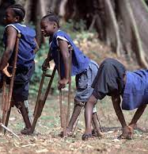
Ìbàabuké
Ìbàarọ
Ìbààfín
Mo júbàaràrá
Kí n tótẹnàlódù.
(Homage to the hunchback Homage to the cripple Homage to the albino
I pay homage to the dwarf. Before I proceed with divination.)
Reference to these four sets of disabled individuals in a few Ifá verses attests to their strong affiliation with the deity. Another verse of Òfún- Yẹ̀kú reads:

Slide 26
Ìyàndá, Ìyàndilẹ́
A díáfúnAbuké
A bùf'Árọ
A bùf'Aràrá a-borí-pàtàkó, òun Àfín
Tí wọ ́nṣe wọléwọ̀de Òrìṣà…
Ìyàndá, Ìyàndilẹ́
(Undertook divination for the Hunchback For the Cripple
For the Dwarf with a big head, also the Albino
Who were Òrìṣà-ńlá's companions…)
As a matter of fact, the Yorùbá language and oral tradition are replete with sayings that establish these individuals as companions of Òrìṣà-ńlá. This, by implication, shows that it is not out of place to categorize the hunchback, the cripple, the albino, and the dwarf as the major ẹni-oòṣà and others—the blind, the dumb, persons with “invisible disabilities”, and so on—as the minor ẹnioòṣà.

Slide 27
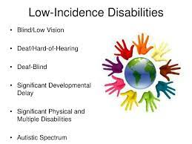
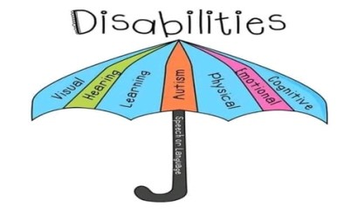
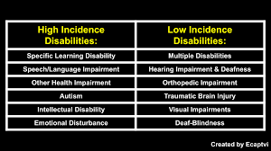
CATEGORIES OF DISABILITIES

Slide 28
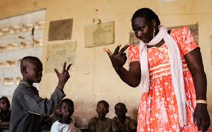
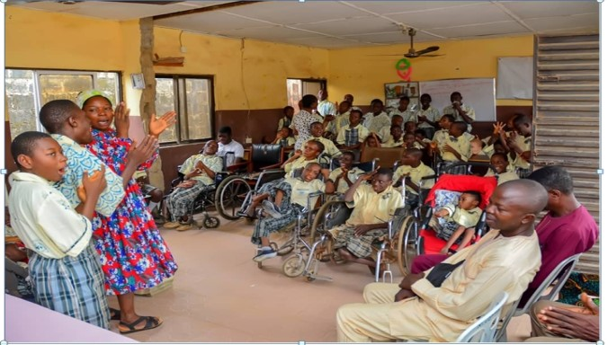
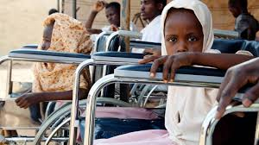
CATEGORIES OF SPECIAL NEEDS
Sign Language Instructor
Cross section of Students with Intellectual Disability and Physical and Health impairment.
Pupils on a wheelchair

Slide 29
Intellectual disability, formerly referred to as mental retardation, is not an inherent trait of any individual but instead, it is characterized by a combination of deficits in both cognitive and adaptive behaviour. The severity of the intellectual disability is determined by the discrepancy between the individuals' capabilities in learning and the expectations of the social environment.
Historically, the categorization of intellectual disability has depended on the extent or level of intelligence impairment, as determined by Intelligence Quotient Tests. The prevalent classification approach mentioned in professional literature encompasses four levels of intellectual disabilities, structured in accordance with the spectrum of intelligence quotient scores. To enhance clarity, the table provided below delineates intelligence test scores, traditional classifications, levels, educational requirements, and the support necessary for individuals with intellectual disability.

Slide 30
Classification of Intellectual Disability
Intelligence Test Score | Traditional | Level | Educational | Support
50-55 to 70 | Moron | Mild | Educable | Intermittent
35-40 to 50-55 | Imbecile | Moderate | Trainable | Limited
20-25 to 35-25 | Idiot | Severe | Totally Dependent | Extensive
Below 20-25 | Idiot | Profound | Totally Dependent | Pervasive

Slide 31
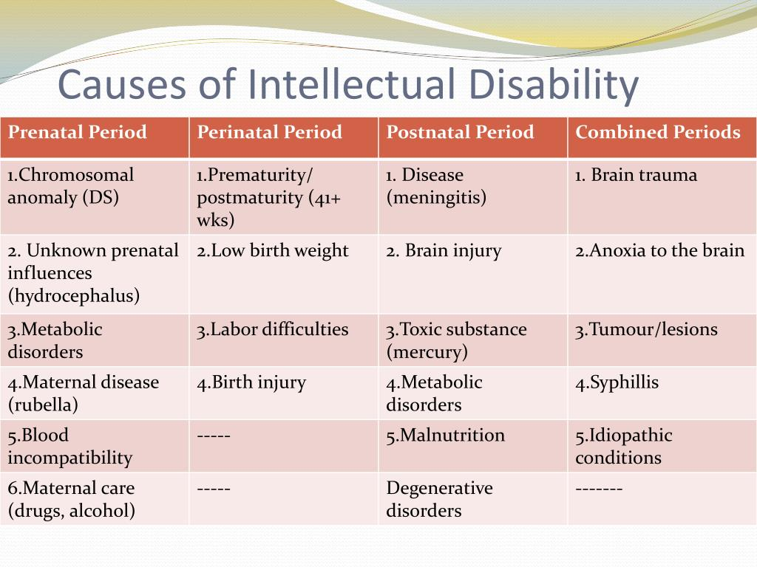
CAUSES OF INTELLECTUAL DISABILITY

Slide 32
MY CONTRIBUTIONS AS A SPECIAL EDUCATOR

Slide 33
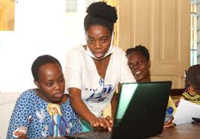
Place of computer in the education of persons with intellectual disability ( Dada, 2011).
Ag. Vice Chancellor Sir, a paper titled the place of computer in the education of persons with intellectual disability posited that computer has become part of everyday activities of human beings (Dada, 2011). It is now a prominent feature of life. It is used for learning new skills such as drills, mathematical activities, meeting daily needs like the use of microwave ovens in the house and other places, ATM machines and enjoying leisure time activities. The use of computer determines individual's success in this computer age.

Slide 34

As a result, there is growing recognition that computer skills are critical for students with intellectual disability to achieve successful outcomes.
The use of computer in the education of persons with intellectual disability can assist them in the following areas:
Improved academic achievement.
Accessibility to general curriculum.
Development of peer relationships.
Employment opportunity.
Improved recreation and leisure activities.

Slide 35

Use of Electronic Technologies by Persons with Disabilities (Dada & Oni, 2012)

Slide 36
The use of electronic technologies, like computers, cell phones, internet, and electronic organizers, hold great promise for individuals with intellectual disability as it allows communication with people around the globe, the conduct of work at home during leisure hours, effective organization and retrieval of information, and access to mainstream culture (Dada & Oni 2012; Arun & Jain 2022).
For students with intellectual disability, electronic technologies have been shown to create more conducive learning environments by allowing students to learn at their own pace, repeat steps as necessary, develop a feeling of control over the learning process, learn effective systems of organization and thereby enhancing their academic skills (Carey et al. 2005; Dada & Oni 2012).
Purposive sampling technique was used to select 200 persons with intellectual disability in primary schools in Oyo State. This group comprised 109 males and 91females. Their ages ranged from 10 to 25 years with a standard deviation of 4.12 years. The study revealed that the age of students with intellectual disability does not have significant effect on the use of electronic technologies

Slide 37

Our findings also showed that most of our participants made use of simple electronic technologies, such as the fan, radio, DVD, rechargeable lamp, and remote control. Our study also identified the use of more sophisticated technologies like organizers (15%), table phone (analog) (19.5%), laptop computer (23.5%), and the desktop computer (27.5%) among the participants (Dada & Oni, 2012). According to their responses, they make use of most of the electronic devices to make life comfortable for themselves (66%), some make use of them because others are using them (64%).

Slide 38
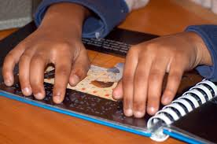
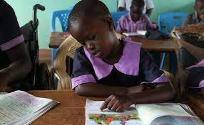
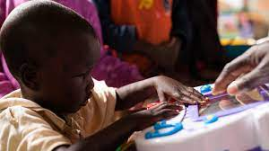
Accessibility and availability of instructional materials in the teaching of persons with intellectual and developmental disabilities (Ajobiewe, Shada, Dada & Ojuawo, 2011)

Slide 39
In a study by Ajobiewe, Shada, Dada and Ojuawo (2011) it was emphasized that instructional materials are very important in teaching and learning process. Persons with intellectual and developmental disabilities experience considerable difficulties in learning which demands a lot of efforts from the teachers. To achieve significant success the teacher needs to make use of instructional materials.
A total of two hundred teachers of persons with intellectual and developmental disabilities in Oyo State were purposively selected for the study. A descriptive design was used, and questionnaire used to elicit responses from them. The result showed that students with intellectual and developmental disabilities performed better when instructional materials are used to teach them (P <0.002, P<0.058).
Ag. Vice Chancellor Sir, the importance of instructional materials cannot be over emphasized in the teaching of persons with intellectual and developmental disabilities (Figure 5). They learn faster when instructional materials are available, effective, relevant, and adequate to the subject matter.

Slide 40
Teachers' Knowledge of and Attitude towards Autism Spectrum Disorder (ASD) (Dada and Sangobiyi, 2015)
Efforts towards inclusive education have increased for everyone irrespective of disability since UNESCO's Salamanca Statement. Adherence to an inclusive rights-based perspective is associated with a greater presence of students with disabilities, including Autism Spectrum Disorder (ASD), in regular classrooms. Teachers play a crucial role in the inclusion of children, teenagers, and young people. Teachers' knowledge about ASD is necessary as many of them can act as knowledge broadcasters of social change towards an inclusive education.
Most school children do not acquire necessary skills and fail to learn at school due to various conditions. One of such conditions may be developmental disorders such as intellectual disability, learning disabilities, Asperger syndrome, and autism among
others. Autism spectrum disorder (ASD) is defined as a heterogeneous neurodevelopmental disorder characterized by persistent deficits in social communication, social interaction and restricted and repetitive patterns of behaviour, interests, or activities (American Psychiatric Association 2013).
In Nigeria, there is paucity of information on the prevalence of ASD as research into this area has received little attention

Slide 41
Ag. Vice Chancellor sir, in lieu of the above, Dada and Sangobiyi, (2015) evaluated the level of awareness and knowledge of teachers about ASD in schools in Kwara State. One hundred and twenty teachers (120) were randomly selected across ten (10) public schools in Ilorin Metropolis.

Slide 42
Our study on the Teachers' Knowledge of and Attitude towards Autism Spectrum Disorder (ASD) among Primary School Children in Ilorin Metropolis revealed that majority (65.0%) of respondents do not have the knowledge of autism spectrum disorder (Table 3; Dada & Sangobiyi, 2015). Furthermore, majority of the teachers have not received specific trainings on the diagnosis and nature of autism.
We also found that the rate and level of belief about ASD among teachers varies with different opinions viz:
That the child with ASD
intentionally creates problems and they could help lessen the triggers to these behaviour
is responsible for his or her behaviour and think that the child could be upset by the smallest things and
needs increased counseling and help from experts and that the environment could be changed to lessen the behaviour (Dada &Sangobiyi, 2015).

Slide 43
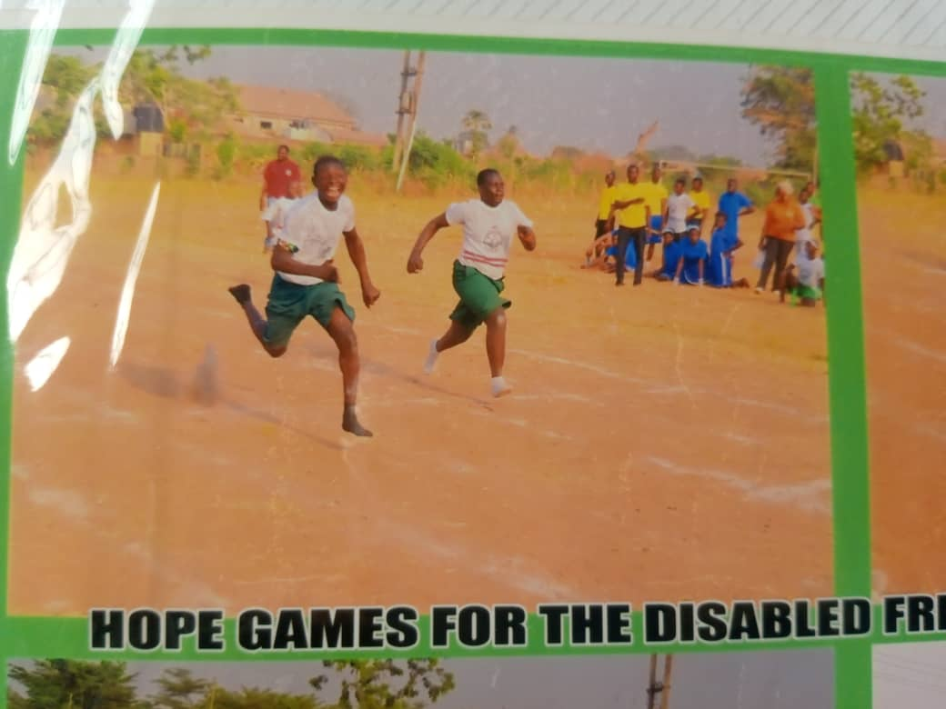
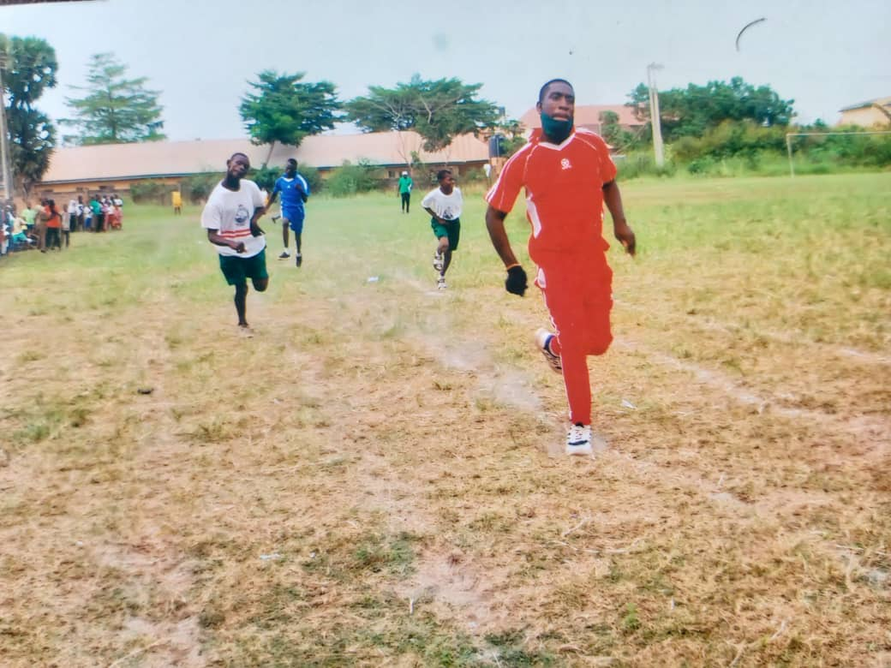
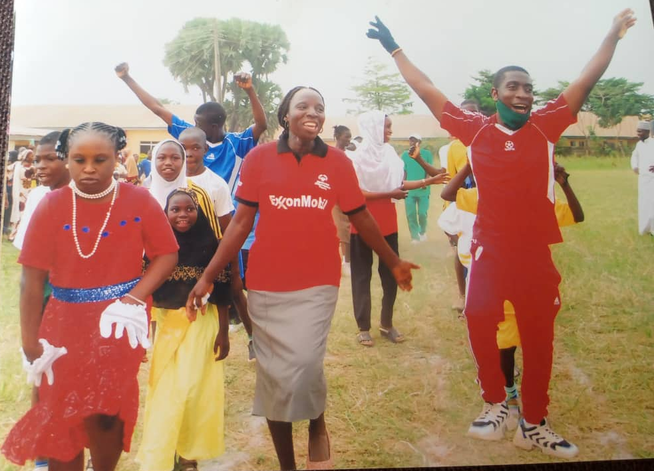
The Need for Adaptive Physical and Health Education to Promote Inclusive Education among Pupils with Intellectual Disability (Dada & Olaniyan, 2019)

Slide 44
Ag. Vice Chancellor Sir, intellectual Disability (ID) is an extremely stigmatising condition that affects the intellectual functioning and adaptive behaviour of some individuals during the developmental period. Research have consistently shown rise in the number of out-of-school individuals with intellectual disability, which as a matter of urgency must be addressed if the sustainable development goal four (SDG4) is to be achieved. Children with intellectual disability cannot be left out, ignored, or not catered for. That is why inclusive education has been recommended by the Federal Government of Nigeria through the National Policy
on Education.

Slide 45
We advised that physical education should be taught because it helps children develop the knowledge, fitness levels, motor skills, and personal and social skills to obtain the goal of a lifetime of physical activity and health. Regular Physical Education can improve children's muscular strength, flexibility, cardiovascular endurance, and body composition. Physical Education also teaches kids about the health benefits of making healthy food choices (e.g., eating more fruits and vegetables), which in turn can help prevent childhood obesity. Physical Education helps children socialize with others successfully while providing opportunities to build self- confidence through participation in dances, games, and sports.

Slide 46
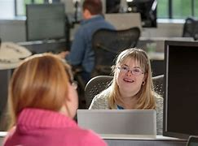
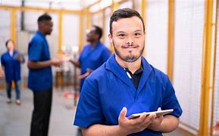
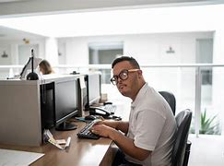
Employment of Persons with Intellectual Disability: Adeniyi and Dada (2012)

Slide 47
Ag. Vice Chancellor sir, billions of persons live with disabilities in the world and more than eighty (80) percent reside in the developing countries. Most of these people are marginalized and disproportionately poor, simply because they are excluded from education, employment, and political processes because of their communication, physical and sensory impairments. To this end, persons with disabilities encounter several barriers as they make the decision to enter or re-enter the workplace, employment, or job. Some of these barriers might be described as external as they involve environmental and workplace supports such as transportation, accommodations, and job opportunities (Loprest & Maag, 2001). Other barriers might be described as internal, as they involve self-perceptions regarding adequacy of work experience, work skills, and vocational beliefs that are necessary considerations in the job search process (Bialik & Mhiri, 2022). Whatever the locus of these barriers, there is ample evidence that they may represent impediments to work. Available data on employment have shown that adults with disabilities have continued to lag their nondisabled counterparts in terms of hours worked, wages earned, and unemployment and under- employment rates

Slide 48
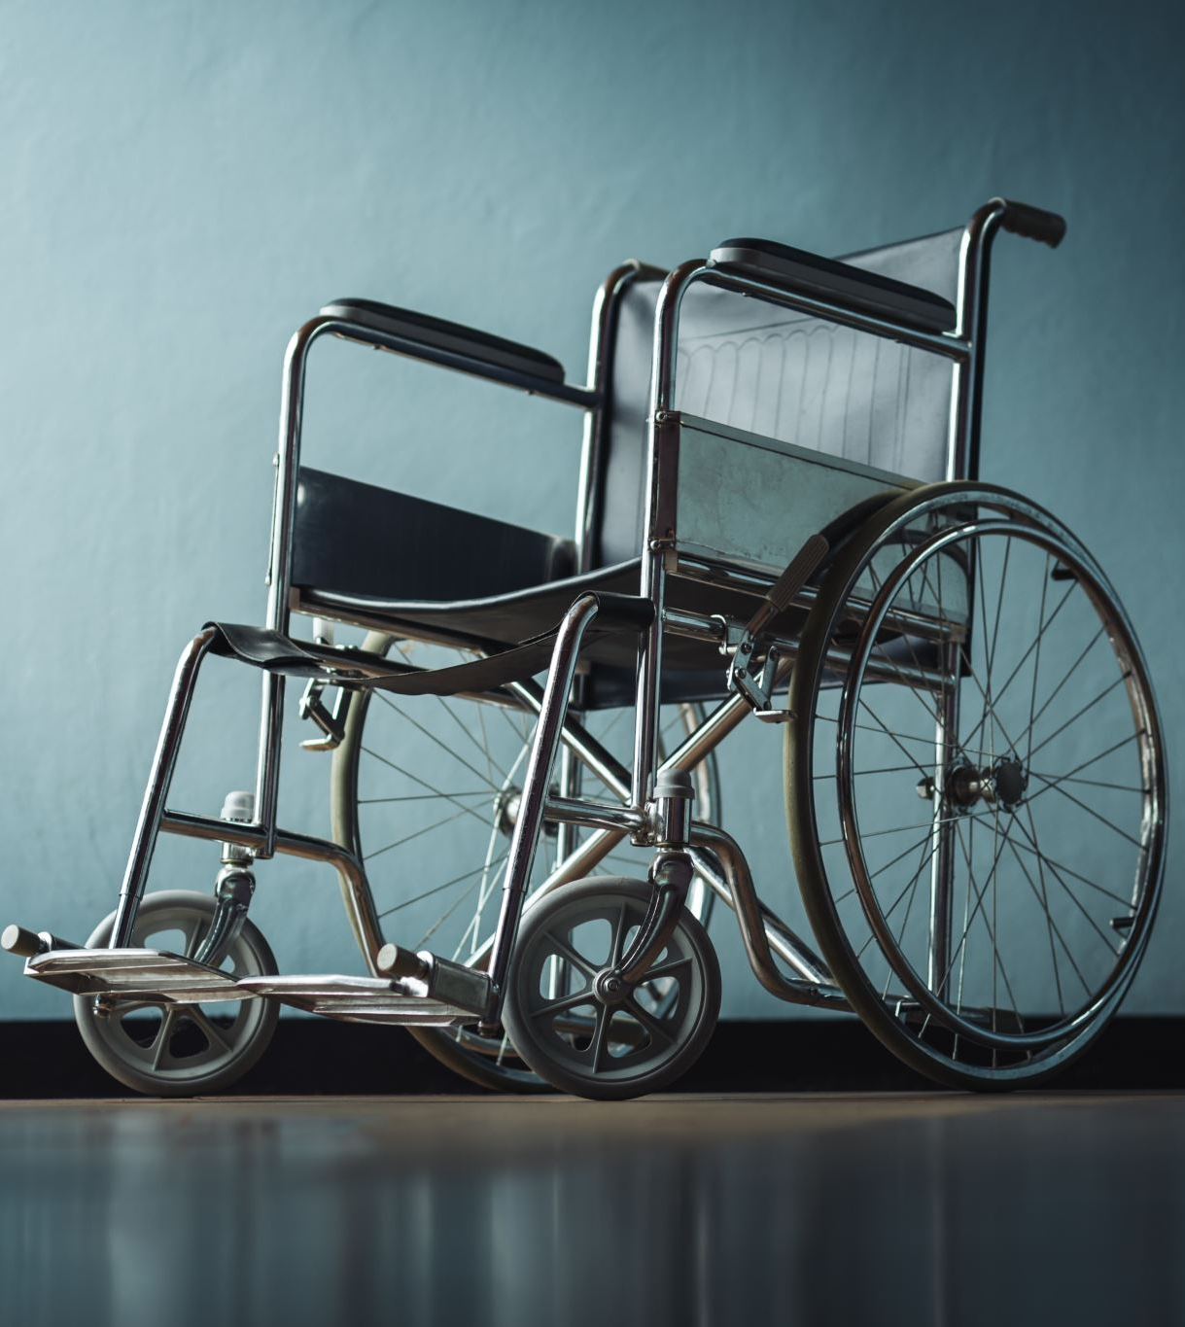
The 1990 Americans with Disabilities Act require that employers employ 15% or more employees to make reasonable accommodations so that quality workers with disabilities have equal employment rights. Among provisions that address the right of person with disabilities to employment are Discrimination Act (1992) in the USA and Disability Discrimination Act Section 15, 4, b in Australia. Similar provision tagged “The Discrimination Against Persons with Disabilities (Prohibition) Act 2019” was enacted in Nigeria, to provide equal employment opportunities among other rights, to individuals with disabilities in the country.
It is against this background that Adeniyi and Dada (2012) investigated the attitudinal and environmental factors that determine job discrimination against persons with disabilities. The findings revealed that attitude and the environment are the major determinants of job discrimination against persons with disabilities. There was no significant difference between private and public employers in their disposition towards persons with disabilities in provision of job.

Slide 49
As is true for those without disabilities, people with disabilities have a right to fair and equal wages, working hours and opportunities, and the cultural benefits of being employed in the community. Unfortunately, throughout the world, individuals with disabilities remain employed at lower rates than people without disabilities, and when employed, often they are in sheltered settings. Based on these findings we recommended that awareness and sensitisation programmes should be done to intimate employers of labour about persons with disabilities to know that employing them would be beneficial to both parties and would make persons with disabilities to be less dependent.

Slide 50
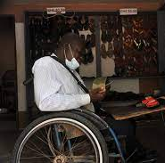
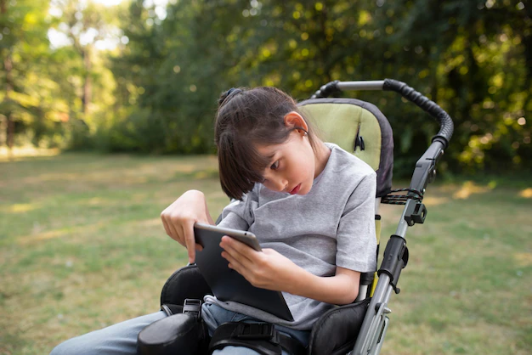
Educational and Vocational Services for Persons with Intellectual Disability (Dada, 2011)

Slide 51
Ag. Vice Chancellor sir, individuals with intellectual disability have unique needs and require specialized educational and vocational services to help them achieve their full potential and have fulfilling lives. One of the most critical aspects of educational services for individuals with intellectual disability is early intervention. Early intervention programmes provide children with intellectual disability and their families with the necessary support, resources, and services to optimize the child's development and potential. Dada (2011) in a study conducted on the educational service for people that are mentally and physically challenged in Ibadan, Oyo state, revealed that the services provided for intellectually and developmentally disabled were not adequate with only 44% agreeing that educational service is adequate and available while 56% disagreeing with the adequacy as indicated in table 4 below.

Slide 52
Vocational services are critical for individuals with intellectual disability, as employment is essential for their social, emotional, and financial well-being. Vocational services should focus on developing job skills, work habits, and social skills necessary for successful employment. To access the level of vocational support services provided to individuals with intellectual disability Dada and Akanni (2012) conducted a study on vocational rehabilitation as a channel for enhancing the independence of persons with intellectual and developmental disability using samples of 50 persons with intellectual and developmental disabilities. We found that the parental financial background has significant effect in enhancing the independency of persons with IDD (Dada & Akanni, 2012). Similarly, parental educational and occupational status had significant influence on vocational rehabilitation as a channel of enhancing the independence of the IDD.

Slide 53
We also recommended the supported employment approach to further enhance the employability of individuals with intellectual disability and have been shown to be effective in increasing employment rates and job satisfaction for them. As educators and professionals, it is our responsibility to ensure that individuals with intellectual disability have access to these essential services and supports, and that we are continuously improving and refining our practices to meet their unique needs.

Slide 54
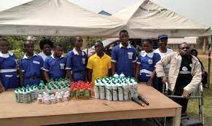
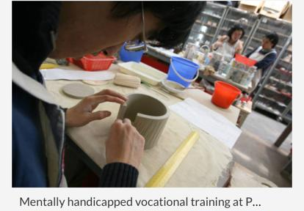
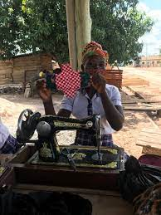
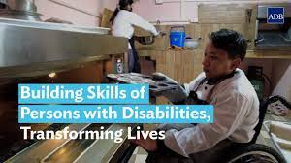
Self-help Skills Acquisition (Dada, 2005)

Slide 55
Self-help skills are daily and routine activities of personal care activities appropriate to the age, gender, and environment necessary for a living that are gradually attained to give more independence for persons with intellectual disability. It is about learning life skills which includes getting dressed, having a shower, brushing teeth, eating, bathing, grooming, use of the toilet and mobility in the home, so that they can look after themselves without depending on others.
Persons with intellectual disability because of their low intelligence quotient and poor adaptive behaviour lack the necessary self-help skills that are needed for daily living in performing basic skills such as personal grooming, dressing, and eating. The school and the home may not pay particular attention to self-help skills of the trainable intellectually disabled even though it is a vital part of the school curriculum of children with special needs. As a result of this, a study was conducted with the aim of determining whether socio-economic status affect the acquisition of self-help skills (Dada, 2005).

Slide 56
Based on the findings of this study, a child from high socio- economic class or an enlightened and educated background responded better to self-help skill than one from a non- enlightened and illiterate background. A culturally stimulating background can help a child to develop the right kind of attitude to his/her tasks and this may assist the child in having a good stand in performing self-help skills. Equally, children from low socio- economic status home have little or no intellectual support at home. This reflected itself in their poor performance of self-help skills.

Slide 57
In as much as poor self-help skills exhibition is one of the numerous problems confronting persons with intellectual disability, it is imperative for policy makers, and all concerned educational bodies to fashion a way to attach behaviour modifiers to special schools. Parents should be encouraged to have adequate contributions and expectations towards their children with intellectual disability. They should neither be over-pampered nor abandoned, as there is ability in every disability. Parents need to develop positive attitude towards children with intellectual disability, devote more time to them and be actively involved in their programs

Slide 58
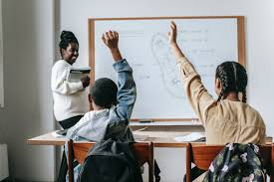
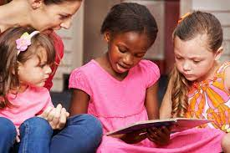
Social Interactions and Academic Performance (Dada, 2020).

Slide 59

Research on the influence of social interactions on the academic performance of students with intellectual disability in an inclusive classroom was conducted recently by Dada in 2020. The study revealed that social interaction influences the academic performance of students with intellectual disability in inclusive schools in Ilorin East Local Government Area to a high extent (mean= 3.1). It was also shown that there is no significant difference between social interaction of male and female students with intellectual disability (p<0.05). It was found out that there is no significant difference between language skills and social interaction of students with intellectual disability (p<0.05) and lastly, it showed that there is no significant difference in the mean rating of students regarding the extent of influence of social interaction on academic performance based on religion (p>0.05).

Slide 60
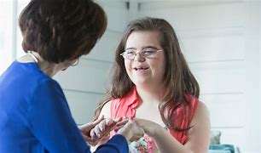
Based on the finding it was concluded that social interaction had significant influence on academic performance of students with intellectual disability in an inclusive classroom. Public enlightenment and education programmes should be put in place for teachers, parents, and students on how best to interact and guide learners with intellectual disability

Slide 61
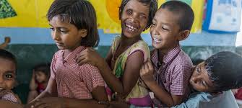
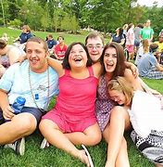
Friendship Skills

Slide 62
Ag. Vice Chancellor Sir, school is a social institution saddled with the responsibility of developing learners in all aspects of life. As a social setting, the school enables various interpersonal relationships such as students to teachers, teachers to teachers, students to students and so on. In the school system, academic skills are acquired as well as social skills. One factor that school systems often fail to consider is the impact of friendship on academic performance in school. Based on this a study was conducted on the impact of friendship skills on academic performance of students with intellectual disability in Ilorin metropolis, Kwara State (Dada, 2019). Findings revealed that the level of friendship skills among students with intellectual disability was high. This means that friendship skills had an impact on academic performance of students with intellectual disability in Ilorin metropolis. It was also discovered that friendship skills deficits affect male and female students with intellectual disability the same way. It was recommended that special needs schools should incorporate friendship skills training into routine teaching of students with intellectual disability to maintain and improve on their current level of friendship skills for improved academic performance (Dada, 2019)

Slide 63
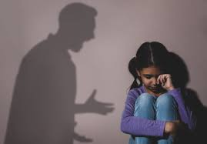
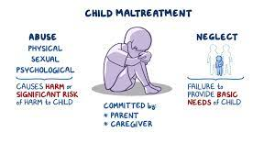
Determinants of Child Abuse among Persons with Disabilities (Dada, 2016).

Slide 64
Ag. Vice Chancellor sir, child abuse has become a focus of concern today. Persons with disabilities have often suffered more abuse from parents and adults largely because of their disabilities and their lack of assertiveness attributable to poor self-concept. The signs and symptoms of abuse in persons with disabilities have not been effectively recognized, assessed, or treated. Many people have difficulty believing that persons with disabilities can be victims of physical abuse, sexual abuse, emotional abuse, and neglect. This misconception creates an exaggerated level of vulnerability, as persons with disabilities, and their families, are not prepared psychologically, intellectually, or physically to resist or respond to these abuses (Dada, 2016).

Slide 65
The combination of the four variables jointly accounted for the total variance in the abuse of person with disabilities. Physical abuse, neglect and sexual abuse contributed significantly to child abuse, whereas emotional abuse was not significant. These three variables are the most important determinants of child abuse. However, the extent of contribution of each of these variables to the prediction of abuse among persons with disabilities differs (Dada, 2016). In order of potency to contribution to abuse, neglect ranked highest, followed by physical and emotional which are both ranked the least (Table 5; Dada,2016).

Slide 66
Counsellors are advised to create rapport and conducive environment to allow persons with disabilities relate their experience. Parents and caregivers are, therefore, advised to periodically monitor persons with disabilities for signs and symptoms of abuse and neglect.

Slide 67

Are we Ready to Marry Persons with Disabilities?

Slide 68
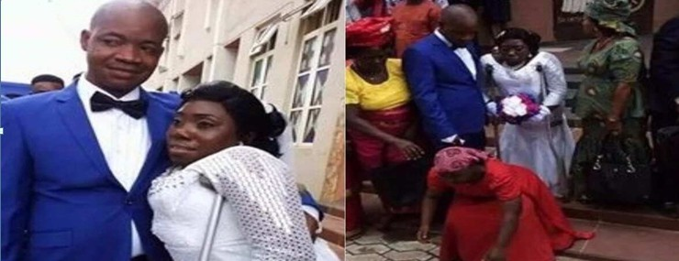
Couple with disability

Slide 69
Fundamental human rights include right to sexual relationships because they are critical to overall physical, emotional, and social health and well-being of individuals. Persons with disability are sexual beings, and deserve equal rights and opportunities to have, choices about, and access to their sexuality, sexual expression, and fulfilling relationships throughout their lives (Shah, 2017). United Nations Convention on the Rights of Persons with Disabilities (UNCRPD) guarantees disabled people the right to “enjoy legal capacity on an equal basis to others in all aspects of their lives (United Nations, 2006; Shah, 2017).
Marriage is an institution ordained by God, and if an individual has not decided to practice celibacy, sexual relationship and marriage will be on the front burner when an individual comes of age, irrespective of status of ability. In the field of special education, so many issues concerning persons with disabilities all over the world have been studied and reported which include their education, inclusion, career, empowerment, and recreation, helping them to develop social skills and how to manage them in general. However, issues relating to sexual relationship and marriage of persons with disability have received very little attention in our society.

Slide 70
Specifically, in Nigeria, persons with disabilities are still treated with caution by those without disabilities in marriage. The general attitude seems to be un-encouraging. Oladele and Dada (2007) conducted a research on attitude of tertiary institutions students towards marrying persons with disabilities in Oyo State. The choice of the respondents was strategic because they are active sexual groups who are thinking of dating and marriage possibly after school.
Our findings revealed that the attitude of students is generally negative towards marriage with persons with disabilities (Table 6). Many of the students are not ready to marry any person with disabilities. Female respondents, who were expected to be more liberal, soft, and compassionate, also have negative attitude towards marriage with persons with disabilities. The results showed pronounced negative attitude of the male students than the female students (Table 6).
To think or vehemently oppose the idea of persons with disabilities getting married means the society considers them as lesser human beings who are not fit to mingle with those without special needs. This is not only gross injustice but violation of their fundament right like any other person. Although marriage is a personal issue between two interested people, once they show interest, they should not be discouraged; they should rather be encouraged and supported

Slide 71

MY CONTRIBUTIONS TO THE COMMUNITY

Slide 72
Ag. Vice Chancellor Sir, I have made significant contributions to community development as a Lecturer at Federal College of Education (Special), Oyo and Kwara State University, Malete. I have focused on creating inclusive environments that accommodate diverse populations and promote equal opportunities for all individuals with Special needs which was spurred by openness and encouragement from the college and university authorities.

Slide 73
While at Federal College of Education (Special) Oyo, I was engaged in the rehabilitation of Persons with Special needs and today all of them are standing tall in the society and we still engage in different discourse. In 1999, I met a young man living with cerebal palsy that got admission into the Department of Rehabilitation Education. Aside bagging his NCE certificate, he was also rehabilitated. Today, Omo-Adua Nurudeen Olanrewaju is a master's degree holder and a Chief Examination Officer at National Examination Council (NECO) and happily married with a kid. Others with visual impairments are PhD holders and gainfully employed. Some are intellectually disabled and are gainfully employed in different walks of life. I cannot forget my friend Kabiru, whom I met at HLA Agodi Ibadan during my teaching practice days who told me about the interim government. Though, I thought I knew so much he drew my attention to this (Ijoba fi idi he). He also told me that being hygienic is part of him when I told him to handle my water with care. He told me in plain language that 'do you think I am not equally intelligent?'

Slide 74
Through these programmes, we have created a culture of social responsibility and civic engagement among members of the university community with the admission of students with disabilities (5 visually impaired and 4 hearing impaired in different programmes in the university – Mass Communication, Public Administration and Special Education at both Undergraduate and Postgraduate Levels). We have also organized a few community outreaches in sensitization programme for pregnant women on the causes and prevention of having children with disabilities held at Health Centre, Malete, Kwara State, Assessments, counselling, and reports on clients being referred to the Department of Special Education, self- prompted Community Outreach programme on Providing Drinkable and Hygienic Water for Alapo Community among others. For more than a decade, We have initiated the “Annual International Day for Persons with Disabilities” in the Department of Special Education, KWASU.

Slide 75
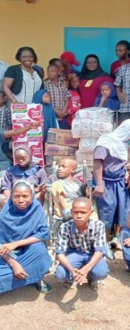
Overall, my contributions to community development at the university and my advocacy for inclusive education, community engagement, research, and innovation in special education have helped to create a more equitable and inclusive environment among students with special needs and their peers, faculty members and community dwellers at large.

Slide 76

Ag. Vice Chancellor sir, I have been able to elucidate my contributions to the field of Special Education and the discipline of intellectual disability. No doubt, persons with intellectual disability would continue to be part of humanity as people can acquire a disability status at any age, from birth to advanced years. Having a disability, especially intellectual disability, does not exclude people from discovering and pursing their aspirations in life changing despondency, despair to hope. To make life more meaningful for persons living with Intellectual Disability, there is need for the utilization of assistive technology. Assistive Technology can compensate for limitations relative to mobility and speech for persons with Intellectual Disability. From the foregoing it could be seen that persons with intellectual disability can be included in all phases of life such as school, vocation, employment, marriage, among others. There is ability in disability
Conclusion

Slide 77
Recommendations
Parents should seek caring support for a child with intellectual disability because this condition could be challenging. Supports are needed from family, friends, professionals, support groups advocacy organizations and disability service providers in the community.
02
The strengths (passion and interest) of the person with Intellectual Disability should be focused on, as it is important to identify and address the challenges. It is of utmost importance to discover and encourage the interests and their talents and provide opportunities for them to develop new skills to enable them to be self-dependent, assertive, and self- reliant.
03
Technology would have a vital role to play in turning intellectual disability to greater ability with the advent of high-powered computing and artificial intelligence. Appropriate technology should be provided for persons with disabilities to make life easy and fulfilling.
01

Slide 78
Recommendations
There is also the need to build a strong team with special educators, health care providers and other professionals to develop a comprehensive support plan that will address the unique needs of each person with Intellectual Disability.
The school curriculum should also pay close attention to the peculiar needs of persons with Intellectual Disability as we are in the era of “No child should be left behind”.
4
5

Slide 79
Early identification and diagnosis are also paramount for persons with Intellectual Disability. No child should be left under lock and key as the era of infanticide is long gone. The earlier the diagnosis the better the prognosis.
There is the urgent need for the establishment of support centres for persons with special needs in all Tertiary Institutions in Nigeria. I must commend KWASU Management for taking the lead with the establishment of the Disability Support Office. These centres should be equipped with necessary facilities and competent professionals.
Recommendations
7
6

Slide 80
8
9
10
Commendation should be given to Joint Admission Matriculation Board for the establishment of CBT centres for students with special needs, the JAMB Equal Opportunity Group (JEOG) and provision of free UTME registration for interested students with disabilities. I also want to use this medium to solicit the establishment of more centres in each senatorial district.
Funding of Special and Inclusive schools in the country is also pertinent. Evaluation of these schools and personnel should be carried out periodically to enhance quality service delivery.
Government should rehabilitate and upgrade special and inclusive schools with modern facilities.

Slide 81

Acknowledgements

Slide 82
I want to express my gratitude to the Almighty God, through my Lord Jesus Christ, for bringing this day into existence. The fact that today is here is not due to human power or strength, but rather the grace of God that has supported and preserved me up to this point. All the glory and praise belong solely to God for the great things that have been accomplished and for even the greater things that He will do. In the words of the Psalmist, I joyfully proclaim: "You have made me so happy, Lord, because of all you've done for me! I sing for joy at what you've done!" (Psalms 92:4, Free Bible Version).
I hold my parents in the highest regard. I am deeply grateful for my late father, Pa Ezekiel Oladejo Akinola, who went above and beyond to ensure that I received the best education possible, despite retiring as an Assistant Superintendent of Police in 1976 when I was just four years old. My mothers, Mrs. Ajitoni Akinola (JP) and Mrs. Ruth Akinola (JP), are unwavering sources of support. To all of you, I want to express my heartfelt appreciation and love.

Slide 83
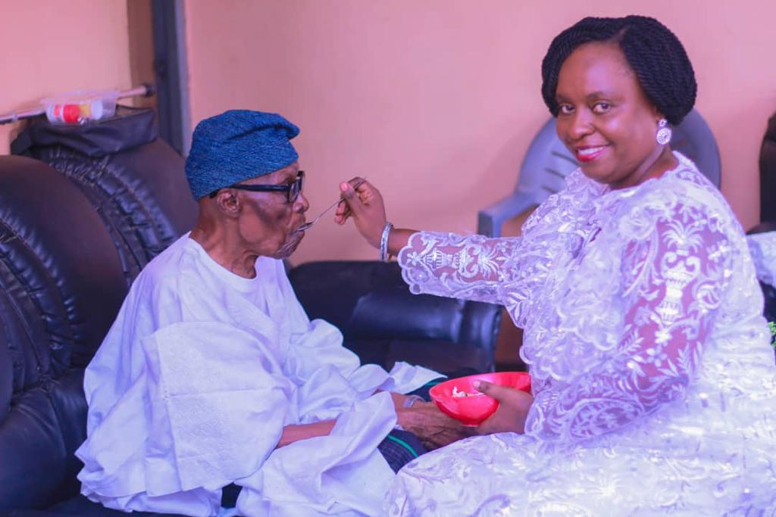
Pa. Ezekiel Oladejo Akinola

Slide 84
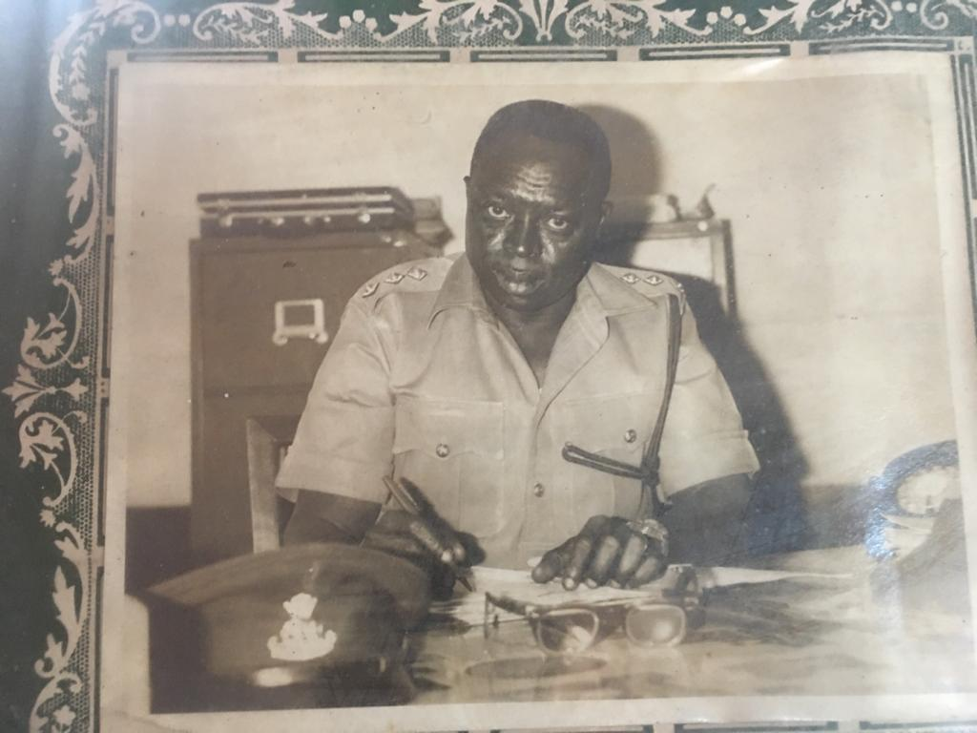
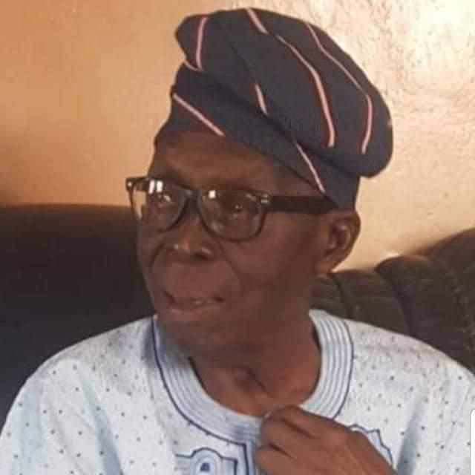
My Father when he was in Nigeria Police Service

Slide 85
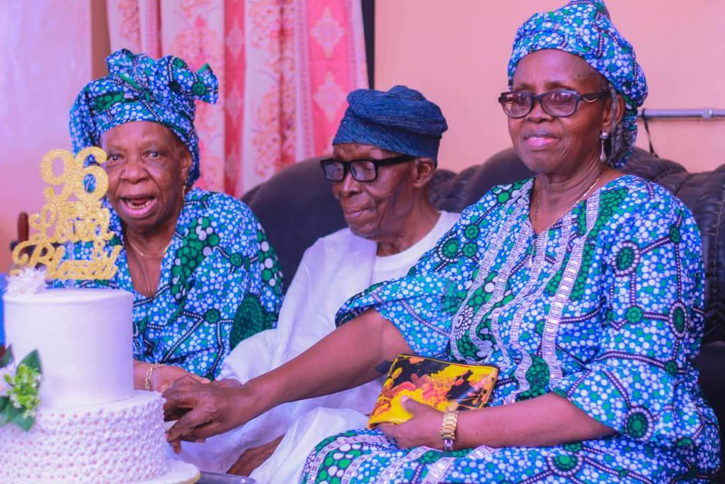
My Parent

Slide 86
I would like to extend my sincere appreciation to Acting Vice Chancellor, Prof. Shaykh Luqman Jimoh, for his exceptional dedication to special needs education at the university. His commitment has greatly supported students and staff with disabilities, and he deserves recognition and admiration. I am also grateful to former Vice Chancellor Prof. AbdulRasheed Na’Allah for facilitating my sabbatical leave and securing my permanent role as a Senior Lecturer in the Special Education Department.
I acknowledge the contributions of one-time Acting Vice Chancellor Prof. Sakah Mahmud, who fostered the growth of the department and promoted me to the position of Associate Professor. My deepest gratitude goes to the former Vice-Chancellor, late Professor Muhammed Mustapha Akanbi SAN, who appointed me as a full Professor in special education. Though he is sadly not here to witness the outcomes of his efforts, I am truly grateful for his belief in me. I also appreciate the Registrar, Dr. Mrs. Kikelomo Sallee, and the staff of the Registry, as well as the Bursar, Mallam Mohammed Abubakar Sanni, and the Bursary Staff. I am thankful to Librarian Prof. Abdulsalam Salman and the Library Staff for their invaluable contributions.

Slide 87
I am indebted to the Faculty of Education for playing a crucial role in my journey, and I would like to express my gratitude to former Provost Prof. Muhammed Gambari for encouraging my transition to a full-time university staff member. Prof. Olusegun Ogungbemi, as well as the late Profs Olaiya Aina and Ibrahim Kolo, served as inspirations for my decision to join this institution. I would like to give special recognition to the immediate past Dean, Prof. Titus Umoru, and the current Dean, Prof. Ibrahim Laro Abubakar, whose exceptional leadership has greatly influenced today's lecture. I am grateful for the support provided by the Professors and Heads of Departments in the Faculty, including Profs Olaniyi Bojuwoye, Titilayo Oladunjoye, Bibiana Nwabufo, Stephen Afolabi, and Drs Lawrence Femi Ademiluyi, Tunde Saadu, Safi Lawal, and Mr Mujib Alabidun. I would also like to express my appreciation to the entire academic colleagues and Non-Teaching Staff at the Faculty of Education.
The camaraderie and encouragement from senior colleagues and colleagues such as Profs Omololu Fapojuwo (Former, DVC Administration), Binta Sulyman, Oluremi Awogbade, Abdulrauf Ambali, Kazeem Gbolagade, Matthew Odedokun, Sunday Awe, Emmanuel Ajayi, Issa AbdulRaheem, Drs Sunday Ojo, Olayiwola Olorisade, Sikiru Akinyeye Ahmed, Nathaniel Babatunde, Isiaka Mope, Jumoke Ajao, Abdulrasheed Adio, Rasida Oyoru, Khadijat Musa, Hajia Hamidat Sulyman Yusuf, and others have been a significant source of motivation, and I deeply appreciate their support.

Slide 88
I am deeply grateful for the sense of solidarity and teamwork within the Special Education Department, which feels like a close-knit family. I would like to express my special appreciation to Dr. Jonathan Omoniyi Olukotun, who has been my teacher and mentor from my undergraduate days up until the present, for introducing me to KWASU. Furthermore, I would like to extend my gratitude to Dr. Adedayo Adesokan, Mr. Raheed Alaro Hamzat, Mrs. Esther Ogunfeyitimi, Fiyifoluwa Jinadu, Sakirat Ibrahim, and Mr. Nma Solihu for their collaboration. Working alongside each of you has been an incredibly rewarding experience. I would also like to acknowledge and value the contributions of the GNS lecturers and facilitators, whose support has made the Directorate manageable for me.
I deeply appreciate the guidance provided by my Professors at the University of Ibadan, Nigeria, where I pursued all of my degrees. I extend my heartfelt gratitude to Professors Moji Oyebola, Ikechukwu Nwazuoke, Sunday Eniola, Julius Abiola Ademokoya, Tolu Eni-Olorunda, Adebomi Oyewumi, Olufemi Fakolade, Ayo Osisanya, Drs Kelechi Lazarus, Adebayo Komolafe, and numerous others. I hold a special appreciation for my Supervisors, Miss Eniola Ayoola during my undergraduate days and the late Dr. J. Akin Ikujuni during my postgraduate studies, whose guidance and prayers have played a pivotal role in my accomplishments.

Slide 89
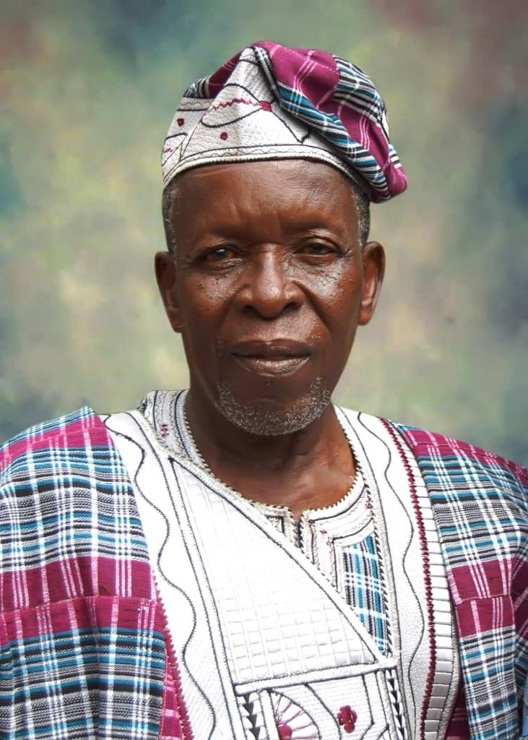
Dr. J. Akin Ikujuni
My Supervisor

Slide 90
The unwavering support and motivation provided by Prof. Olawale Mashood Aliyu, who diligently reviewed the manuscript from its early stages right through to its final form is highly appreciated. I hold the utmost respect for you and deeply appreciate your invaluable contributions that have greatly contributed to the success of this lecture. I would also like to commend Prof. Musbau Akanji for reviewing the manuscript, providing valuable insights, and consistently reminding me to schedule the lecture. I am profoundly grateful for the contributions made by these exceptional mentors, and I wish them abundant blessings.
I am grateful for the significant role that my time at the Federal College of Education (Special) Oyo has played in shaping today's lecture. I would like to extend a special thanks to my senior colleagues and colleagues, including Dr. and Dr. Mrs. Olufemi Olubusola Adeniyi, Dr. and Mrs. Kunle Adebiyi, Dr. and Dr. Mrs. Theo Ajobiewe, Dr. Noah Osatuyi, Dr. Joe Okuoyibo, Dr. Aderemi Asiyanbi, Baba Fedrick Ayoku, Baba James Gbegbin, Mrs. Faith Atikpui, Mr. Aneifiok Ufford, Mr. Gbade Adesola (Former Registrar, Federal School of Survey Oyo), Mr. Jimi Olukoya (Former Registrar, University of Ibadan), Mr. Dauda Adediran, the late Dr. Mrs. Adetoun Oladele, the late Mrs. Bisi Adesoun, the late Miss Bukola Adeniran, the late Mr. Gbade Babatunde, and many others.

Slide 91

I would like to express my profound gratitude to the Akinola and Dada families for their unwavering love and support. I extend my special appreciation to all my siblings, namely Chief and Mrs. Olufunmilayo Adewoyin, Pastor and Mrs. Olusegun Akinola, Mr. and Dr. Mrs. Faith Oluremi Olufajo, Mr. Olugbade Akinola, Pastor and Deaconess Olubisi Akinade, Mr. and Dr. Mrs. Olukayode Akinola, Mr. and Mrs. Oluyemisi Ayodele, Dr. and Mrs. Olugbenga Akinola, Engr. and Mrs. Olufemi Akinola, and Miss Adeola Akinola.
I also acknowledge and appreciate my family-in-law members, namely Mr. and Mrs. Sule Dada, Mrs. Tundun Adeyemo, Mr. and Mrs. Deji Dada, and Mr. and Mrs. Kehinde Seyinko. My nephews, nieces, and cousins hold a special place in my heart, and I am deeply grateful for their presence in my life. I would also like to acknowledge and appreciate the prayers and love from my spiritual families, namely Antioch Baptist Church, Trinity Baptist Church, Christ Landmark Ministry, Christ Covenant Apostolic Church in Ibadan, Oyo State, and the KWASU Christian Community.

Slide 92
I express my heartfelt appreciation to my friends: Captain and Mrs. Julius Ajayi (Iceland), Chief and Mrs. Abiodun Adigun (Lagos), Dr. and Mrs. Ademola Adedeji (Jos), Alhaji and Alhaja Ismail Olaniyan (Lagos), Prof. and Mrs. Abiodun Gesinde (Covenant University, Otta), Prof. and Mrs. Tunde Oni (United Kingdom), Prof. and Mrs. Yakibi Afolabi (FUOYE), Dr. Folashade Ogunshola (NSCDC), Prof. and Mrs. Ogbonnaya Ugorji (South Africa), Prof. and Dr. Mrs. Sola Adu (South Africa), Mrs. Gbemisola Adetunji, and Mrs. Gbemisola Egbayilo.
I also extend my gratitude to the Alumni association of Vinning Day Nursery and Primary School, Molete, Ibadan (1982); St. Anne's School, Molete, Ibadan (1987); and Olivet Baptist High School, Olivet Heights Oyo (1989). Your unwavering support and encouragement have been truly invaluable.

Slide 93


To my beloved husband, Revd Dr. Oluyemi Dada, your love and unwavering support have been my guiding light. I am deeply grateful for your presence in my life. To my incredible sons, Samuel Oluwatomide, Goodness Olawale, and Joshua Ifeoluwa, you are the embodiment of wonderful children any mother could hope for. Your presence has made this success even more meaningful and complete.
Mr Ag. Vice-Chancellor, distinguished guests, ladies, and gentlemen, I thank you for your time and attention. May God bless you all.

Slide 94


