Slide 1
information DISORDER
Oluwole Durodolu
“When fake news is repeated, it becomes difficult for the public to discern what's real”.
Jimmy Gomez
Webinar, May 23, 2022

Slide 2
Information Disorder
Twisting facts, Distorting information, sharing information without understanding the consequences, slanderizing others' beliefs and faiths, and running behind propaganda and fake news with or without vested interest are some of the kind of a disorder.
Fake new is not a recent phenomenon, but the advent of the internet has made it difficult to control.

Slide 3
Rumors, misinformation, disinformation, and mal-information are common challenges confronting media of all types. It is, however, worse in the case of digital media, especially on social media platforms. Ease of access and use, speed of information diffusion, and difficulty in correcting false information make control of undesirable information a horrid task. Alongside these challenges, social media has also been highly influential in spreading timely and useful information.

Slide 4
Types of Information Disorder
Misinformation
Disinformation, and
Malinformation.

Slide 5
Information Disorder as a Threat to Knowledge
With growing dependency on social media for reportage, coupled with rising media errors with potential to threatening the boundaries of knowledge and reliable information, attention is now being drawn to credibility of using social media and other media outlet. This increasing attention is because of the apparent disorderliness in the information milieu as a result of powerlessness to regulate activities on social media coupled with the dilemma of tampering with fundamental right of individual to free speech. Unlike the traditional media houses with specific address and location, identifying the whereabouts of promoters of fake news is challenging as information can be manufactured at the remote locality and the consequence will be felt in all the four compass points of the world. Tracking down individuals peddling fake news for charges of slander, defamation or libel is difficult, as a result of the intercontinental nature of the social network.

Slide 6
Despite their potential to democratise access to and use of the media, they have also added to the crisis of public communication leading to fake news and hate speech. Fake news and hate speech heat up the polity and threaten democratic governance.
Fake news results in fear and tension which jeopardises public peace and security. People have risen against one another, ethnic groups against themselves and regions against regions because of fake news peddled through platforms by people with different motives.

Slide 7
Disaster Aggravated by Misinformation
Rwandan genocide.
EndSARS Protest
Fulani Herdmen
May 12 incidence.
COVID 19

Slide 8
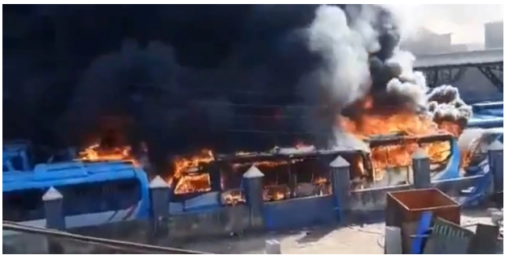
EndSARS Protest: 80 BRT buses worth N3.9 billion were destroyed by hoodlums

Slide 9
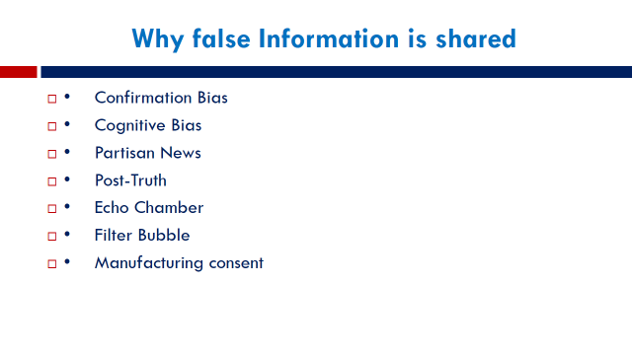

Slide 10
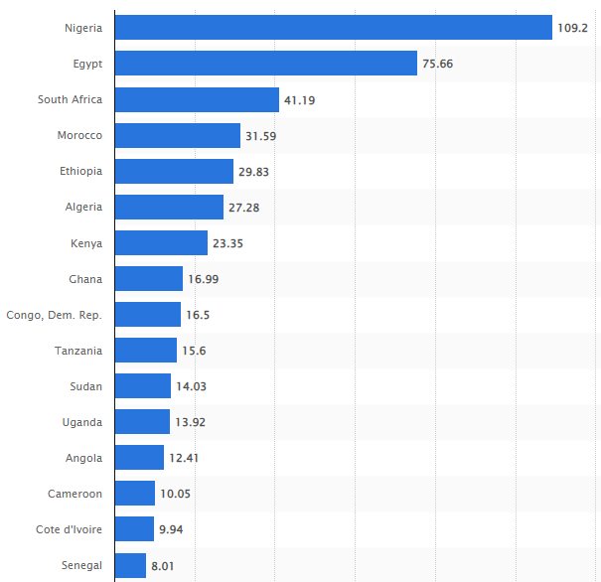
Number of internet users in selected countries in Africa as of January 2022, by country(in millions)

Slide 11
Fixing our misinformation problem
1. Fact checking – studies don’t show it to be all that effective and might contribute to spread of misinformation in some instances
2. Media and Information literacy courses
3. Platform intervention (removing false claims, delisting serial abusers, noting that a story is suspect) – most promising but more research on efficacy is needed.
4. Legal and Policy Framework
5. Information Ethics
6. censorship

Slide 12
Fact-checking is a process that seeks to verify sometimes factual information, in order to promote the veracity and correctness of reporting.
*Ante hoc fact-checking aims to identify errors so that the text can be corrected before dissemination, or perhaps rejected.
*Post hoc fact-checking is most often followed by a written report of inaccuracies, sometimes with a visual metric provided by the checking organization.

Slide 13
Thank you –
Questions, Observations, Objections

