Slide 1


ARTIFICIAL INTELLIGENCE AND LIBRARY DEVELOPMENT IN THE 21ST CENTURY
Presented by
Professor Wole Michael OLATOKUN
Department of Data and Information Science
University of Ibadan, Nigeria
Email: woleabbeyolatokun@yahoo.co.uk
Lead Paper presented at the 2ND Virtual Conference on Artificial Intelligence, Digitalization, Publishing and Reference Services as Panacea to Library Development in the 21ST Century on 23 May, 2023 at Kwara State University, Malete, Kwara State, Nigeria

Slide 2
INTRODUCTION
The 21st century has witnessed a rapid proliferation of digital information, leading to unprecedented challenges and opportunities for libraries.
Libraries continue to play a crucial role in organizing, preserving, and providing access to vast amounts of knowledge.
The sheer volume and complexity of digital content pose significant challenges for traditional library systems and processes.
Libraries have thus begun to embrace artificial intelligence (AI) as a transformative tool for library development

Slide 3
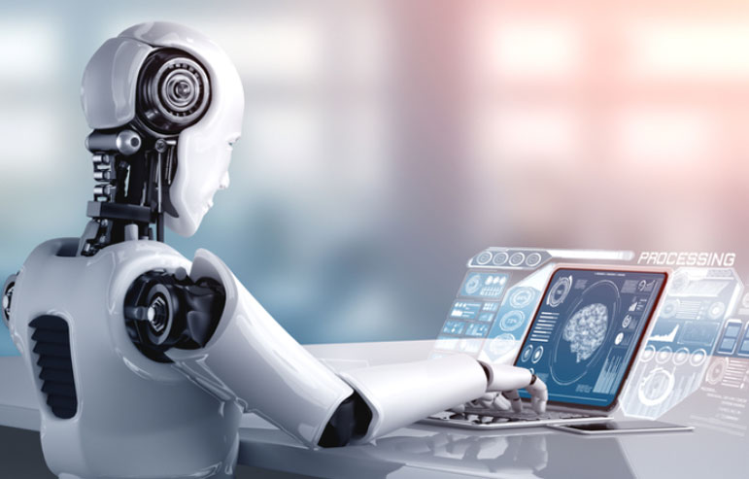
INTRODUCTION
In this presentation:
Explore the intersection of artificial intelligence and library development in the 21st century.
Identify various applications of AI in libraries
State of AI in Nigerian libraries
Discuss potential benefits, challenges, and ethical considerations associated with adoption of AI in libraries.
Suggest ways forward for AI adoption in Nigerian libraries

Slide 4
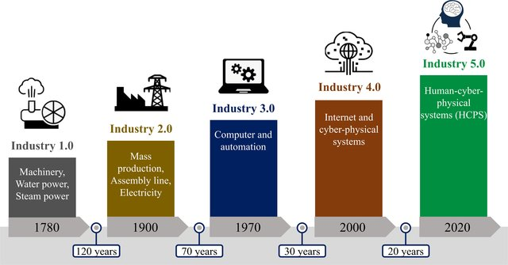
INDUSTRIAL REVOLUTIONS
The Fourth IR combines the physical, digital and biological worlds, enabled by quantum computing, genetic engineering, robots, cyber-physical systems and artificial intelligence (AI).

Slide 5
Explosive Data and Information leading to Bigdata
Artificial Intelligence &Experts Systems
Machine Learning
Robotics
Internet of Things
Augmented and Virtual reality
Exponential technology
3D and 4D Printing
Key drivers of the 4IR
They will continue to alter existing realties, thereby offering newer paths to global transformation in the 4IR

Slide 6
How do organizations benefit from the 4IR?
4IR Technology | Application
Internet of Things | Data collection, security, surveillance, alarms
Cloud Computing | Data storage in virtualized environments
Bigdata and data Analytics | Analysis of patterns, correlations, associations and forecasting. Assists in generation of knowledge to aid decision making in various domains
Artificial Intelligence and Robotics | Think, reason and solve problems/Automation of manual routine tasks
Virtual and Augmented Reality | Useful for active learning
Blockchain | Securely and transparently track all types of transactions
Quantum computing | High level computation

Slide 7
WHAT THEN IS ARTIFICIAL INTELLIGENCE?
According to McCarthy (1955) it is “… making a machine behave in ways that would be called intelligent if a human were so behaving”.
AI is also defined as “the study and design of intelligent agents where ’intelligent agent’ is a system that perceives its environment and takes actions which maximizes its chance of success.
“Machines that imitate some features of human intelligence, such as perception, learning, reasoning, problem-solving, language interaction and creative work (UNESCO, 2022: 9)
But how can we define intelligence?
Highly advanced machines like Deep Blue and others beat humans in chess, Jeopardy or Go. Are they intelligent, or just fast processors? They possess enormous datasets and simulating thinking but are they really thinking?

Slide 8

Artificial Intelligence and Robotics
Machines with in-built intellectual/cognitive ability to:
Think
Learn
Reason
Problem-solve
Use language
Originate ideas
Augment human intelligence
Levels of AI and Robotics
Automated Intelligence - automation of manual, routine tasks
Assisted intelligence - helping to perform tasks better & faster, but no learning
Augmented intelligence - helping to make better decisions & learning from human interaction
Autonomous intelligence - automated decision-making without human intervention

Slide 9
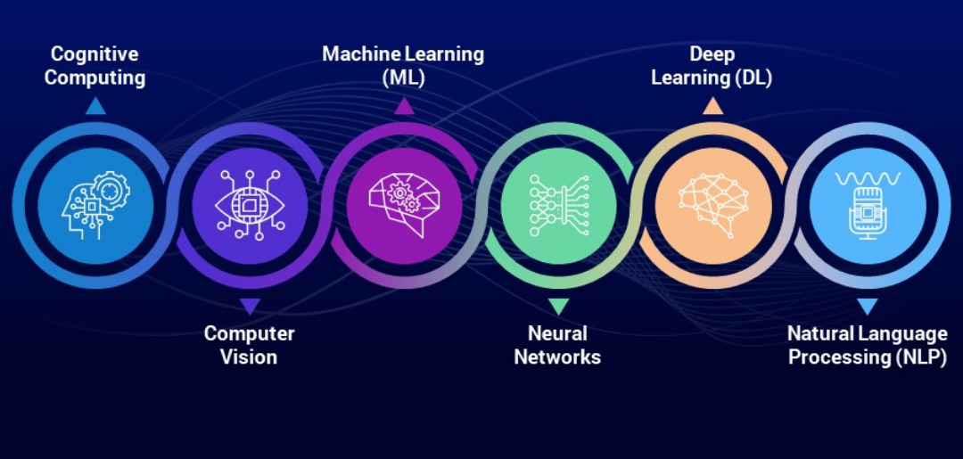
ARTIFICIAL INTELLIGENCE (AI) SUB-FIELDS

Slide 10
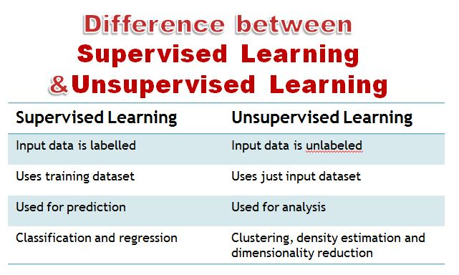
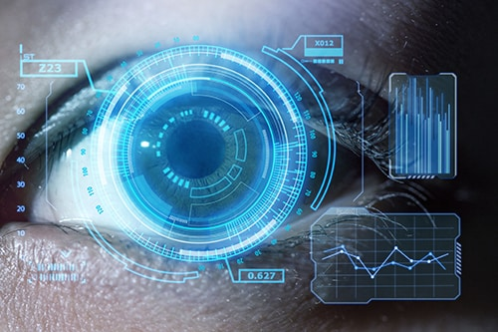
AI SUB-FIELDS…
Machine learning is the science of training a device or software to perform tasks.
Deep learning is a subset of machine learning. Several layers of neural networks are connected in order to make a prediction. Deep learning is used in areas from autonomous cars to robotics.
Computer vision (CV) is the process of analyzing visual images, so that computers can ‘see’. CV can be used to analyze sound, as the sound chart is also a visual image.
Speech Recognition or speech-to-text, is a capability which enables a program to process human speech into a written format.

Slide 11
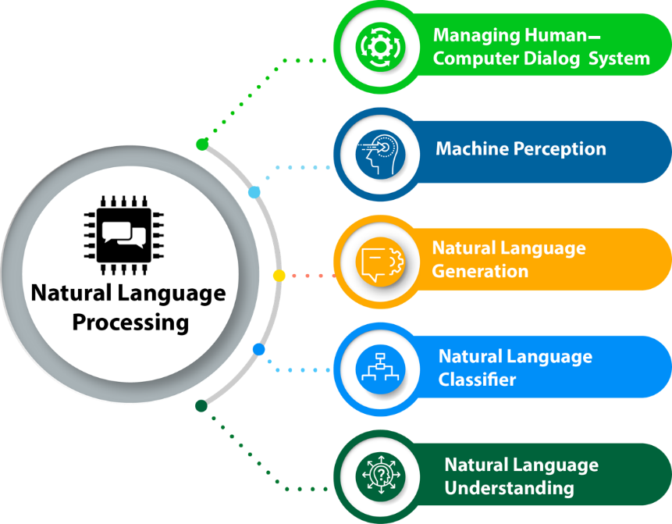
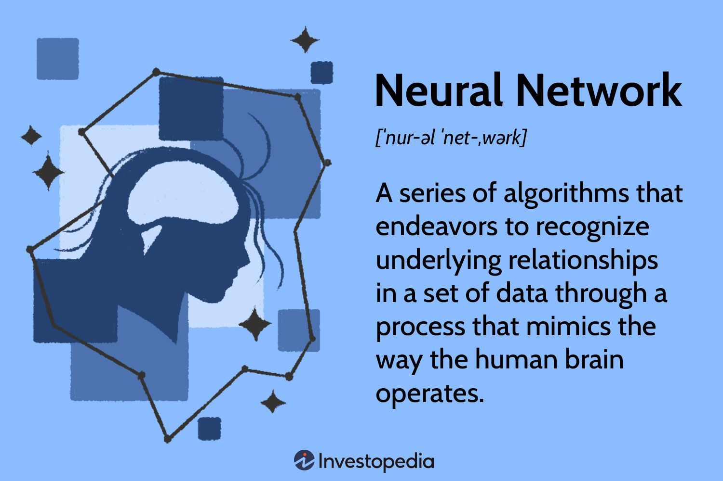
AI SUB-FIELDS…
Natural Language Processing (NLP) earlier focused on codifying word categories and syntax. NLP now uses statistical machine learning methods. For example, Google translate, Trados and DeepL step on big data – the official translations of documents, thus confirming existing rules and staying flexible to ‘learn’ NLP is used for indexing, creating summaries and answering questions.
An artificial neural network is a computer program inspired by certain principles of a real neural network, such as human brain. Multiple types of robots have been developed and have various uses in industry, social work, elderly care, police, libraries and even as composers of music.

Slide 12
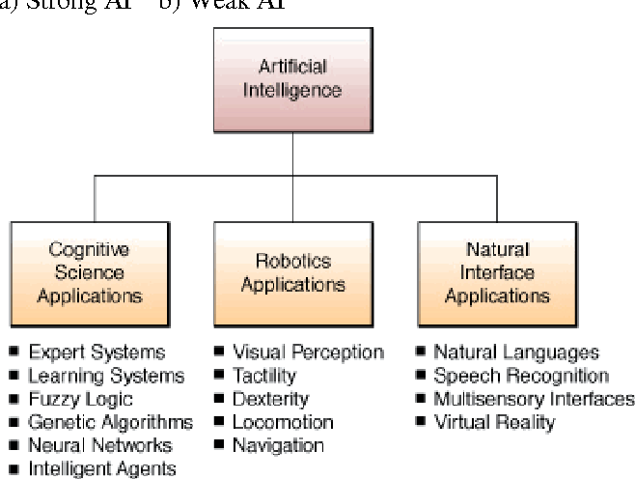

Slide 13
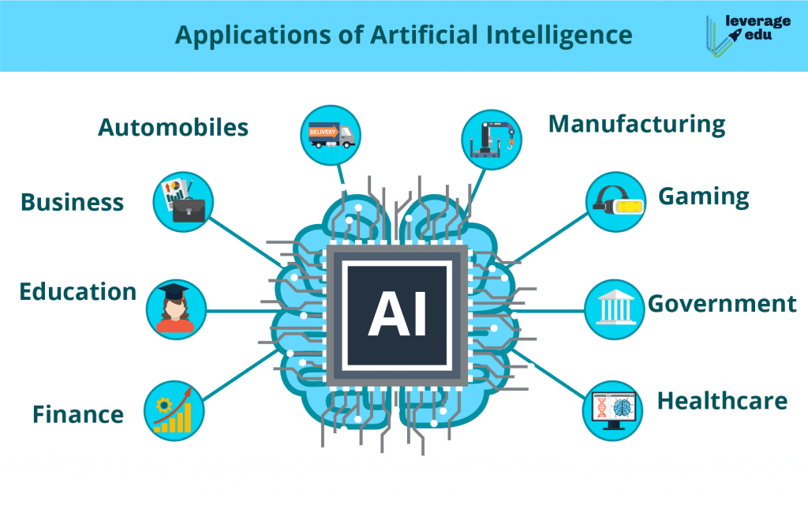

Slide 14
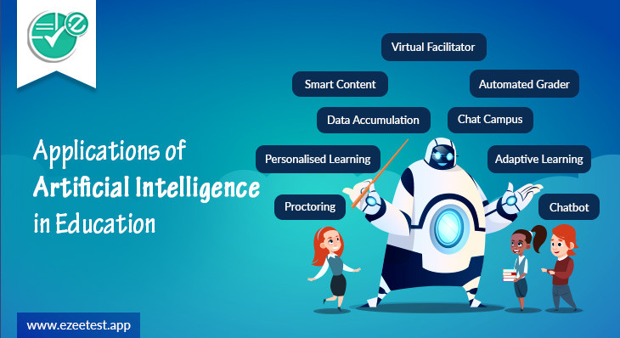

Slide 15
ARTIFICIAL INTELLIGENCE AND LIBRARIES
ROLES OF LIBRARIES
Facilitating access to Information
Digital Inclusion
Lifelong Learning: Hubs for lifelong learning
Community Engagement
Preservation of Culture and History
Information Literacy
Intellectual Freedom
Support for Research and Innovation: Providing resources and access to scholarly literature

Slide 16
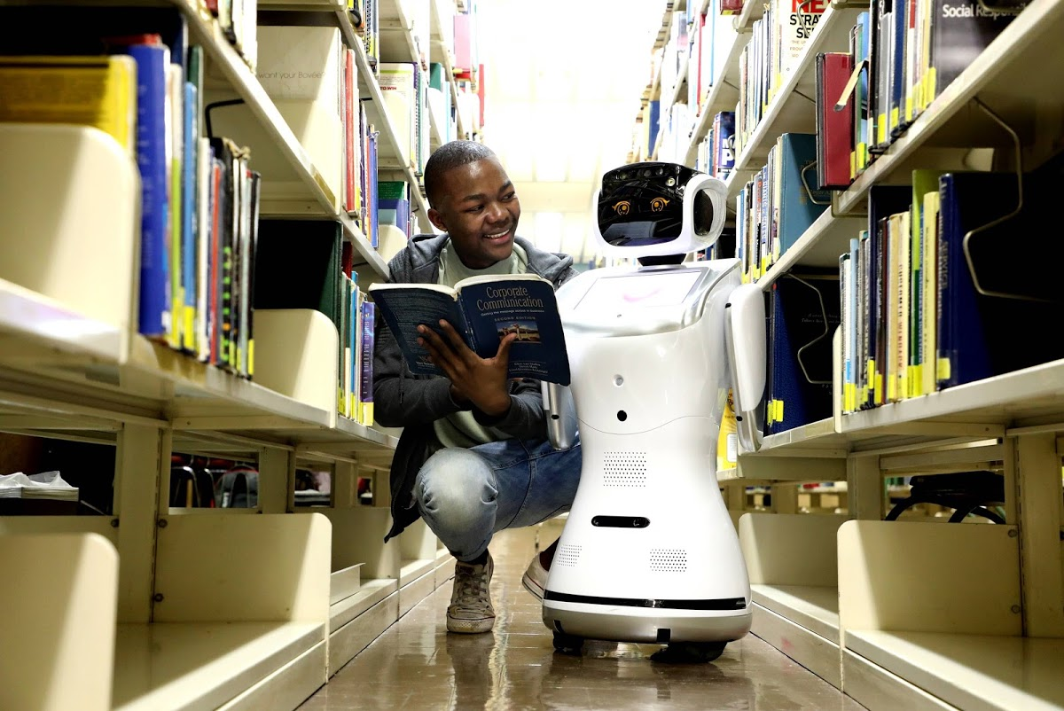
AI APPLICATIONS IN LIBRARIES
1. Application of AI to backend library operations
e.g. Use of robotics in the manual tasks around sorting returned books or checking shelves for out of sequence books
Meet Libby – the new robot library assistant at the University of Pretoria's Hatfield campus | bluesyemre

Slide 17
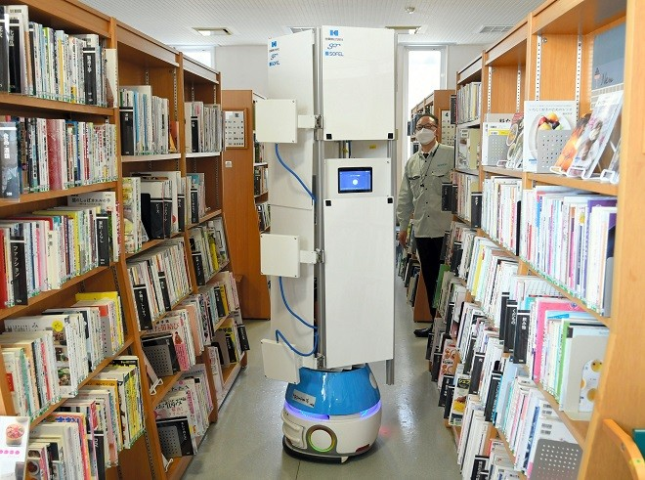
Robot takes stock of books at Akita public library | The Asahi Shimbun: Breaking News, Japan News and Analysis

Slide 18
AI Applications in Libraries …
2: Use of data to analyse, predict and influence user behavior
AI is about using data to identify patterns. Libraries have collections that can be treated as data, but they also have many forms of data about users.
AI techniques are highly relevant to analysing user data
Sentiment analysis is used to investigate positive or negative feelings towards service provision in an organisation
Predictive modelling would seek to anticipate levels of use of the library at certain times of year or to predict book circulation

Slide 19
Areas of application of AI in libraries
3. Cataloging and classification:
Automated metadata generation and enrichment:
  AI algorithms can analyze the content of digital resources and automatically generate descriptive metadata, including titles, authors, subjects, and keywords. This saves time for librarians and ensures consistent and accurate metadata.
  Example: The Library of Congress uses AI techniques to automate the generation of subject headings and classifications for digital resources, improving the efficiency of cataloging processes.
Intelligent indexing and retrieval systems:
  AI-powered indexing systems can analyze the content of documents and identify key terms and concepts, enabling more precise indexing for efficient retrieval.
  Example: The Internet Archive's BookReader utilizes AI algorithms to automatically identify and highlight relevant sections of books, enhancing the browsing and search experience for users.

Slide 20
Areas of application of AI in libraries
4. User services and personalization:
AI-powered virtual assistants for user support and information retrieval:
  Libraries can utilize AI chatbots or virtual assistants to provide instant support to users, answer common queries, guide users in navigating library resources, and recommend relevant materials.
  Example: The New York Public Library's "Ask NYPL" chatbot uses AI technology to provide real-time assistance to users, helping them find books, access online resources, and get information about library events.
Personalized recommendations based on user preferences and behavior:
  AI algorithms analyze user behavior, such as borrowing history and search patterns, to provide personalized recommendations for books, articles, or other resources tailored to individual interests.
  Example: The recommendation system in platforms like Amazon or Goodreads employs AI techniques to suggest books based on users' reading history and preferences, enhancing the discovery of relevant materials.

Slide 21
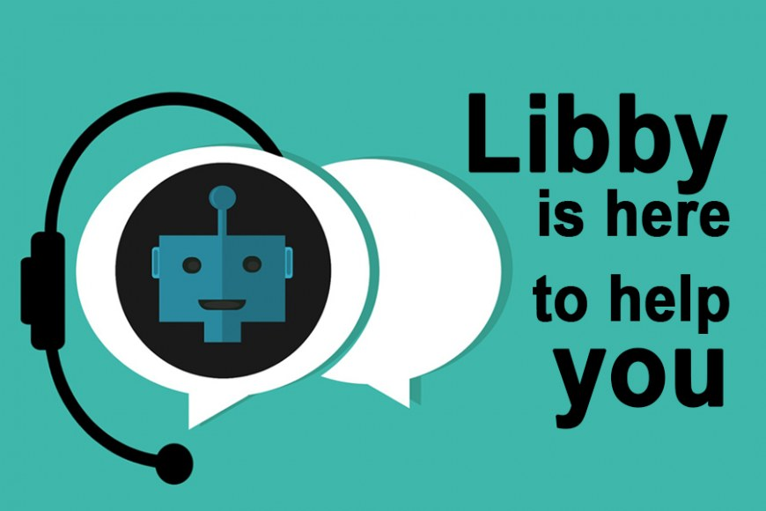
AI Applications in Libraries…
5.Application of AI to library services to users
a. Knowledge Discovery
b. Chatbots and Digital assistants.
Use of AI in knowledge discovery involves applying AI techniques to describe library collections, usually special collections of unique archival material, such as found in research libraries. Here AI relates to the central library role of collection management.
Chatbots are available 24/7 to respond to routine information requests or even handle the early stages of complex reference
enquiries.
Digital assistants, such as Alexa, can also be customised to answer user queries, to explain collections or offer guided tours
Chatbots and digital assistants could also be used to gather routine information from users, such as students or support performance of certain tasks (such as requesting an ILL)

Slide 22
Areas of application of AI in libraries
6. Preservation and digitization
AI-assisted digitization and preservation techniques:
  AI algorithms can enhance the digitization process by automatically correcting image distortions, removing noise, and improving image quality, ensuring the accurate representation of physical materials.
  Example: The British Library uses AI techniques to automate the digitization of millions of pages from historical newspapers, improving the efficiency and accuracy of the digitization process.
Text recognition and digitization of historical documents:
  AI-powered Optical Character Recognition (OCR) technology can accurately convert scanned text from historical documents into machine-readable formats, enabling full-text search and access to valuable archival materials.
  Example: The National Archives and Records Administration (NARA) utilizes AI-powered OCR technology to digitize and make accessible historical documents, facilitating research and preserving cultural heritage.

Slide 23
Areas of application of AI in libraries
7. Data analytics and decision-making:
Predictive analytics for collection management and resource allocation:
  AI algorithms analyze data on resource usage, circulation patterns, and user preferences to predict future demand, enabling libraries to optimize collection management, acquisition decisions, and resource allocation.
  Example: The Library of Birmingham in the UK implemented AI-based predictive analytics to anticipate demand for specific book genres, enabling proactive collection development and ensuring popular titles are readily available to users.
Usage statistics and user behavior analysis:
  AI can analyze user behavior, such as click-through rates, search queries, and session duration, to gain insights into user preferences, trends, and information needs. These analytics inform decision-making and service improvements.
  Example: Academic libraries often use AI-powered analytics tools to understand user engagement, resource usage patterns, and student success metrics, helping them optimize library services and support academic achievement.

Slide 24
Areas of application of AI in libraries
8.Fraud Detection and Security: AI can help libraries identify and mitigate potential security risks, including fraudulent activities, copyright infringement, or data breaches. Machine learning algorithms can analyze user behavior patterns and network traffic to detect anomalies and alert library staff about suspicious activities.
9. Accessibility and Inclusion: AI can play a crucial role in making library resources more accessible to users with disabilities. Optical Character Recognition (OCR) combined with text-to-speech algorithms can convert printed materials into audio formats, enabling visually impaired individuals to access library collections.

Slide 25
AI Applications in Libraries…
10: Data and AI literacy as a dimension of Information Literacy
Citizens need some data and AI literacy because AI is being used in decision making in many sectors of life
In the realm of information seeking and use, search and recommendation tools that most of us encounter every day, such as google and amazon, are based on AI.
There is the need for information literacy training to encompass some basic understanding of data and AI
Incorporating data and AI literacy into IL and other user training, implies some basic knowledge of AI combined with librarians already increasing understanding of pedagogy

Slide 26

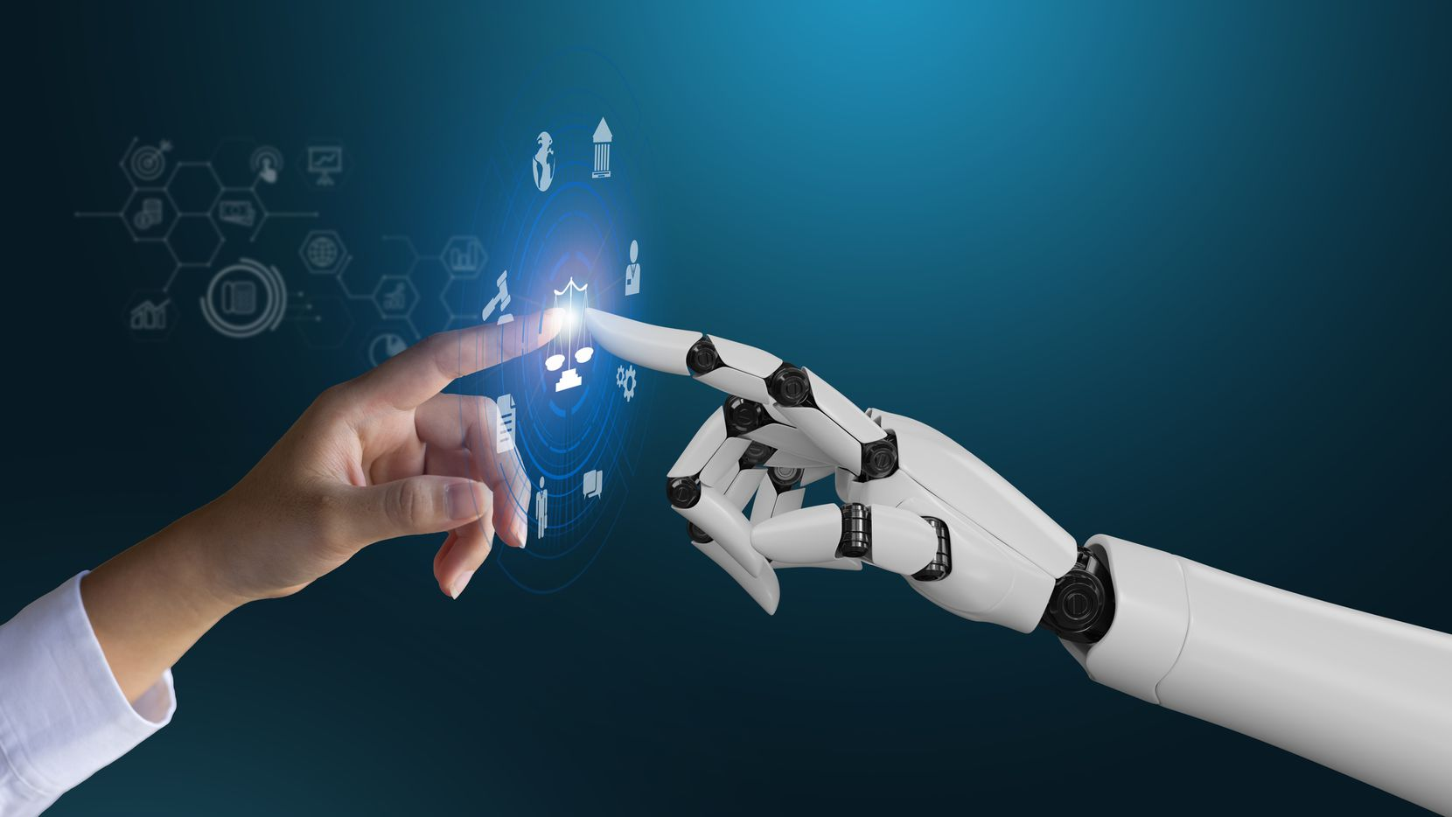

How AI is changing the job of librarians
Content indexing: AI tools for indexing will improve consistency and quality. It can identify concepts and assign them corresponding keywords.
Index automation also helps readers discover new literature and navigate through different disciplines which is not applicable in manual indexing.
Document matching: AI tools are now identifying similarities and differences between documents and patents.
Matching documents with similar ones or connecting section treating similar topics is now possible which helps researchers and libraries to get their knowledge easier and faster.

Slide 27
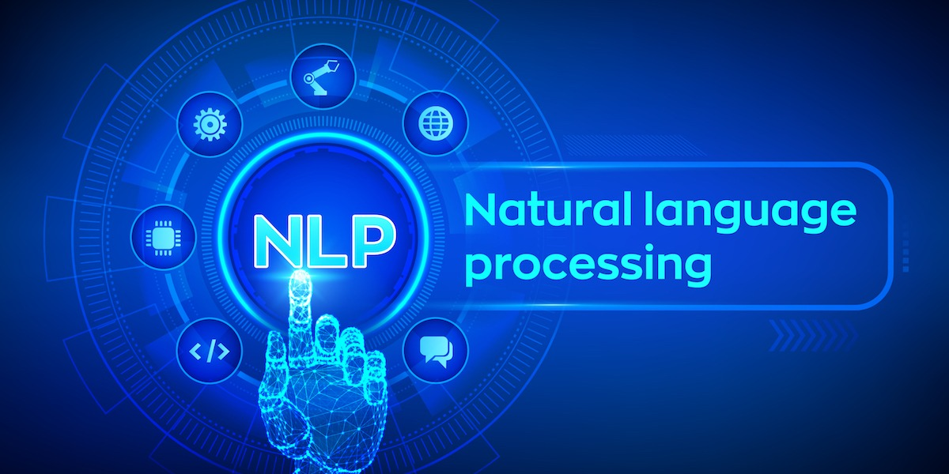
How AI is changing the job of librarians
Content summarization:
Abstracted summarization uses advanced natural language techniques to produce a new summarized version of the document that is different from the original one.
It aims at preserving the most important sentences while rephrasing them and incorporating critical information, like a human written summary.

Slide 28
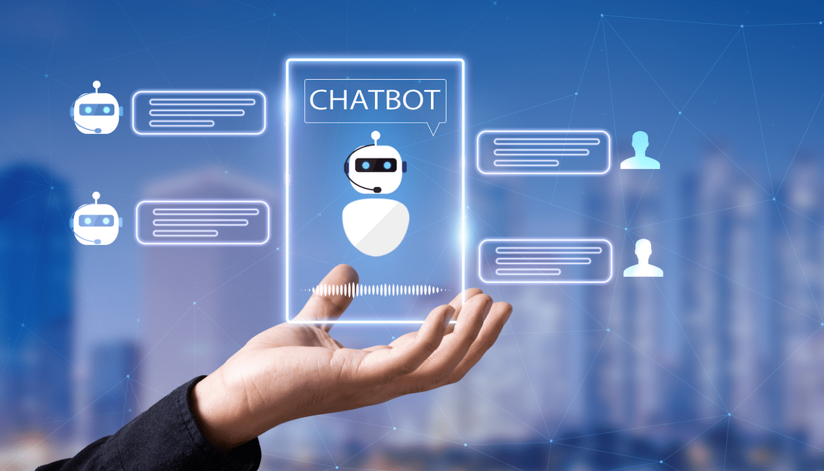
How AI is changing the job of librarians
Quality of service: AI has penetrated the world of librarians and researchers in the form of chatbots that can answer directional or simple questions, alert when a new book is published, and direct a user/patron to specific library resources.
The automation of conversations between a user and a machine will enable librarians to embed their focus on more difficult questions and save time answering repetitive ones.

Slide 29

How AI is changing the job of librarians
Impact Factor of the Future: In future AI algorithms will be capable of breaking down scientific research into arguments and validating them against other pieces of research.
Or it would be able to build for each document a truth tree of arguments and evidence, verify each branch and then find the overall validity score. Having validated or rephrased research is more important than the number of its readers, as it is the solid and validated research that deserves a wider readership

Slide 30

How AI is changing the job of librarians
Better operational efficiency: Libraries can identify and magnify operational efficiency by improving service effectiveness and reducing operational costs with process automation, optimized research data management, and digital assets management.
Implementation of machine learning in library’s processes and digital resources can optimize collection analysis, visualization, and preservation and reduce expenses associated with the provision of services.

Slide 31
AI in Nigeria academic libraries
Interview with Librarians in some universities (10 Federal; 13 State; 6 Private) revealed that AI is still at the conception stage
Platform Capital's funding in June 2020 allowed the University of Lagos to become the first organisation in Nigeria to employ artificial intelligence (robots).
The "cloud-based intelligent humanoid robots," have the following features:
face recognition
surveillance technology
data management
advert & promotion
book shelf management,
research
entry validation (University of Lagos, 2020).

Slide 32
Impact of AI on employment
Global Partnership on Artificial Intelligence (2020) elaborate the wide range of potential impacts of AI on employment: Jobs can be:
Replaced or reduced (automation destroys jobs),
Divided (some benefit, others are deskilled and so workforce divisions deepened)
Complemented and supplemented (where AI adds to what the professional is able to do)
Rehumanised (where jobs are enriched by having routine elements removed)
Due to its disruptive role, according to estimates, the adoption of AI will lead to job losses in India of 69%, Thailand of 72%, China of 77%, and Ethiopia of 85%. These show that AI has the potential to cause major employment destruction as well as job losses.

Slide 33
Impact of AI on skills of Librarians
The skills required for the different types of application of AI are different.
Librarians will for sure still be needed, because we are entering a more complex information landscape than ever before so information mediating roles will shift but not disappear.
AI relies on good quality, well managed data, the fact that librarians have good quality data in their collections will become important.
Librarians’ understanding of things like data structures puts them in a good position to play future roles.
Probably they need to do more work to translate their existing skills in finding, managing and preserving information to apply specifically to data, and talk more about data.
Reskilling, multiskilling, Learning, Re-learning, Unlearning will be required of future librarians
Skilling in AI technologies is a must for continued relevance

Slide 34
Impact of AI on equality, diversity, inclusion
The library profession has a female majority
AI is currently conceived and represented in Western thought - is masculine (Adam, 2006) and white (Cave and Dihal, 2020)
IT and AI are stereotypically a male profession
There is a widely recognised problem of under-representation of women in the design of AI systems.
This applies not just to roles in IT, but groups such as librarians and other information professionals who have both some role in the direct creation and development of AI, but also in maintaining and managing AI systems
Unchallenged AI might well reinforce inequalities within the information profession because men are over-represented in technical roles, which are seen as driving automation, and in more senior roles, which are less vulnerable to automation.

Slide 35
Ethical and Social implications of AI in Libraries
Privacy concerns and data security
Bias and fairness in AI algorithms
Digital divide and access disparities
Impact on traditional library roles & employment
Disruption leading to job loss

Slide 36
Artificial Intelligence Challenges in Nigerian Libraries
Inability to use current approaches due to a lack of infrastructure
Insufficient funding for universities, specifically libraries
Scarcity of artificial intelligence professionals with a focus on libraries
Lack/shortage of expertise (human librarians) who have been trained in artificial intelligence technologies. To many, the concept of artificial intelligence is still very foxy.
Erratic electricity supply
Lack of relevant curricula to train students and researchers to apply AI in libraries.
Lack of political will to develop libraries and make them contemporarily compliant with AI

Slide 37
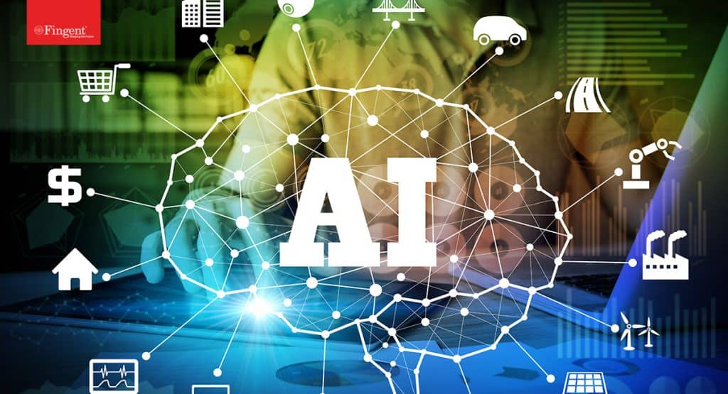
Future of AI: Game changer for Industries
Whether we like it or not
Whether we are ready or not
Future of AI is very bright
AI will be the Game Changer for various industries in the future
Healthcare
Manufacturing
Finance
Education
Retail
Automobile, Etc.

Slide 38
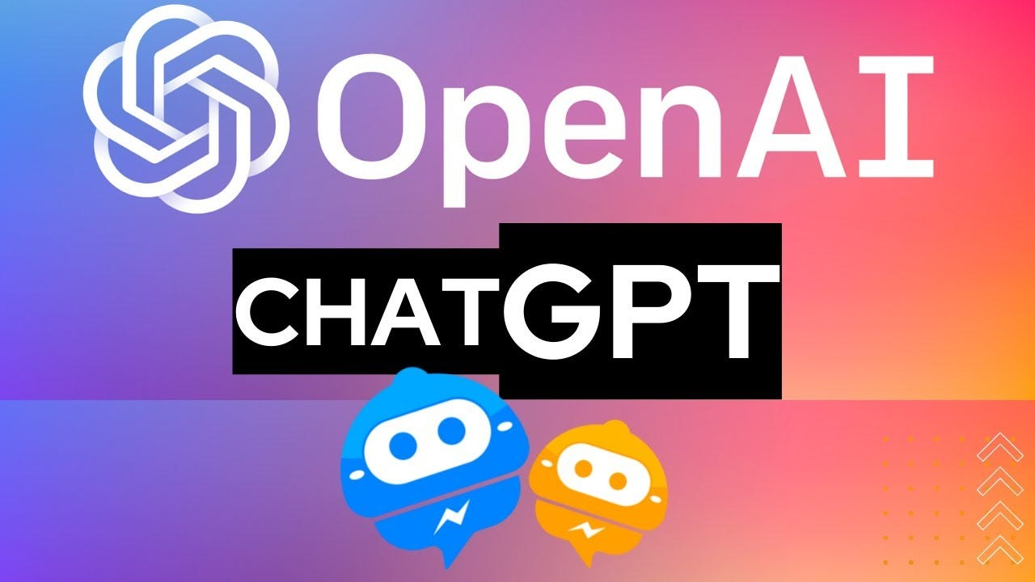
ChatGPT: Revolutionary or Distruptionary?
Chat Generative Pre-Trained Transformer
Some uses
Write emails and applications
Generate practice questions
Write literature review
Summarise and paraphrase
Write stories, poems, essays, papers
Interpret analysis
Develop outlines
Generate new ideas for homeworks and assignments
Coming up with unique ideas, titles and abstracts, for projects and research proposals
Help solve complex problems
Just as ChatGPT has disrupted learning and teaching in an unpredictable way, so also any AI application can make human librarians less relevant

Slide 39
WHAT TO LEARN
Data Management | Spreadsheet software: Tools like Microsoft Excel or Google Sheets for data cleaning, organization, and basic analysis. Relational database management systems (RDBMS): Familiarity with systems like MySQL or PostgreSQL to handle structured data. Data visualization tools: Software like Tableau or Power BI to create visual representations of data
Information retrieval: | Need to understand and utilize AI-powered search engines, recommendation systems, and chatbots to help users find relevant information. Search engines: Understanding how popular search engines work, such as Google or Bing, can provide insights into information retrieval techniques. Natural language processing (NLP) libraries: Familiarity with NLP libraries like NLTK (Natural Language Toolkit), spaCy, or Gensim can aid in understanding NLP concepts and working with text data.
Basic Statistics | Learn basic statistics and offer courses in the use of tools like Excel, SPSS or STATA. Learn data visualization using tools like Power BI or Tableau.

Slide 40
WHAT TO LEARN
Machine learning basics | Training data, algorithms, and model evaluation enables them to collaborate with data scientists or AI developers on projects involving AI applications in libraries. Python programming language can provide a foundation for machine learning understanding and implementation.
Text mining and text analysis: | These skills enable them to extract insights, discover patterns, and generate metadata from large volumes of textual data, facilitating more efficient organization and retrieval of information. Text mining libraries: Python libraries like NLTK, spaCy, or TextBlob offer functionality for text preprocessing, sentiment analysis, topic modeling, and more. Text analytics platforms: Tools like RapidMiner or KNIME provide graphical interfaces for text mining and analysis tasks.
User experience (UX) design | Librarians with UX design skills can contribute to the development of AI-powered interfaces, chatbots, or recommendation systems in libraries. Wireframing and prototyping tools: Software like Adobe XD, Sketch, or Figma can help design and prototype user interfaces and experiences.

Slide 41
WHAT TO LEARN
Collaboration and integration | Librarians should be adept at collaborating with technologists and data scientists. By fostering interdisciplinary partnerships, they can work together to develop and deploy AI solutions that address specific challenges in library management, information organization, and user support. Project management tools: Platforms like Asana, Trello, or Jira can facilitate collaboration and task management within interdisciplinary teams.

Slide 42

WHERE TO LEARN
Professional Association organised development programs and workshops, conferences, webinars
Online Courses and Platforms: Platforms like Coursera, edX, LinkedIn Learning, and Udemy offer relevant courses.
Webinars and Workshops: Librarian associations, academic institutions, and professional organizations often organize webinars and workshops on AI-centred skills
Library and Information Science (LIS) programs: Librarians can consider pursuing a graduate or postgraduate degree in Library and Information Science. Many LIS programs need to review their curricula to include courses or specializations in areas related to AI and data management.
Self-Study and Online Resources: Tutorials, blogs, forums, and documentation to learn specific skills related to AI, data management, and text analysis. Websites like DataCamp, Towards Data Science, and Medium often provide informative articles and tutorials on these topics.
Collaborative Projects and Networking: Librarians can participate in collaborative projects that involve AI technologies and work alongside technologists, data scientists, and developers.

Slide 43

WHAT GOVERNMENTS SHOULD DO
Increase funding of education, nay public universities
Provide congenial environment for universities to thrive and focus on their mandates
Build and/or boost country’s digital and energy infrastructure
4. Develop policies to promote digital inclusion and access
5. Solve insecurity/terrorism challenges confronting the nation

Slide 44
CONCLUDING REMARKS AND WAY FORWARD
AI is changing the information landscape and disrupting librarians’ jobs
Librarians are required to embrace AI, not as a user but as an active leader to better serve the new upcoming generations.
The fear of being replaced by AI robots is totally understandable but we cannot neglect that advanced technologies will open up new horizons for librarians.
It will help them maintain new innovative positions and roles, solve current challenges, and prevent them from becoming old fashioned.

Slide 45
CONCLUDING REMARKS AND WAY FORWARD
Library schools need to embark on extensive curriculum review and make them AI friendly not the CCMAS curriculum that reduces LIS to an education programme
Just as ChatGPT has disrupted learning and teaching in an unpredictable way, so also any AI application can make human librarians less relevant
Training in AI is key to securing and protecting the job future of librarians
Librarians need to leave their comfort zones and make themselves AI-compliant as outlined earlier
AI policies are needed in Libraries to prevent bandwagon effects

Slide 46
THANKS FOR LISTENING

Slide 47
ARTIFICIAL INTELLIGENCE AND LIBRARY DEVELOPMENT IN THE 21ST CENTURY
Presented by
Professor Wole Michael OLATOKUN
Department of Data and Information Science
University of Ibadan, Nigeria
Email: woleabbeyolatokun@yahoo.co.uk
Lead Paper presented at the 2ND Virtual Conference on Artificial Intelligence, Digitalization, Publishing and Reference Services as Panacea to Library Development in the 21ST Century on 23 May, 2023 at Kwara State University, Malete, Kwara State, Nigeria

